Slide 1
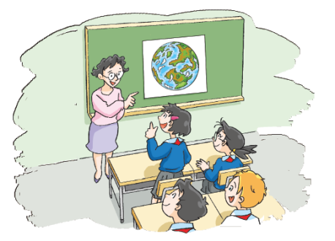
The Earth
12
WWW.PPT818.COM

Slide 2
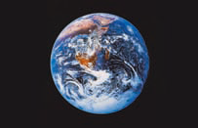
the Earth

Slide 3
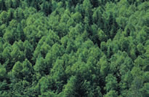
forest

Slide 4
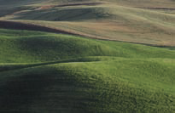
land

Slide 5
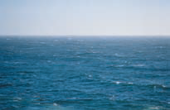
ocean

Slide 6
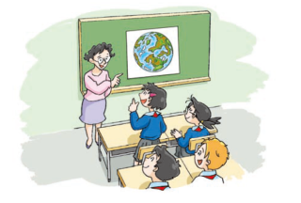
Ms Guo: Look at this picture. What is it?
Kitty: It’s the Earth.
Ms Guo: The green and brown parts are forests and land.
What are the blue parts?
Joe: I think they’re oceans.
Ms Guo: Yes, they are. The Earth was very clean and
beautiful in the past, but now some parts are dirty.
Can we do anything to help the Earth?
Alice: Yes. We should stop throwing rubbish into rivers.
Peter: We should stop cutting down so many trees.
Kitty: We should stop using plastic bags.

Slide 7
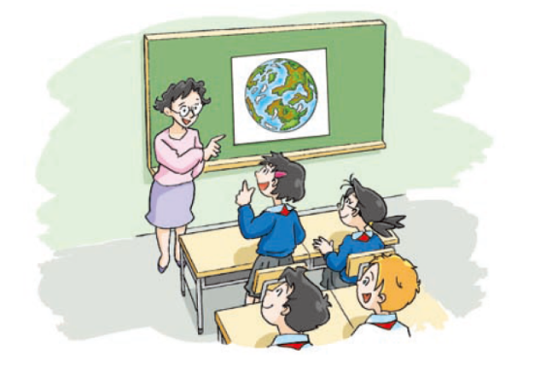
Say and act
Ms Guo:
Kitty:
Ms Guo:
Joe:
Ms Guo:
Alice:
Peter:
Kitty:

Slide 8
True or false.
(1) | The weather in different places on the Earth is different. | ( )
(2) | Different animals live in different places. | ( )
(3) | People can get air, water and food from the Earth. | ( )
(4) | People make the Earth dirty. It is pollution. | ( )
T
Some parts of the Earth are very hot, and some are very cold.
T
Some live on the land.
Some fly in the sky.
Some live under the water.
T
The Earth gives us air, water and food.
T
We burn things to make energy. This pollutes the air. We put rubbish into the sea and under the ground. This pollutes the Earth and kills animals and plants.

Slide 9
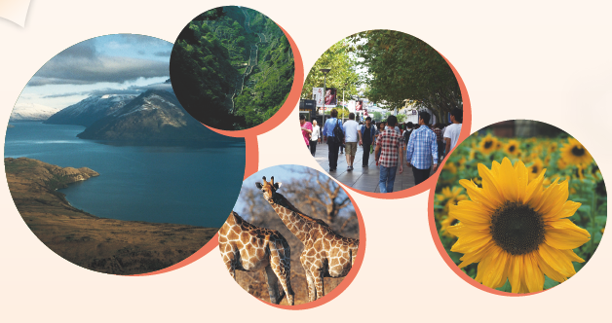
We must save the Earth

Slide 10
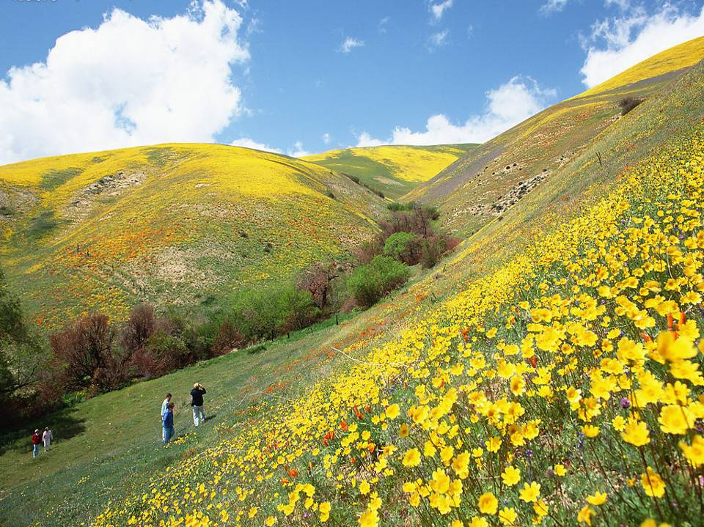
There is air and water on the Earth. There are people, animals and plants on the Earth. People have lived on the Earth for millions of years. Many years ago, the Earth was clean. Today, there is air pollution, water pollution and land pollution.

Slide 11
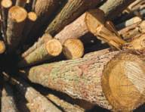
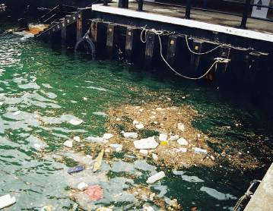
People cut down the forests. Many plants, wild animals, birds and insects live there.
People kill animals for food and their skins. People are polluting the land, the water and the air.

Slide 12
What lives in the forests?
What do people do to the forests?
Why are people killing animals?

Slide 13
How to save the Earth?

Slide 14
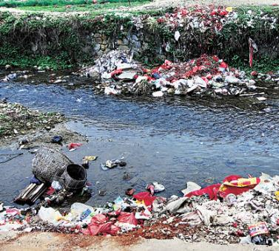
Can we do anything to help the Earth?
We should stop throwing rubbish into rivers.

Slide 15
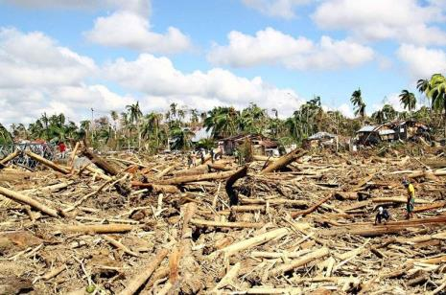
Can we do anything to help the Earth?
We should stop cutting down so many trees.

Slide 16
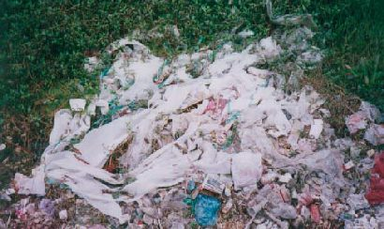
Can we do anything to help the Earth?
We should stop using plastic bags.

Slide 17
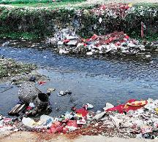
Let’s read！
We should stop throwing rubbish into rivers.
We should stop cutting down so many trees.
We should stop using plastic bags.

Slide 18
What else should we stop doing
to protect the Earth?

Slide 19
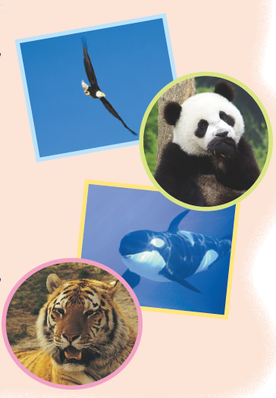
We should stop killing …

Slide 20
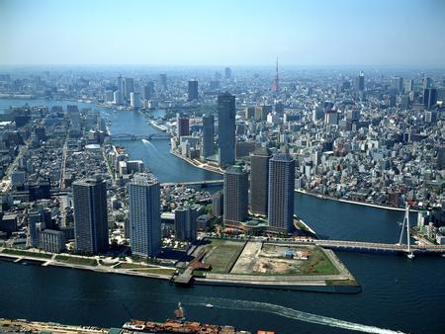
We should stop building …

Slide 21
We should stop doing …
cutting down
so many trees
throwing rubbish
into rivers
We should stop
…
using plastic bags
…

Slide 22
Think and say
We should stop doing …
We should do …

Slide 23
We should stop throwing rubbish into rivers.
We should recycle rubbish.

Slide 24
We should stop cutting down so many trees.
We should plant more trees.

Slide 25
We should stop using plastic bags.
We should use shopping bags.

Slide 26
We need you!
Let’s make a change!
We should stop killing wild animals.
We should stop building more factories.
We should ...

Slide 27
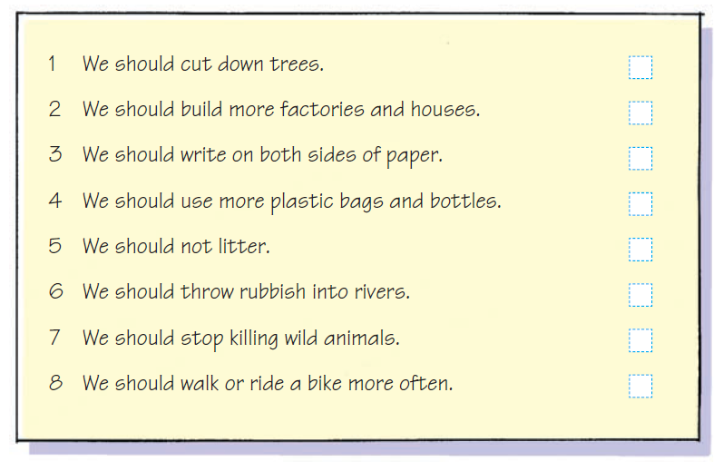
What should we do to save the Earth? Put a tick (√) or a cross (×) in the box. Then talk about it in groups.

Slide 28
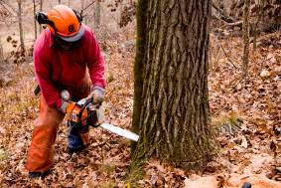
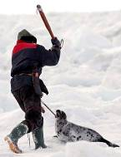
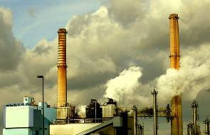
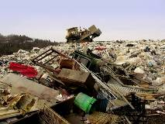
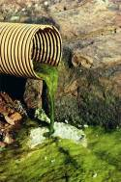
We must save the Earth.
People must stop cutting down forests.
People must stop killing animals.
People must stop polluting the air.
People must stop polluting the land.
People must stop polluting the sea.

Slide 29
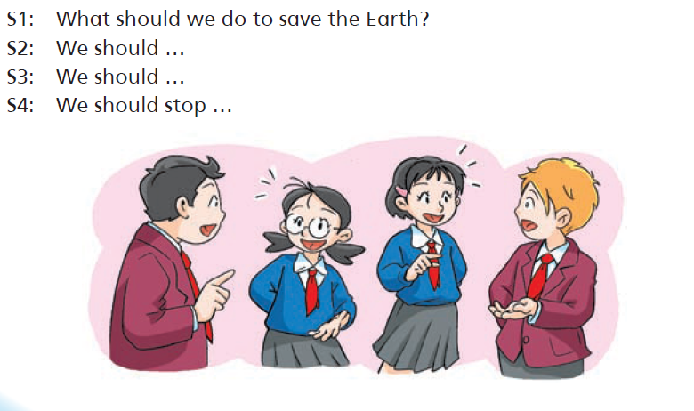

Slide 30
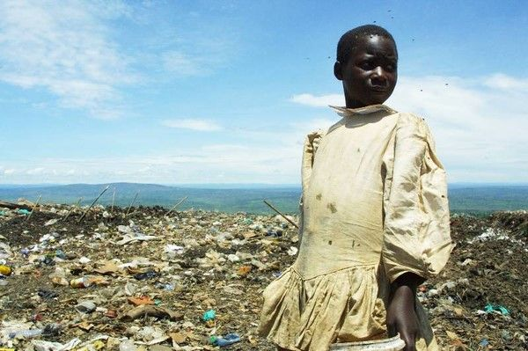

Slide 31
Three things you can do
to help save the Earth
Save water.
Save energy.
Ride bikes or use public transport.
Please remember: Little things can make a big difference.

Slide 33
Take care of the Earth! Make it a better place!

Slide 34
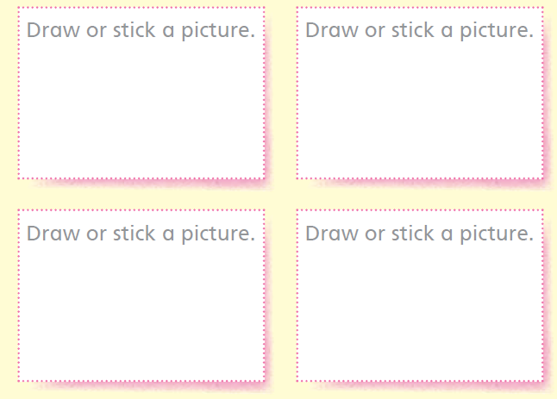

Slide 35
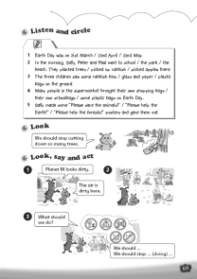
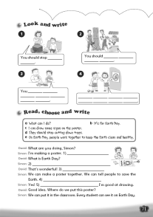
Homework
Listen to and read Student’s Book page 80.
Write down ten things we can do to save the Earth.
3. Make a poster “The Earth is sick!”
4. Finish Workbook pages 69 and 71.

