Slide 1
It's red and yellow.
Unit6 Lesson2
WWW.PPT818.COM

Slide 2
Look! Jenny and Li Ming are talking about colours of national flags. （Jenny 和 Li Ming正在讨论国旗的颜色。)

Slide 3
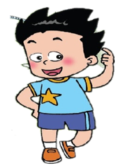
What colour is it？
China
red
yellow
It’s and .

Slide 4
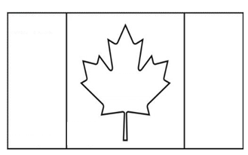
What colour is it？
Canada
red
white
It’s ___ and _____.

Slide 5
What colour is it？
England
It’s____,____ and ____.
red
blue
white

Slide 6
Listen, point and imitate: （听音指读，注意模仿语音语调）

Slide 7
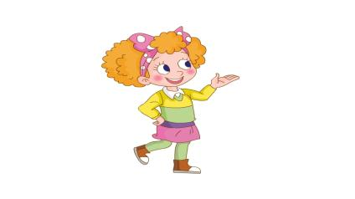
Read in roles (分角色朗读)
What colour is it？
It’s ___ and _____.

Slide 8
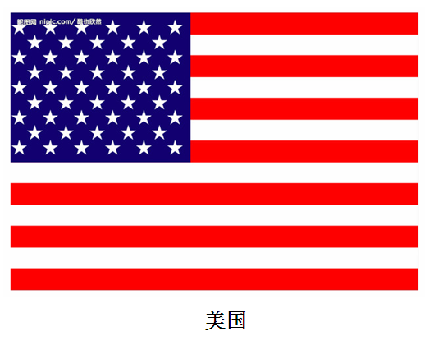
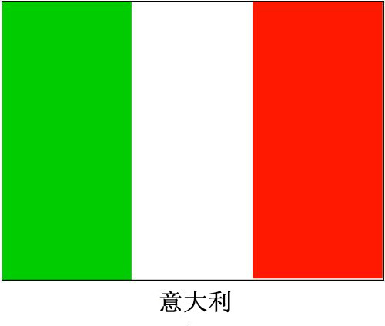
Let's talk.

Slide 9
What colour is it？
It’s……and …...

Slide 10
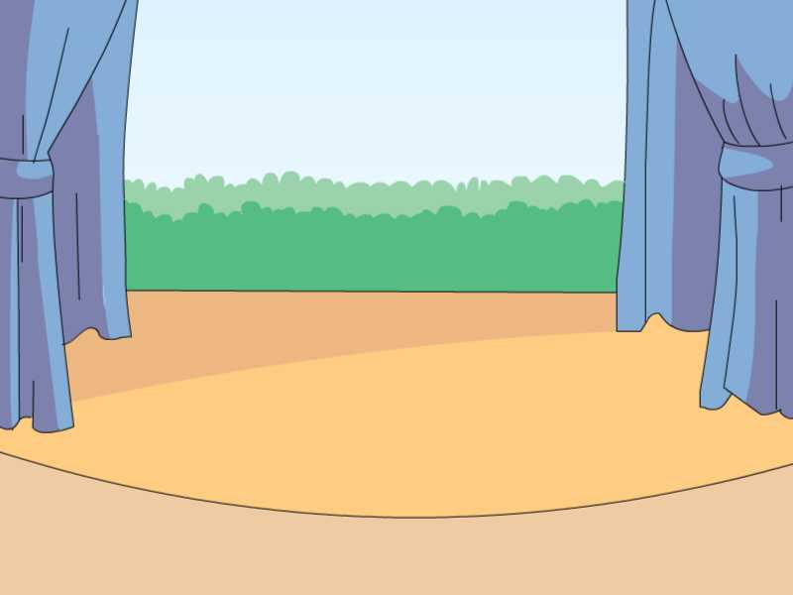
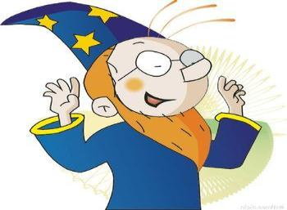
gametime
我猜，我猜，
我猜猜猜!

Slide 11
Go!
What colour is it?

Slide 12
GO!
100
再来一次
500
10000
What colour is it?

Slide 13
GO!
继续
What colour is it?

Slide 14
GO!
继续
What colour is it?

Slide 15
OVER! Well done！
What colour is it?

Slide 16
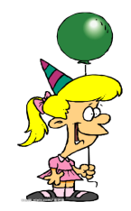
Look! This is my flag.
It’s... , ...and...
It’s nice/ cool .

Slide 17
在小组内介绍一下自己的物品，说说它是什么颜色的。
I have a….
It’s…and ….
It’s nice/lovely.
I love it．

Slide 18
Summary
这节课你学到了什么？

Slide 19
Homework:
Listen and repeat the text.
（听音跟读课文。）
Find the colours in your life
and talk with your friend.
（和你的朋友一起谈论生活中的颜色）
Other choices:
Draw and make a story

Slide 20
Thank you!

