Slide 1
Unit 2
I’m in Class One, Grade Three.
WWW.PPT818.COM

Slide 2
Let’s learn
one
一

Slide 3
two
二

Slide 4
three
三

Slide 5
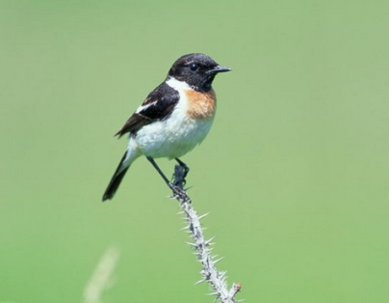
_________ bird.
one

Slide 6
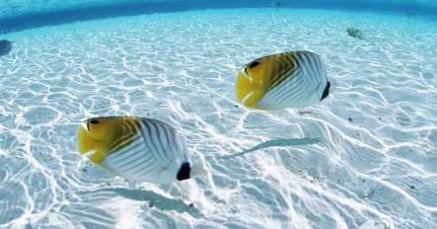
_________ fishes.
two

Slide 7
_________ flowers.
three

Slide 8
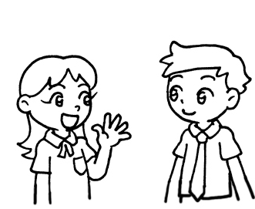
Let’s learn
Li Yan: What’s your name?
你叫什么名字？
Ann: My name is Ann, I’m in Class Two.
我叫安，我是二班的。

Slide 9
Ann: What’s your name?
你叫什么名字？
Li Yan: My name is Li Yan, I’m in Class One.
我叫李艳，我是一班的。

Slide 10
询问别人名字时说What’s your name?
回答时说My name is …….

Slide 11
Let’s do
同桌间互相对话
A: What’s your name?
B: My name is ………….

Slide 12
A: _______________?
B: My name is Mary, I’m in _____________.
What’s your name?
Class One

Slide 13
A: _______________?
B: My name is Jack, I’m in _____________.
What’s your name?
Class Two

Slide 14
A: _______________?
B: My name is Lucy, I’m in _____________.
What’s your name?
Class Three

Slide 15
Let’s read
A: Hello, I’m Li Yan, I’m in Class One.
B: Hi, my name is Ann, I’m in Class Two.
A: Pleased to meet you.
B: Pleased to meet you, too.

Slide 16
Let’s talk
介绍自己的名字和班级给大家听
My name is ….I'm in …..

Slide 17
Homework:
1.熟读本课对话;
2.抄写本课重点单词3遍。

