Slide 1
Lesson 2
I have a face.
WWW.PPT818.COM

Slide 2
nose
mouth

Slide 3
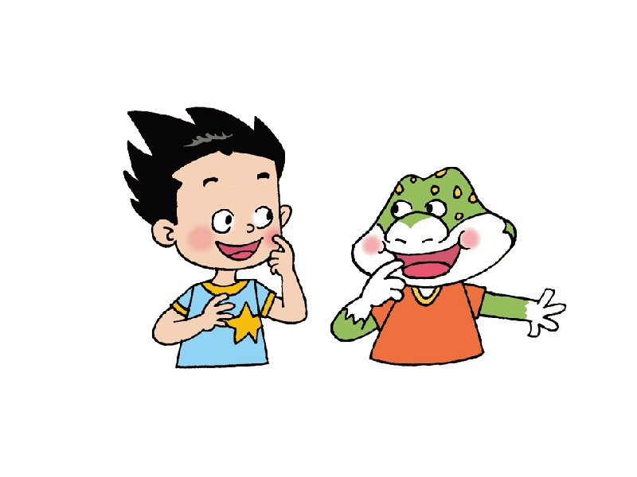
I have a mouth.
Me too!

Slide 4
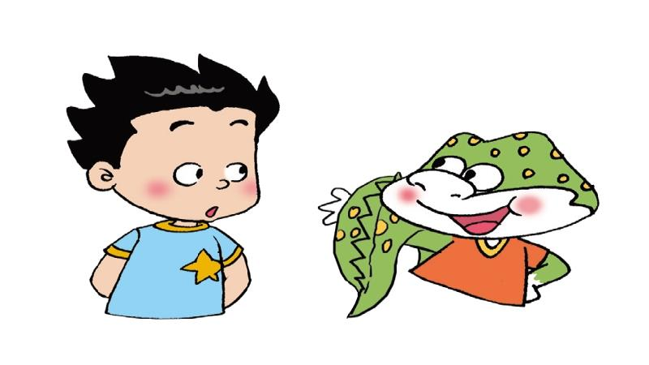
I have a tail.
Oh!

Slide 5
I have a nose.
I have a face.

Slide 6
let’s sing.
Head，shoulders，knees and toes.
Knees and toes，knees and toes.
Head，shoulders，knees and toes.
Eyes，ears，mouth，nose.

Slide 7
Goodbye！

