Slide 1
Unit 8 How do you make a banana milk shake?
WWW.PPT818.COM

Slide 2
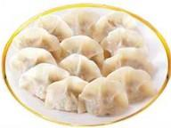
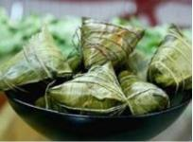
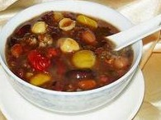
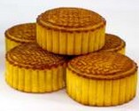
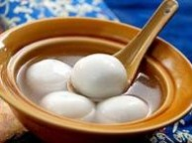
2a What kind of traditional food do people eat on special holiday in China?
dumplings
moon cakes
zong zi
laba porridge
yuan xiao

Slide 3
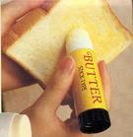
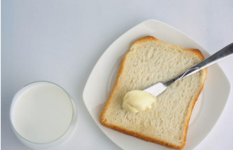
How do you make
a turkey sandwich?
First
Put some relish on a slice of bread.

Slide 4
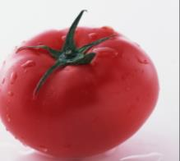
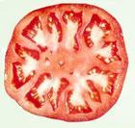
Next
Cut up one tomato.
Put the tomato on the bread.

Slide 5
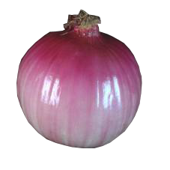
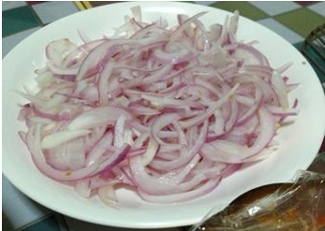
Next
Cut up an onion.

Slide 6
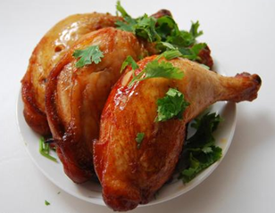
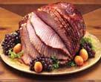
Next
Add two slices of turkey.

Slide 7
Then
Put two teaspoons of
relish on the turkey.

Slide 8
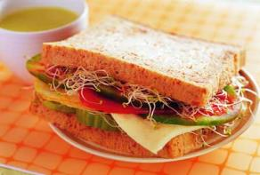
Finally

Slide 9
Thanksgiving 感恩节
也作： Thanksgiving Day
美国的感恩节一般在11月的第四个礼拜。
2b Read the article.
traditional adj.
传统的；惯例的
tradition n.
惯例;传统
Thanksgiving in the United States
In most countries, people usually eat traditional food on special holidays. A special day in the United States is Thanksgiving. There are many reasons for this special day. For some people, it is a time to give thanks for food in the autumn. So it is always on the fourth Thursday in November in the United States. At this time, people also remember the first travelers from England who came to live in America about 500 years ago. These travelers had a long, hard winter, and many of them died. In the next autumn, they gave thanks for life and food in their new home. These days, most
traveler n.旅行者；旅客
travel v. 旅行
remember v.
回忆起；回想起；记起

Slide 10
celebrate v.
庆祝；赞美
Americans still celebrate this idea of giving thanks by having a big meal at home with their family. The main dish of this meal is almost always turkey, a large bird.
Making a turkey dinner
Here is one way to make turkey for a Thanksgiving dinner.
First, mix together some bread pieces, onions, salt and pepper.
Next, fill the turkey with this bread mix.
Then, put the turkey in a hot oven and cook it for a few hours.
When it is ready, place the turkey on a large plate and cover it with gravy.
Finally, cut the turkey into thin pieces and eat the meat with vegetables like carrots and potatoes.
fill…with…
装满；充满
cover…with…
覆盖

Slide 11
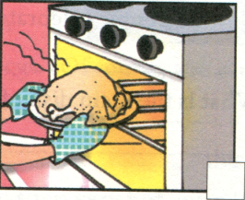
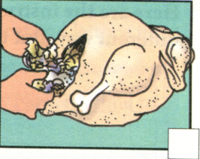
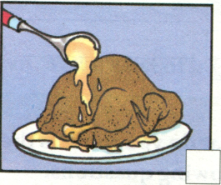
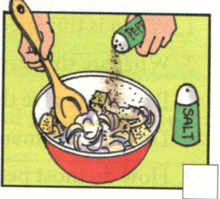
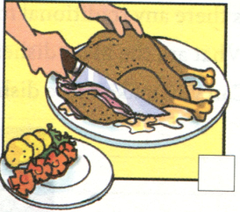
Then number the pictures
3
2
4
1
5

Slide 12
2c Read the article again and answer the following questions.
1. Where do people celebrate Thanksgiving?
2. Why do people celebrate it?
3. When do people celebrate it?
4. How do people celebrate it now?
5. What is the main dish of the Thanksgiving meal?
In the USA.
On the fourth Thursday in November.
They give thanks for life and food in their new home.
By having a big meal with their family at home.
Turkey .

Slide 13
2d Here are the instructions for making
a turkey dinner written in a different way.
Put them in order. Write First, Next,
Then and Finally.
_______, serve it to your friends with some other food.
_______, put this into the bird.
_______, cook it at a very high temperature for a long time.
_______, put everything you need together in a large bowl.
Finally
Next
Then
First

Slide 14
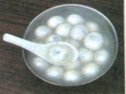
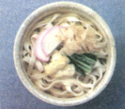
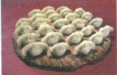
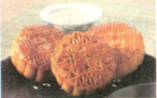
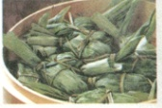
2e What do you think is the most special day in China? Answer the following questions.
1.When is this special day?
2.What are the reasons for this special day?
Do people give thanks for anything on this day?
Do people remember anything or anybody on this day?
3.How do most people celebrate this day?
4.Is there any traditional food?
What are the main dishes?
5.Can you make these dishes?

Slide 15
Explanation
1. Do you like lettuce in sandwiches?
你喜欢吃莴苣三明治吗?
(1) like v. 喜欢
like sth. （接名词或代词） 喜欢某物
like to do sth. （接动词不定式）
喜欢做某事

Slide 16
like doing sth. （接V- ing 形式）
喜欢做某事
like sb. to do sth. （接复合宾语）
喜欢某人做某事
如： How do you like the weather here?
你觉得这里的天气如何?

Slide 17
Do you like to play football?
你喜欢踢足球吗？
I like reading very much.
我非常喜欢读书。
Teachers always like their students
to ask questions.
老师们总是喜欢学生们问问题。

Slide 18
(2) like prep. 像, 与……一样
词组: look like （看起来像）；
be like （像）
He looks like his father.
他长得像他爸爸。
What’s your new teacher like?
你们的新老师怎么样？

Slide 19
2. Put some butter on a slice of bread.
a slice of 量词， 一片
如: How many slices of roast beef
would you like? 请问你要几片烤牛肉？
There are several slices of bread.
有几片面包。

Slide 20
slice也可用作动词， 意为把 （面包等）
切成薄片，常与up连用。
如: She sliced up a loaf for us.
她把面包切成薄片给我们吃。
Please slice beef thin.
请将牛肉切成薄片。

Slide 21
3. Add these to the sandwich.
add做动词为“加”的意思。在本句中的
结构是：add sth. to sth. 将……加在……里。
Will you add more sugar to your coffee?
你的咖啡要多加些糖吗？

Slide 22
Please add my name to the list.
请在名单上加上我的名字。
add也可与to合用:
add to … 增加的意思。
如： The news added to his anxiety.
这个消息增添了他的忧虑。

Slide 23
4. In most countries, people usually eat traditional food on special holidays.
在大多数国家，人们通常在特殊的节日里吃传统食物
此处的 holiday 表示“节日”，而非“假期”的意思，指国家法定的公众性“节日；假日”如：
Christmas is the most important holiday in Western countries.
圣诞节是西方最为重要的节日。
holiday 也有“假期”之意，在英国比较多用，美国则用vacation如：
Will you take a holiday next week?
=Will you take a vacation next week?
下周要休假吗？
The school holidays(美vacation) start tomorrow.
学校明天开始放假。

Slide 24
3a Read the recipe below and fill in the blanks with the words in the box.
cook next wash finally have enjoy first cut
Yunnan Rice Noodles
In Yunnan, many people eat rice noodles for breakfast, and even for lunch and dinner. To make this special food, you need to _________ rice noodles, chicken soup, chicken, lettuce and eggs. (Of course, you can also have other things like fish and different vegetables.)_________, _________ the lettuce and cut it up.________, ________the chicken into pieces.
have
First
wash
Next
cut

Slide 25
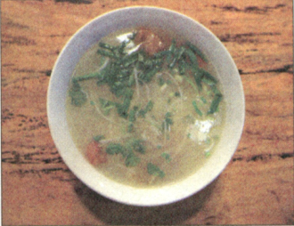
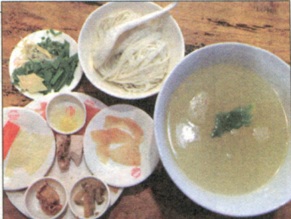
Then, make the chicken soup very hot, over 100℃. Then ,_______ the eggs, meat and lettuce in the pot of hot soup, one by one.________, put the rice noodles into the soup. Now, it’s time to ________ the rice noodles!
cook
Finally
enjoy

Slide 26
3c Write a recipe for your favorite food
I like ________________________________________________________________________________________________________________________________________________________________________________________________________________________________________________________________________________________________________________________________________________________________

Slide 27
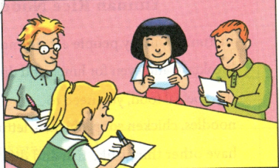
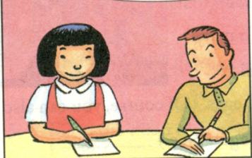
4 Make up a crazy recipe with your partner. Then tell another pair of students how to make this crazy food. The other pair will draw it.
First, put some yogurt on a piece of bread. Then, cut up one apple and an onion and put them on yogurt…

Slide 28
Thank you for your listening!

