Slide 1
Unit 6
I’m watching TV.
Section B 第3课时
WWW.PPT818.COM

Slide 2
Review
写出下列动词现在分词形式。
cleaning
1. clean _______ 2. work _______
3. watch _______ 4. eat ________
5. read _______ 6. wait ________
7. talk _______ 8. go ________
9. play _______ 10. study _______
working
watching
eating
reading
waiting
talking
going
playing
studying

Slide 3
having
11. take _______ 12. have _______
13. dance _______ 14. write _______
15. come _______ 16. make _______
17. get _______ 18. run ________
19. swim _________ 20. shop ________
21. stop _________ 22. sit _______
taking
dancing
writing
coming
making
getting
running
swimming
shopping
stopping
sitting

Slide 4
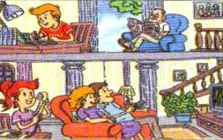
3a
Complete Jim’s letter.
Dear Bob,
Here is a picture of my family. We
are all at home now. I am doing
my homework. My parents _______________ in the living room. My grandfather ___________________.
My sister ____________________.
Jim
are watching TV
is reading a newspaper
is talking on the phone

Slide 5
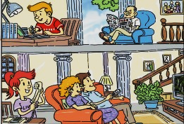
Report: This is Mike. He is doing his homework.
This is Mike’s sister. She is …

Slide 6
3b
Bring in some photos of your own (or draw some pictures of you and your family or friends) and write about them.

Slide 7
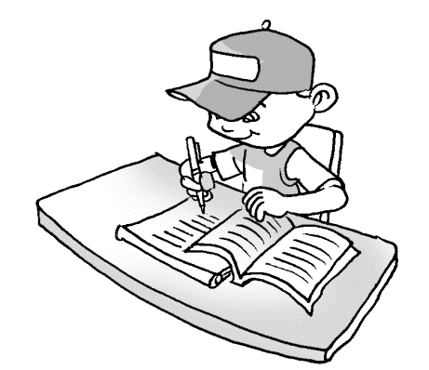
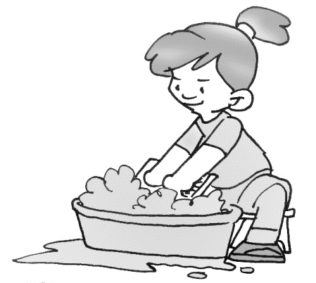
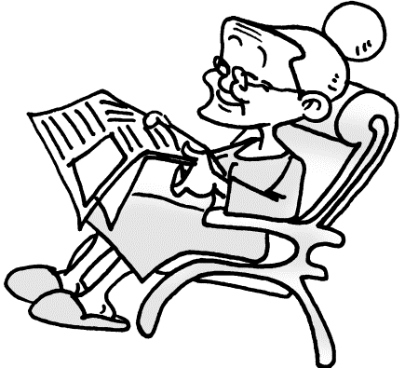
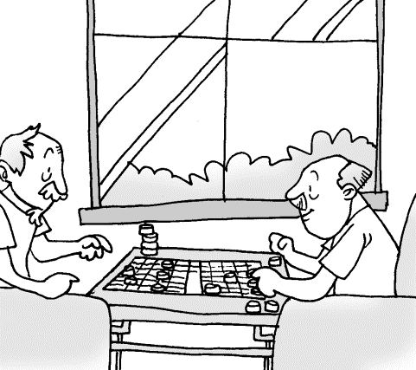
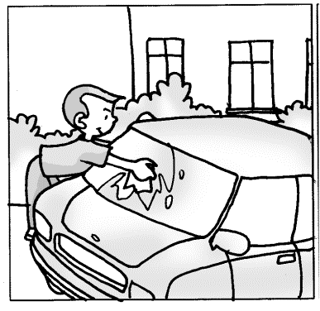
My photos

Slide 8
 | Who | Doing
me
my mother
my father
my grandma
my grandpa and his friend
doing homework
washing clothes
cleaning the car
reading a newspaper
playing chess

Slide 9
范文欣赏
It’s ten o’clock in the morning. I’m doing my homework. My mother is washing the clothes. My father is cleaning the car. My grandma is reading a newspaper. My grandpa is playing chess with his friend.

Slide 10
Self Check
1 Add more words in the chart. Then write at least
five sentences using the words.
play-playing | make-making | run-running
watch-watching
write-writing
sit-sitting
talk-talking
live-living
shop-shopping
read-reading
use-using
cut-cutting
Jack is playing basketball now.

Slide 11
Sentences：
Bob is talking to his mother now.
Sam is swimming in the pool now.
Zhu Hui is living in New York now.
Jill is using the computer now.
My father is reading a newspaper.

Slide 12
2 Write questions to complete the conversation.
A: Hey, Bob! __________________?(what)
B: I’m listening to the radio.
A: _______________________? (play soccer)
B: Sounds good, but this talk show is interesting.
What are you doing
Do you want to play soccer

Slide 13
A: _________________? (what, Tony)
B: Oh, he’s studying for a test.
A: ___________________________? (Steve, too)
B: No, he’s not. I think he can play soccer with you.
What’s Tony doing
Is Steve studying for a test, too

Slide 14
Language points
1. Here is a picture of my family.这是我家的照片。
本句是由here开头的倒装句。在以副词here或there开头的倒装句中，谓语动词的单复数应由后面的真正主语决定。
Here _____ some new books.
Here _____ my schoolbag.
are
is

Slide 15
Exercise
汉译英。
1. 她的父母亲正在做汤。
2.他们在干什么? 正在打排球。
3. Lucy 和Mary正在做作业。
Her parents are making soup.
—What are they doing?
—They are playing volleyball.
Lucy and Mary are doing their homework.

Slide 16
4.男孩子们正在池里游泳。
5.我的姑姑正在超市里购物。
6.我的女儿正在图书馆看书。
The boys are swimming in the pool.
My aunt is shopping in the supermarket.
My daughter is reading in the library.

Slide 17
根据提示填空。
are
It’s a fine Sunday morning. Many children ___(be)
in the park. They are _______ (play) happily. Some
are playing under the tree. Some girls are singing
and _______ (dance). Some boys are______ (sit 坐)
on the hill. Jim is near the lake. He’s _______(read)
a story. Where are Sam and Dale? _______ (他们)
standing over there. What are they _______(do)?
Sorry, I _____ (do not) know.
playing
dancing
sitting
reading
They’re
doing
don’t

