Slide 1
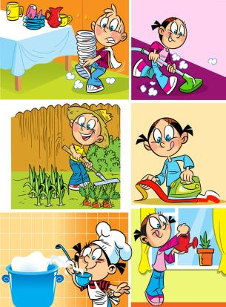
Unit 5
Helping our parents
第一课时
WWW.PPT818.COM

Slide 2
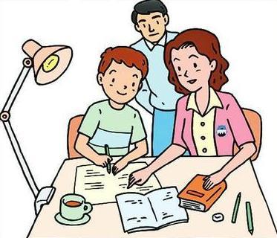
Introduce
--What is he doing?
--He is playing basketball.
--What are they doing?
--They are doing homework.

Slide 3
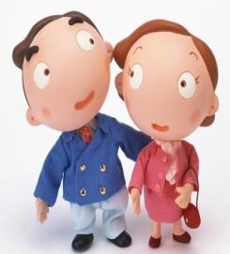
Words
parent [ˈpɛərənt]
名词，意为“父或者母”，为第三人称单数形式。
eg： My parent will come to see me this afternoon.
今天下午我的父亲或者母亲将会来看我。
小练习：用所给词的适当形式填空：
His parent______（be）from UK.
is

Slide 4
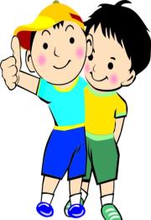
Words
cousin [ˈkʌzn]
名词，意为“表兄弟，表姐妹”。
eg： Paul and I are cousins.保罗和我是表兄弟。
小练习：用所给词的适当形式填空：
My________（aunt’s children）are in the garden.
cousins

Slide 5
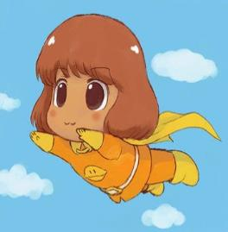
Words
busy [ˈbizi]
形容词，意为“忙碌的”。
eg： I am very busy. 我很忙。
小练习：汉译英：
忙碌的一周 ______________
a busy week

Slide 6
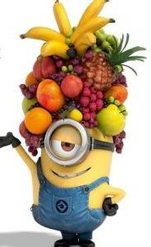
Words
fruit [fru:t]
名词，意为“水果”。
eg： Thy to eat more fresh fruits. 尽量多吃些水果。
小练习：汉译英：
一些水果 _____________
some fruit

Slide 7
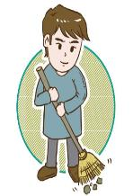
Expressions
What are Tim and Jim doing? 吉姆和蒂姆在做什么？
此句为现在进行时的特殊疑问句式，当主语为第三人称复数时，它的句式结构为：What +are+主语+现在分词+其他？答句句式结构为：主语+are+现在分词+其他。
eg： --What are they doing? 他们正在做什么？
--They are sweeping the floor. 他们正在扫地。
小练习：用所给词的适当形式填空：
What are they______（sing）?
singing

Slide 8
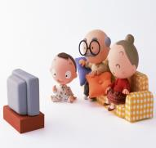
Expressions
We’re watching TV too. 我们也正在看电视。
此句为现在进行时的肯定句式，当主语为第一人称复数时，它的句式结构为：We+are+现在分词+其他。
eg：We are washing the dishes. 我们正在洗盘子。
小练习： I am looking for my purse.（对划线部分提问）
____________________________
What are you doing?

Slide 9
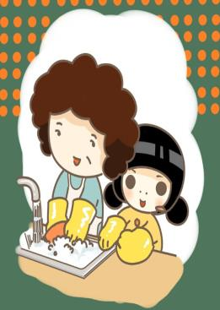
Dialogue
My mother is busy.
我的妈妈很忙。
She is cooking dinner.
她在做晚餐。
Helen and I are helping her.
海伦和我正在帮助她。
Helen is washing the dishes.
海伦正在洗盘子

Slide 10
Dialogue
I am cleaning the table.
我正在擦桌子
What are Tim and Jim doing?
吉姆和蒂姆在做什么？
They are eating fruit in the living room.
他们正在客厅里吃水果。
We’re watching TV too.
我们也正在看电视。

Slide 11
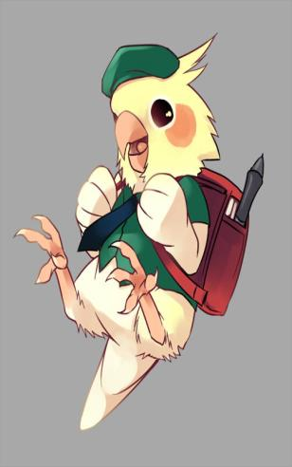
Expand
经典小故事
The owner said, “Well, apart from talking, he can also do some amusing actions, like dancing and so on. That’s why he’s so expensive.” Then the customer said, “How about the third one? What can he do that makes him so expensive?” The owner of the shop said, “I don’t know. Normally, I have never heard him talk, or dance, or whistle, or sing, nothing at all! But the other two call him ‘The Boss.’”

Slide 12
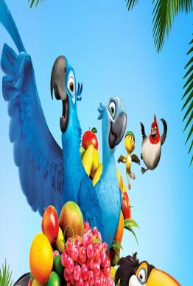
Expand
老板最大
有个人到一间商店买鹦鹉。店里有三只鹦鹉，其中一只卖五千元，另一只卖一万元，还有一只卖三万元。顾客问老板：“为什么这只要卖五千元？这个价钱对这种鹦鹉来说太贵了！”老板说：“因为我有训练他讲话。”顾客又问：“那这只呢？他会做什么？为什么要卖这么贵？”老板说：“他除了会说话之外，还会表演一些有趣的动作，好比说跳舞等等，所以才卖这么贵。”顾客接着又问：“那第三只呢？他会做什么？为什么要卖这么贵？”老板说：“我不知道。我从没听过他讲话、吹口哨或唱歌，也没看过他跳舞，什么都没有！不过另外两只叫他：老板！”

Slide 13
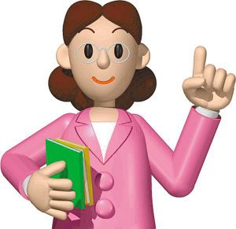
Summary
fruit
busy
parent
cousin
What are Tim and Jim doing?

Slide 14
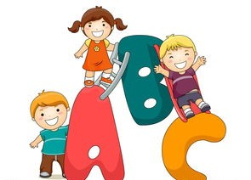
Exercise
汉译英
1.做晚饭______________________
2.洗盘子________________________
3.擦桌子___________________
4.吃水果_______________________
cook dinner
wash dishes
clean the table
eat fruit

Slide 15
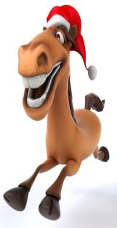
Exercise
单项选择
（ ）1.My cousin _____ in the afternoon.
A. coming B. come C . comes
（ ）2.I am _______ her in the classroom
A. help B. helping C. helps
（ ）3.Look, the boy _______ in the playground.
A.is running B. runs C. run
（ ）4.We should not ________ in the library.
A. laugh B. are laughing C. laughs
C
B
A
A

Slide 16
Homework
Write down your families’ names.

