Slide 1
M4 Rules and suggestions
Unit 2 We must keep
the camp clean
WWW.PPT818.COM

Slide 2
New words
tent
fall
fall asleep
hang
sudden
gun
soft
still
wood
blood
帐篷
变成，进入（某种状态）
入睡
悬挂；吊
突然的；急剧的
枪
软的，柔软的
静止的，不动的
（小）树林，林地
血；血液

Slide 3
New words
帐篷
变成，进入（某种状态）
入睡
悬挂；吊
突然的；急剧的
枪
软的，柔软的
静止的，不动的
（小）树林，林地
血；血液
tent
fall
fall asleep
hang-hung-hung
sudden
gun
soft
still
wood
blood

Slide 4
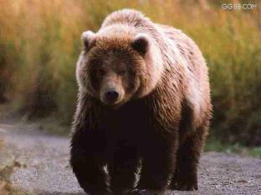
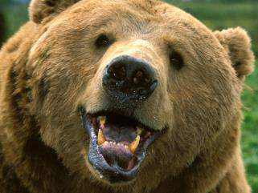
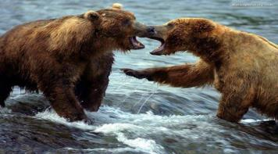
Free talk
What do you know about bears?
What do they look like?
Where do they live?
What can they do?
Do you think bears are dangerous animals?

Slide 5
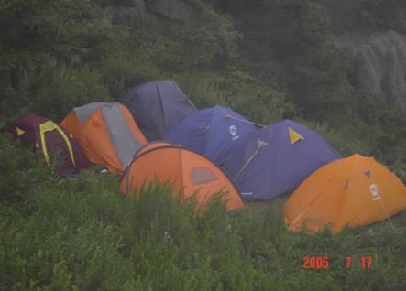
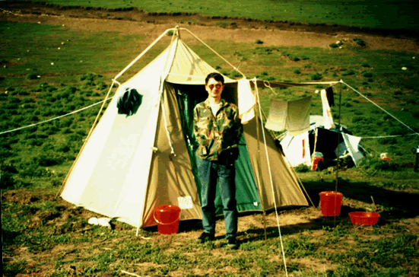
What do you need when you go camping?
tent
…

Slide 6
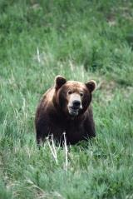
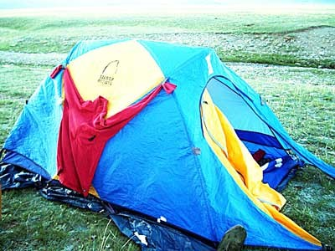
If …
What should you do ?
But I have a good idea!
Please look!

Slide 7
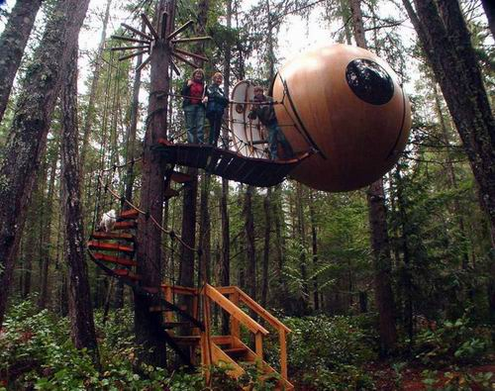
hang in a tree

Slide 8
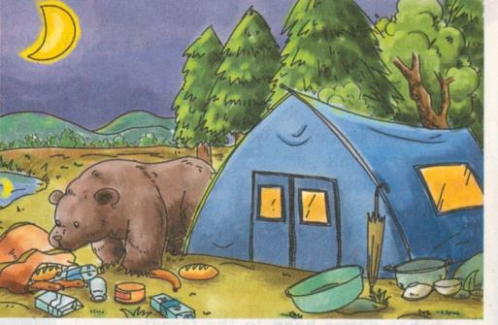
Look at the picture and answer the questions.
When is it?
Where is it?
What can you see?
1. What is the bear doing?
2. What do you think the people in the tent should do?
What do you think will happen?

Slide 9
Read on and find out the details.
Watch out! Bears about!
当心！附近有熊！

Slide 10
Fast reading
How many days did the three men stay in Yellowstone park?
About thirteen days.
Reading Suggestion:
Don’t read word by word look through the whole passage quickly.

Slide 11
2 Read the passage and answer the questions.
3. Where do you think is the best places
to keep food safe from bears?
4. What was the noise behind the writer?
5. Do you think their stay in the park
was a success?
High off the ground./ High in the tree
It was a mother bear.
I think so. / I don’t think so.

Slide 12
Read the passage quickly and we can divide the passage into four parts.
Part 1 (Para 1-2) the first day
Part 2 (Para 3-11) the second day
Part 3 (Para 13-17) the third day
Part 4 (Para 18) the next ten days

Slide 13
Part 1 (the first day)
On our first evening the three of us were tired after walking for about eight hours. we soon fell asleep.
In the middle of the night , I heard a strange noise outside. but when I looked out of the tent,there was nothing there.

Slide 14
Part 2 (the second day)
In the morning I got up to make breakfast. The bag of food was open.
“Bears” said Joe. “we should hang the food in a tree tonight.”
Later that day we stopped in a beautiful field by a stream. We put up the tent and fell asleep.
During the night the bears came again. This time they took the food from the tree.
…
…
That night, we went to sleep … or we tried to.

Slide 15
Part 3 (the third day)
The next day we stopped at eleven o’clock for a break. While the others were resting, I went for a walk in the forest.
…
…
I ran back to my friends. I have never run so fast back to my friends.
Part 4 (the next ten days)
For the next 10 days every time there was a sudden noise my blood went cold.

Slide 16
Careful reading
Part one: the first day
Questions:
1. What did they do on the first evening?
2. What did they hear and see in the middle
night?
They soon fell asleep.
They heard a strange noise and saw nothing.
Reading Suggestion:
When you are reading you should pay attention to the time and events (事件).

Slide 17
Part two: the second day
Fill in the chart.
Time | See | Do
in the morning
later that day
during the night
The bag of the food was open
hang the food in the tree
A beautiful field
fell asleep
The bears came again and took the food
tidy up and move on

Slide 18
Question:
How much did the three men know about
bears?
The bears can climb trees.
The bears can smell food from a distant.
The bears can run fast.

Slide 19
Discuss
What should you do if there are bears about?
(Use “can / can’t / should / shouldn’t / must / mustn’t”)
You should hang the food in a tree.
2. You must keep a clean camp site.
3. You should pick up your rubbish.
4. You can make a lot of noise.
5. If you see a bear you mustn’t run away.

Slide 20
Part three: the third day
Judge the statements true or false.
1. The writer didn’t like the baby bear at
all. ( )
2. The writer ran away quickly after hearing
a loud noise. ( )
3. The baby bear ran away because it was
afraid of the noise. ( )
4. The mother bear loved the baby bear. ( )
F
F
F
T

Slide 21
Part four: the next ten days
Choose the best answer.
The writer’s blood went cold because he ___.
a) thought the mother bear was coming back
b) was afraid of noise
c) liked bears
d) felt ill after running so fast
a

Slide 22
3. Complete the table.
What happened | What they should or should not do
In the middle of the first night, the writer heard a __________outside. And the bag of food __________ | They should_____________________________
During the second night, the bears came again and ________ from the tree. | They should ______________ and ___________
On the fourth day, the writer saw _____________. Then ________________ came. | He should not _________________
hang the food in a tree
strong noise
was open
keep the camp clean
took
make lots of noise
a baby bear
touch the bear
a mother bear
Activity 3

Slide 23
4. Complete the passage with the words in the box.
blood gun sticks sudden
On the third day of our camping trip, Ben told us that if we saw a bear, we should not make any (1) _________ moves. We did not have a (2)_______ to keep ourselves safe. The next day, I saw a baby bear playing with some (3)__________and stones. His mother arrived soon, and I was so afraid that my (4)__________ went cold. I did not move until the bears walked away. Then I ran back to my friends as fast as I could.
sudden
gun
sticks
blood
Activity 4

Slide 24
Language points
Part 1
序数词前面要用冠词the，但若其前已经
有形容词性物主代词，则可以省略。
如：我们的第一次会面
our first evening
2. The three of us were tired after walking
for about eight hours. after we walked
after doing sth
吃完午饭
the three of us，the 用在数词前表示特指。意为“我们三个人”(一共就三个人)。
three of us “我们中的三个” (我们不止三个人)
after having lunch

Slide 25
如：
They have eight people in the team.
(这八个人) all know only good teamwork will enable them to get the job done on time.
There are 10 people in the office and
(其中八个) are women.
The eight of them
eight of them
3. fall asleep 入睡
go to bed 上床睡觉
4. in the middle of the night 在午夜
in the middle of … 在……的中间、中央

Slide 26
Part 2
5. tidy up 整理……
6. move on 继续前进
7. make lots of noise 发出许多的响声
8. above all 更重要的是，首先

Slide 27
Part 3
9. see sb /doing sth:看见某人正在干某事
当我路过他房间的时候，我看见他在看书。
When I walked past his room, I saw him
reading a book.
10. remember doing sth:记得做过某事(已做)
remember to do sth:记着去做某事(还没做)
Don’t you remember the man before? 你不记得以前见过那个人吗? Remember the post office after school.
记着放学后去趟邮局。
seeing
to go to

Slide 28
11. reach out (for sth): 伸出手(去摸/够) …… 如：
The monkey reached out a hand for the banana. 猴子伸出手去够香蕉。
He reached out for the phone and knocked over a glass.
他伸手去够电话，打翻了一个杯子。
12. stand very still …
When he heard the surprising news, he stood still like a sculpture (他像雕像一样纹丝不动的站着).
16. Stay in the same position: 保持同一姿势

Slide 29
Part 4
13. For the next 10 days, every time there was
a sudden noise, my blood went cold.
every time: “每次……，每当……”。
如：每次我去看他，他总是在房间学习。
Every time I go and see him, he is always
working in the room.
go 表示“处于(某种状态，尤指令人生厌的状态)”，其后可以接形容词。如：

Slide 30
谷物歉收时，人们会挨饿。
When the crops fail, .
在我难为情的时候，总会脸红。
I always when I’m embarrassed.
people go hungry
go red

Slide 31
表达不同时间段的短语
1) on our first evening: 在我们的第一晚上
2) in the middle of the night: 在午夜
3) in the morning / afternoon /evening:
在早上 / 下午 / 晚上
4) on the morning of… / on … morning:
在具体某天的早上/下午/晚上
5) later that day: 那天晚些时候
6) during the night: 在夜间
7) the next day: 第二天
8) for the next 10 days: 在接下来的十天里

Slide 32
Choose one part you like best to retell.
Time | Happened
the first day | tired / fell asleep / strange noise / nothing
the second day | the bag open / hang the food / stopped in a field / came again/ took food / tidy up
the third day | went for a walk / saw / a loud noise / stood still / ran back
the next ten days | heard / blood went cold

Slide 33
Writing
Think of an area of countryside nearby. Answer the questions and make notes.
where is it?
why do people go there?
Are there any dangers from animals?
how can we protect ourselves?
what should we do to look after the place ?
You can use reference books or the Internet to help you.
Activity 5

Slide 34
Write sentences with the notes you have made in Activity 5:
Say where it is
Lushan National Park is in Jiangxi Province.
Say why people go there
People go there to see the mountains and streams
Say if there are any dangers from animals
The fish and birds there are not dangerous, but there are some snakes.
Activity 6

Slide 35
Write sentences with the notes you have made in Activity 5:
Say how we can protect ourselves
We mustn’t walk in the grass.
Say what we should do to look after the park
We should allow only 1,000 people to visit it each day.
Activity 6

Slide 36
Try it
If you work as a guide for Yellowstone park please give some suggestions to the visitors about how to protect yourselves and the places.
Where it is: in the USA
What to see: mountains / valleys / warm
springs / and rare plants …
What dangers there are: bear
How we can protect ourselves: …
What we should do to look after the place: …

Slide 37
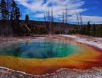
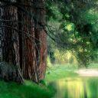
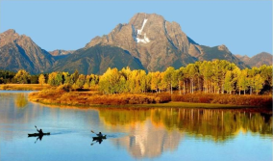
Example
Yellowstone Park is in the USA.
Many people visit it to see the mountains / valleys / warm springs moose / bison and rare plants. It is peaceful but there are some bears. So we mustn’t …. And We should ….We can …. We can’t …. We should allow only 1000 people to visit it each week.

Slide 38
Writing Suggestions
1. When we write in paragraphs, we should choose one topic for each paragraph first.
2. Next, We can write notes under headings.
3. Finally, we should use linking words (and,
but, so, because etc) to join the sentences
together.

Slide 39
单项选择
1. －Don’t make a ___ in the library, Bill.
－Sorry, I won’t do that again.
A. voice B. noise C. sound D. singing
2. －Where’s Mr. Yu, do you know?
－Well, it’s hard to say. But I saw him ________ a football game just now.
(2006河南省课改区)
A. was watching B. watching
C. had watched D. watched
B
B

Slide 40
C
3. ―Do you still remember______me somewhere in Shanghai? ―Yes, of course. Two years ago.
(重庆市中考真题)
A. to see B. see C. seeing D. saw
4. ― Mr Wang, I have trouble _____ the text. ―Remember _____ it three times at least. (2007年山东威海)
A. to understand; reading B. understanding; reading C. understanding; to read D. to understand; to read
C

Slide 41
Homework
Finish the exercises in the
workbook Ex. 5, 6, 7 & 8.

