Slide 1
Unit 5 Dr Sun Yatsen
WWW.PPT818.COM

Slide 2
Unit5 Dr Sun Yatsen translation（翻译）
Ben: What are you reading,Xiaoling?
Xiaoling: A book about Dr Sun Yatsen.
本:晓玲，你在看什么书？
晓玲：一本关于孙逸仙博士（孙中山）的书。

Slide 3
Unit5 Dr Sun Yatsen translation（翻译）
Ben: Who is he?
Jiamin: He’s a very famous and important person in Chinese history.
本:他是谁？
家民：他在中国历史上是一位非常著名的，重要的人。

Slide 4
Unit5 Dr Sun Yatsen translation（翻译）
Ben: Wow! Can you tell me something about him?
Jiamin: Yes.He was a great leader.He tried to free the Chinese people and make their lives better.
本:哇！你能告诉我一些有关他的事吗？
家民：可以。他是一位伟大的领袖。他试图解放中国人民，使他们的生活更好。

Slide 5
Unit5 Dr Sun Yatsen translation（翻译）
Xiaoling: Yes. He loved the Chinese people and the Chinese people love him.
Jiamin: That’s right. Today many streets, schools and parks have his name.
晓玲:是的。他热爱中国人民而且中国人民也热爱他。
家民：这很正确。当今许多街道，学校和公园都用他的名字命名。

Slide 6
Unit5 Dr Sun Yatsen translation（翻译）
Ben: Wow, what a great man!
本：哇，多么伟大的一个人呀！

Slide 7
单词小测
famous
1著名的________
2人________
person
history
4领袖______
3历史______
leader
5使……自由_______
free
6使得_________
make
inventor
7发明家________
8发明______
invent
musician
actor
9音乐家_______
10（男）演员______
11有趣的________
funny
movie
12电影______

Slide 8
单词小测
paint
doctor
13画画_____________
14医生________
writer
painter
15作家______
16画家______

Slide 9
单元整体设计内容分配
Period 1 Unit 5 Dr Sun Yatsen 课文对话，及课本P27 相关词条。
Period 2 课本P28-29 Fun with language内容。
Period 3 P30-31 Language focus及Rhyme Time内容,自编快速阅读内容及一篇课外听力内容。

Slide 10
本节课实现目标
1. 能在听说读写的语言活动中理解和运用下列单词和词组：
famous, person, history, leader, free, make, inventor, invent, light bulb, actor, funny, movie, musician。
2. 能理解和流利朗读课文对话。
3. 能根据自己的实际情况，选择教师提供的适当方式，口头完成对课文对话的复述。

Slide 11
Liu Xiang,runner
Yao Ming,basketball player
Pan Changjiang,actor
Li Yong,compere
Chairman Mao
Famous people
Jackie Chan,actor
Einstein,physicist
Zhao Benshan,actor

Slide 12
Famous persons[ˈpɜːsnz]

Slide 13
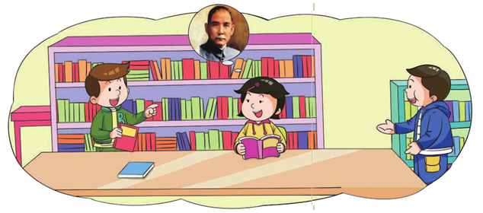
Xiaoling is reading a book about him. Let's listen to Xiaoling.

Slide 14
listen to the dialogues
for the first time.
Listen for meaning

Slide 15
listen to the dialogues for the second time.
Listen & Judge

Slide 16
Listen & Write T or F（判断句子正误，正确的写T，错误的写F，并把错误的改正）
( ) 1. Jiamin is reading a book about Dr Sun Yatsen.
( ) 2. Sun Yatsen was a great leader. He is very important and famous in Chinese history.
F
Xiaoling
T

Slide 17
Listen & Write T or F（判断句子正误，正确的写T，错误的写F，并把错误的改正）
( ) 3. Sun Yatsen is a great leader now, just like Chairman Xi.
( ) 4. Sun Yatsen loved the Chinese people and tried to free them and make their lives better.
( ) 5. Chinese people love Dr Sun Yatsen. Many streets , schools and parks have his name.
F
was
then
Sun Yatsen was a great leader then. Chairman Xi is a great leader now.
T
T

Slide 18
Read the dialogue
with different forms.
Read the dialogue
Students:
1. Follow the teacher and read.
2. Read together all the way through.
3. Role-play and read in your groups.

Slide 19
Retell the text
老师将对课文设计成两个层次进行复述。（待会请大家口头进行复述，课后大家再把复述内容写下来。）

Slide 20
Level 1
Fill in the blanks according to the dialogue.
Ben: What are you reading, Xiaoling?
Xiaoling: A book about __________________.
Ben: Who is he?
Jiamin: He's a very ________ and _________ person in Chinese history.
Ben: Wow! Can you tell me __________ about him?
Jiamin: Yes. He was a great _________. He tried to ______ the Chinese people and _________ their lives better.
Xiaoling: Yes. He loved the Chinese people and the Chinese people love him.
Jiamin: That's right. Today many streets, schools and parks have his name.
Ben: Wow, _________ a great man!
Dr Sun Yatsen
famous
important
something
leader
free
make
what

Slide 21
Level 2
Retell the dialogue and fill in the blanks.
Xiaoling is reading a book about _______________. Ben wants to know __________ about him. Jiamin tells Ben Dr Sun was ___________________. He tried to ______________________ and ___________________. Xiaoling tells Ben Dr Sun _________________________ and __________________________. Ben thinks Dr Sun is a ___________________.
Dr Sun Yatsen
something
a great leader
free the Chinese people
make their lives better
loved the Chinese people
the Chinese people love him
great man

Slide 22
Do you know them?
你认识他们吗？

Slide 23
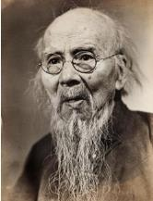
Example:
T: Who is Qi Baishi?
S: He is a painter.
T: Is he a Chinese painter?
S: Yes, he is.
T: What did he paint?
S: He painted flowers and animals. He was good at painting flowers and birds.
Qi Baishi

Slide 24
Dr Sun Yatsen
Sun Yatsen is a very important and famous historical person.
He was born in Guangdong, in 1866. He was born in Xiangshan County（香山县）. It’s not far away from Zhongshan City（中山市）. His father was a farmer. He went to school in Hawaii. His elder brother lived there. From 1887 to 1892, he learnt to be a doctor in Hong Kong. Then he became a doctor and worked in Hong Kong. So people called him Dr Sun Yatsen. He was the father of modern China.
本页PPT可供学生课外阅读。

Slide 25
Dr Sun Yatsen
He came back to China and became President. He was a great leader. He was against the emperor（反对帝制）. He had to leave China again because of his enemies. He stayed in Japan and met Song Qingling. They became husband and wife in Japan. He came back to Guangzhou to work for the people. He freed the people slowly. And finally he started to change China. He died in 1925. all the people were sad.
If you want to learn more about him, you can visit the Dr Sun Yatsen Memorial Hall（中山纪念堂） in Guangzhou.
本页PPT可供学生课外阅读。

Slide 26
Summary（总结）
Today what do you learn ?
今天你学到了什么？
1、有关孙中山先生的事迹
2、认识了一些名人
3、懂得如何复述课文对话
4、学习了如何描述一个人的职业
5、……

Slide 27
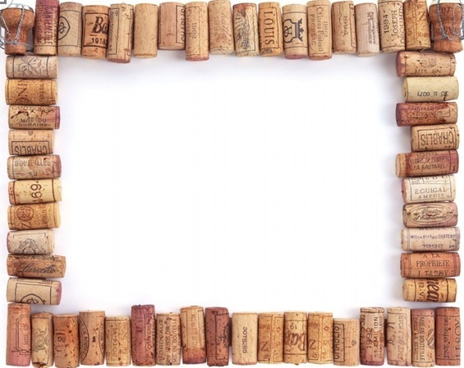
Homework
1.掌握Unit5生词，抄写并背诵Unit5课文+家长签名，用作业A本
2.熟读Unit5对话，用英文将你所了解的中山先生与家人及同学分享。

Slide 28
Thank you!

