Slide 1
Module 12 Western music
Unit 2 Vienna is the centre of European classical music.
WWW.PPT818.COM

Slide 2
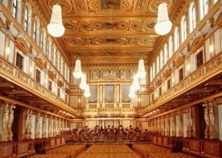
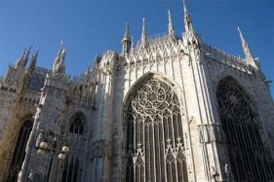
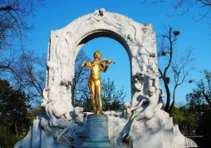
Warming-up
Look and say
Can you guess where they are?
Vienna

Slide 3
Warming-up
Free talk
How much do you know about Vienna?
It’s the capital city of Austria.
It’s a beautiful old city on the River Danube.
Vienna is known as the city of music.
There is a big concert here on New Year’s Day every year.

Slide 4
Pre-reading
Words and expressions
centre
European
musician
classical
composer
century
elder
n. 中心
adj. 欧洲的
n. 乐手；音乐家
adj. 经典的；古典的
n. 作曲家
n. 世纪
adj. 年长的

Slide 5
Pre-reading
Words and expressions
waltz
dance music
another
piece
poor
perfect
n. 华尔兹舞（曲）
舞曲
pron. 又一个；再一个
n. （写作、音乐或艺术的）作品
adj. 贫穷的
adj. 完美的

Slide 6
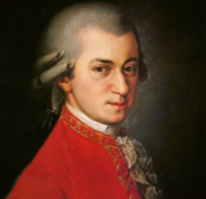
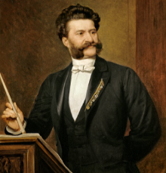
Pre-reading
Look and say
1. Who are they?
2. What do you know about them?

Slide 7
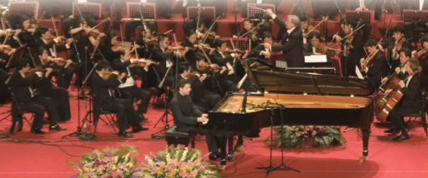
Pre-reading
1 Describe the picture using the words in the box.
concert musician piano violin

Slide 8
While-reading
Read and match
Para. 1 A. the great Strauss family
Para. 2 B. the great musician Mozart
Para. 3 C. the city of music

Slide 9
While-reading
Read Para. 1 and fill in the blanks.
It’s a ____________ old city on the river Danube.
beautiful
Vienna
It’s the __________ city of Austria.
capital
In the 18th century a lot of ___________ came here.
musicians

Slide 10
While-reading
Read Para. 2 and answer the questions.
1. What made Johann Strauss the elder famous all over Europe?
2. Johann Strauss the younger was also successful, wasn’t he?
3. When did Johann Strauss the younger write The Blue Danube waltz?
His dance music did.
Yes, he was.
In 1867.

Slide 11
While-reading
Read Para. 3 and complete the table.
Time | What happened to Mozart?
In 1756 | He was _________.
Before he was six | He played the _______ and the violin.
In __________ | He died.
born
piano
1791

Slide 12
While-reading
2 Read the passage and check ( ) the true sentences.
√
(1) Many musicians came to study and work in
Vienna.
(2) Strauss the younger played the piano, the
violin and the drums at the age of six.
(3) Mozart’s family took him around Europe.
(4) The father, Johann Strauss, died in 1791.
(5) Mozart wrote The Blue Danube.
√
√

Slide 13
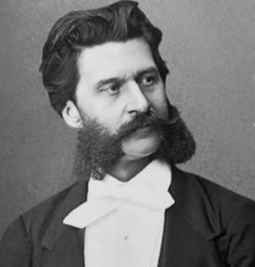
While-reading
3 Answer the questions.
(1) Where is Vienna?
It’s in the centre of Europe./It’s in Austria.
(2) What music did Johann Strauss the
elder write?
He wrote music for traditional
dances, called the waltz.

Slide 14
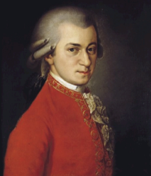
While-reading
3 Answer the questions.
(3) How many waltzes did Johann Strauss the
younger write?
He wrote over 150 waltzes.
(4) When was Mozart born?
He was born in 1756.
(5) How old was Mozart when he died?
He was 35.

Slide 15
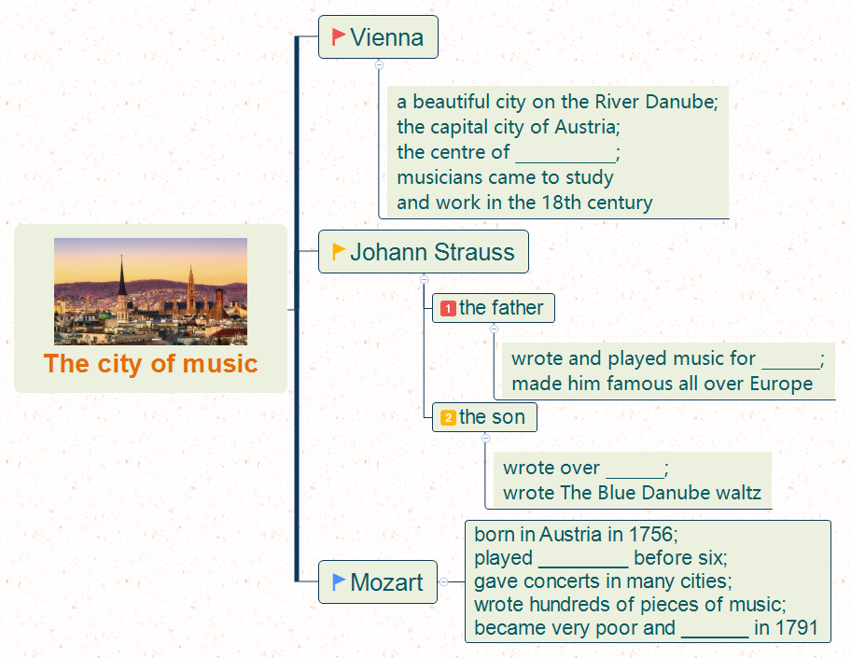
While-reading
Fill in the blanks
European classical music
traditional dances, called the waltz
150 waltzes
not only the piano but also the violin
died

Slide 16
Post-reading
Retell the passage
European classical music
traditional dances, called the waltz
150 waltzes
not only the piano but also the violin
died

Slide 17
Post-reading
Language points
1. His dance music made him famous all over Europe.
(1) make的常见用法：
① make sb. do sth. 使某人做某事
make sb. not do sth. 使某人不做某事
e.g. Parents always make their children learn many
things.
父母总是让他们的孩子学习很多东西。

Slide 18
Post-reading
Language points
②make sb./sth.+adj. 使某人/物……
e.g. The bad news made him very sad.
这个坏消息使他很伤心。
(2) all over 遍及
常见搭配：all over the world 全世界
all over the country 全国
all over China 全中国
e.g. We have friends all over the world.
我们的朋友遍天下。

Slide 19
Post-reading
Language points
2. … he played not only the piano but also the violin.
not only… but also…是表并列关系的连词，用来连接两个并列关系的句子成分，意为“不但……而且……”。
e.g. I can speak not only English, but also French.
我不但会讲英语，而且还会讲法语。

Slide 20
Post-reading
4 Complete the passage with the correct form of the
words from the box.
another elder European perfect poor popular
Both Strauss the (1) ______ and Strauss the younger wrote some very (2) _______ music. (3) _______ successful composer from Vienna was Mozart, but he became very (4) ______ and died at the age of thirty-five. Many people think Mozart’s music is (5) __________. All three were great (6) __________ musicians.
elder
popular
Another
poor
perfect
European

Slide 21
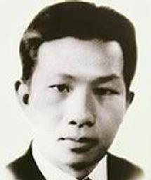
Post-reading
5 Use the notes to write a passage about the Chinese
composer Xian Xinghai.
◆ Xian Xinghai
◆ famous for the song The Yellow River
◆ wrote it in 1939
◆ one of the great composers of
classical and traditional music
◆ born in Macao, China, 1905

Slide 22
Post-reading
◆ died young, 1945
◆ called the “People’s Musician”
◆ used traditional Chinese music
◆ studied in Paris
◆ songs are still popular today
Xian Xinghai is one of the great composers of
classical and traditional music. He was born in…

Slide 23
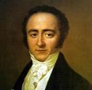
Post-reading
Let’s analyze.
A famous composer
born
Austria, 1756
6, played: the piano, the violin,
took him around Europe, gave concerts
experience
Mozart
his music
hundreds of wonderful pieces of music
die
1791, 35 years old
appreciation (评论)
a great European musican
perfect

Slide 24
Post-reading
Put the notes in order.
( ) Xian Xinghai
( ) famous for the song The Yellow River
( ) wrote it in 1939
( ) one of the great composers of classical and
traditional music
( ) born in Macao, China, 1905
( ) died young, 1945
( ) called the “People’s Musician”
( ) used traditional Chinese music
( ) studied in Paris
( ) songs are still popular today
1
5
6
2
3
8
9
7
4
10

Slide 25
Post-reading
Complete the structure.
Xian Xinghai is one of the great composers of classical and traditional music. He was born in…
He was born in Macao, China in 1905.
born
He studied in Paris.
experience
He was famous for the song The Yellow River.
He wrote it in 1939.
He used traditional Chinese music.
his music
Xian Xinghai
He died young in 1945.
die
He is one of the great composers of classical and traditional music.
He is called the “People’s Musician”.
His songs are still popular today.
appreciation (评论)

Slide 26
Post-reading
One possible version
Xian Xinghai is one of the great composers of classical and traditional music. He was born in Macao, China in 1905 and studied in Paris. He was famous for his song The Yellow River. He used traditional Chinese music to write songs. Unfortunately, Xian Xinghai died young in 1945. But he is called the “People’s Musician” and his songs are still popular today.

Slide 27
Post-reading
Do the exercises
一、根据首字母提示完成单词。
1. Germany is a E________ country.
2. Xian Xinghai is a very f________ Chinese composer.
3. Mozart wrote hundreds of w________ pieces of
music.
4. Practice makes p________.
5. They are twins. Can you guess who is the e________?
uropean
amous
onderful
erfect
lder

Slide 28
Post-reading
Do the exercises
二、按要求转换下列句子。
1. At the age of 20, he joined the army. (改为同义句)
_____ _____ _____ 20, he joined the army.
2. Your father was born in 1948, __________? (完成反意疑问句)
3. Strauss was famous for his waltzes. (改为同义句)
Strauss’ waltzes _______ _______ _______.
When
he
was
wasn’t he
made
him
famous

Slide 29
Post-reading
4. I can play the violin. Tom can play the violin,
too. (改写为同义句)
______ ______ I ______ ______ Tom can play the
violin.
5. Many people went to Qingdao to enjoy the
beautiful sea. (就画线部分提问)
______ ______ many people ______ to enjoy
the beautiful sea?
Not
only
but
also
Where
did
go

Slide 30
Summary
1. make的常见用法：
(1) make sb. do sth. 使某人做某事
make sb. not do sth. 使某人不做某事
(2) make sb./sth.+adj. 使某人/物……
2. all over 遍及
常见搭配：all over the world 全世界
all over the country 全国
all over China 全中国
3. not only… but also… 不但……而且……
4. on the River Danube 位于多瑙河畔
5. in the eighteenth century 在18世纪
6. called 被称为……
7. elder 年长的

Slide 31
Homework
1. Read the passage fluidly and fluently by yourself.
2. Finish the exercises in workbook.

Slide 32
Goodbye!

