Slide 1
Unit6 Outdoor fun
Integrated skills
WWW.PPT818.COM

Slide 2
Introduction:
Hello, boys and girls. Nice to see you.
Introduce myself.
This is my first time to be with you. I feel very excited.
(激动的)

Slide 3
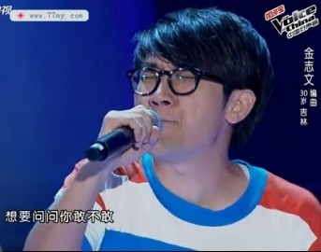
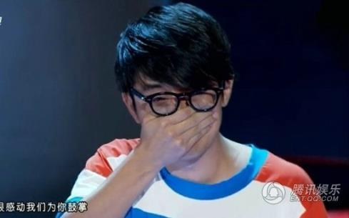
excited
Where is he from?

Slide 4
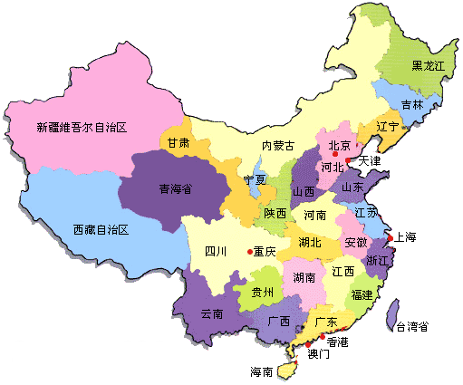
a map of China
Province
省

Slide 5
excited
100 years old
a century
（世纪，百年）
use a mobile phone
（手机）
Do you want to live as long as her?

Slide 6
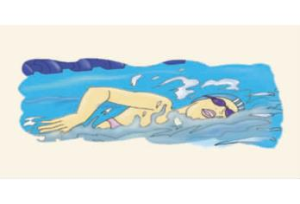
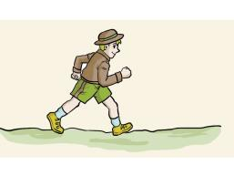
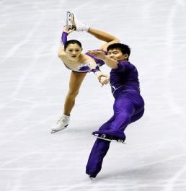
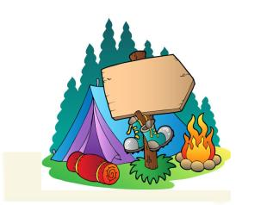
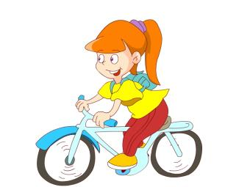
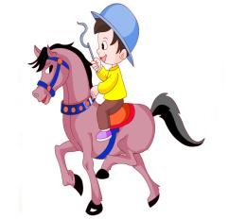
What outdoor activity would you like to do?
jogging
swimming
skating
camping
cycling
riding

Slide 7
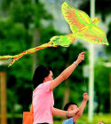
Do you know what outdoor activity I would like to do?
I would like to fly kites on sunny and windy days.
有风的

Slide 8
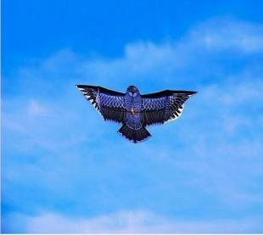
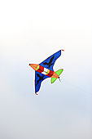
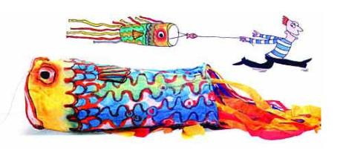
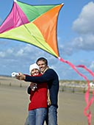
What do they look like?
a bird
a plane
a square
正方形
a fish
Whose kites are these?

Slide 9
Mr. Wu is also asking his students about this question. Open your books and turn to page75.Listen to their conversation and write the students’ names under their kites.

Slide 10
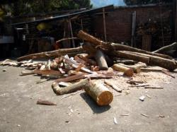
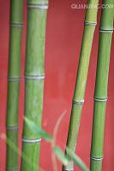
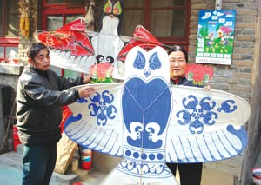
What can we use to make kites?
What can we make kites out of---?
wood
bamboo
paper
（木头，木材）
We can use---to make kites.
We can make kites out of---

Slide 11
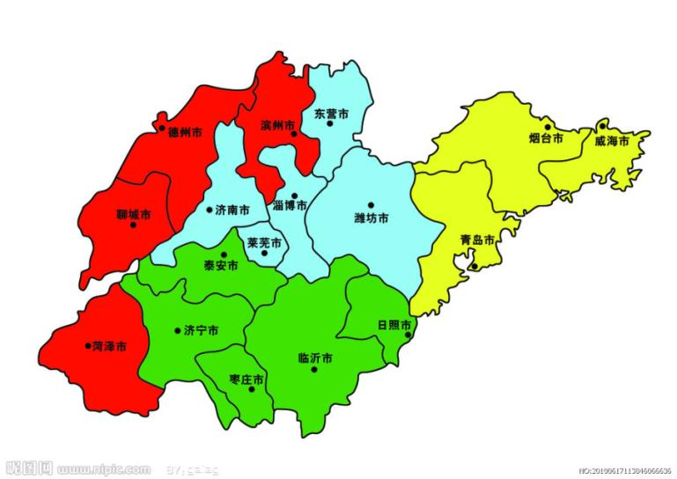
Would you like to watch more kites?
Go to Shan dong Province.
famous for making kites
Go to---?
kite festival

Slide 12
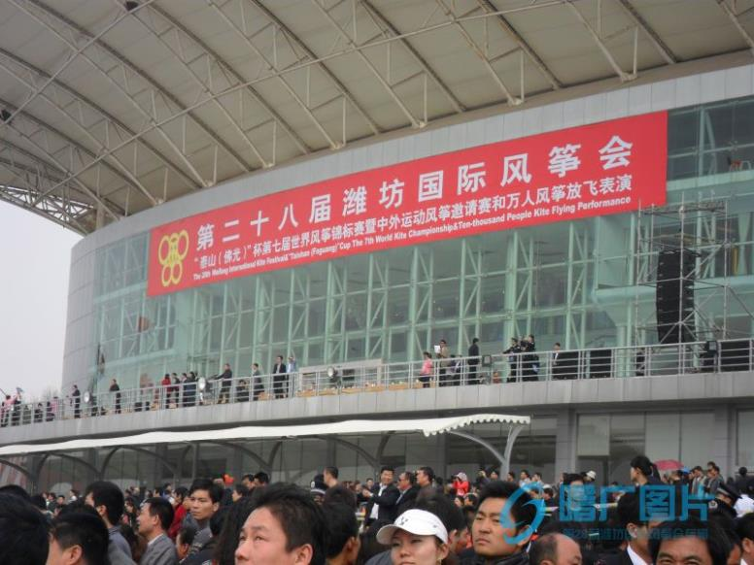

Slide 13
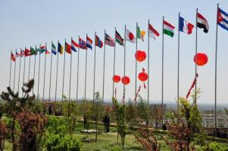
people from different countries

Slide 14
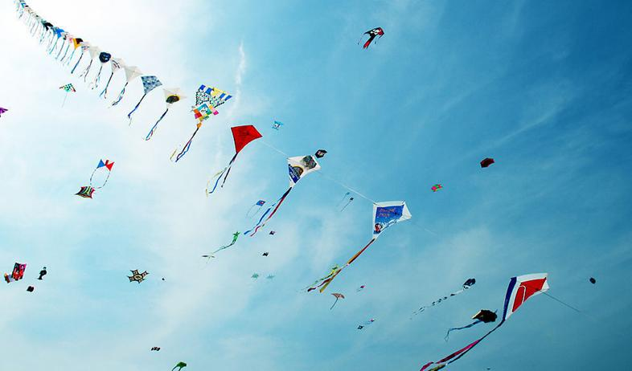
enjoy colourful kites

Slide 15
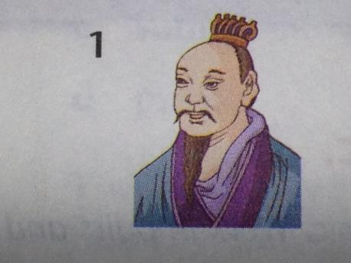
Who is the first person to make kites?
Mozi
over 2000 years ago
(20 centuries)
the period (一段时间，时期）of his life：
too many wars(战争)
call---the Warring States period
（战国时期）

Slide 16
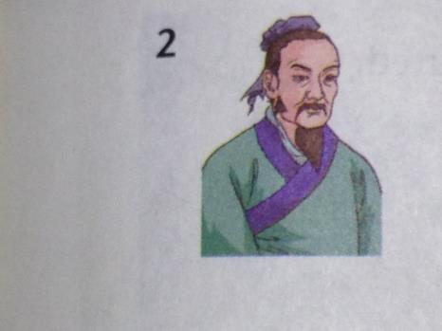
Lu Ban
the Warring States period
student
good at

Slide 17
Cai Lun
（朝代，王朝）
in the Eastern Han dynasty
东汉王朝
good at:
making paper

Slide 18
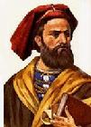
Marco Polo
马可.波罗
意大利
意大利的
Italy, an Italian man
in the 13th century: China
in the Yuan dynasty for---
know---well, tell---about---

Slide 19
Mr. Wu is telling his students about the history(历史)of kites. The four famous people are mentioned(被提到) in his talk. Listen to the talk and finish Part A2 on page75.

Slide 20
We have known a lot about kites. But Millie hasn't. So she wants to write down Mr. Wu’s talk.
Can you help her? Listen to the talk again and finish Part A3 on page76.

Slide 21
We are listening to Mr. Wu’s talk about kites. But Amy and her cousin Shirley are going for a picnic. They are very excited. They are talking about their picnic.
Listen to their conversation on page76 and answer some questions.
1.What can they do?
2.Can they go swimming? Why?
3.What does Amy need to take?

Slide 22
Amy and Shirley can fly kites today. Can we fly kites today?
We can listen to a song called Flying Kites.
Would you like to listen?

Slide 23
Homework:
Make a conversation about a day out like this:
Feeling
What you can do
What you can’t do and why
Things you need to take

