Slide 1
Small animals
11
第三课时
WWW.PPT818.COM

Slide 2
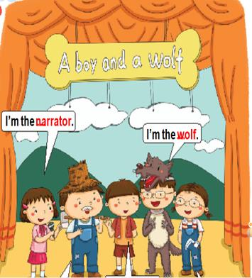
Stories about animals

Slide 3
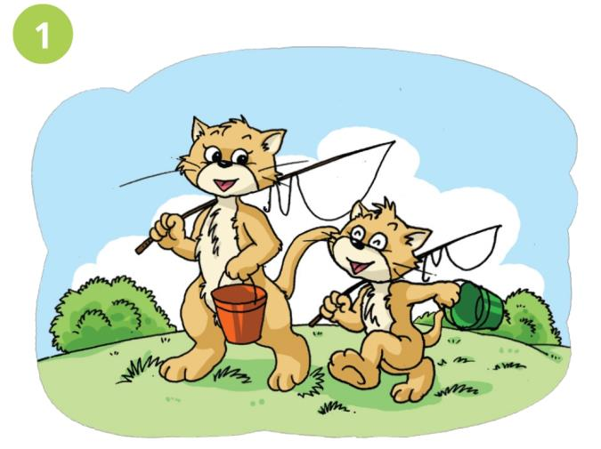
Story time
Let’s go fishing!
It is a nice day!

Slide 4
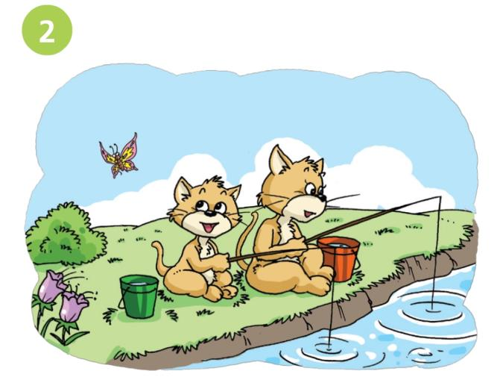
Story time
What is it,Mum?
Sh...

Slide 5
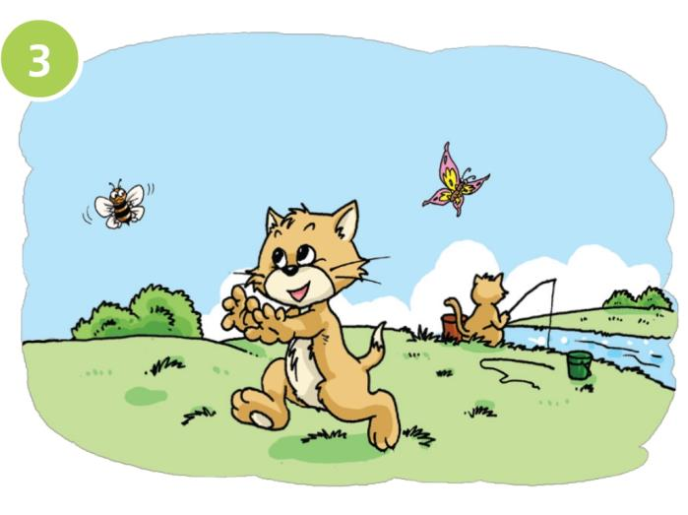
Story time
What is it,Mum?

Slide 6
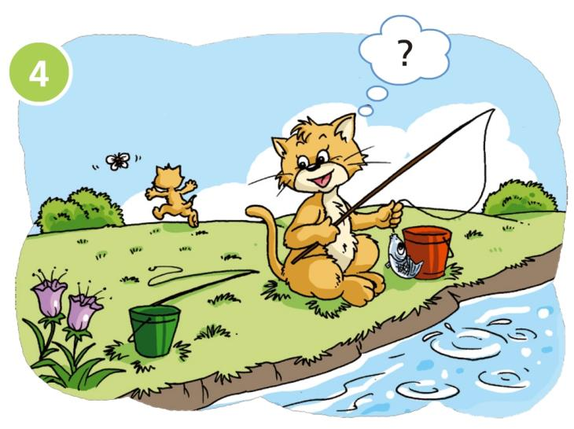
Story time

Slide 7
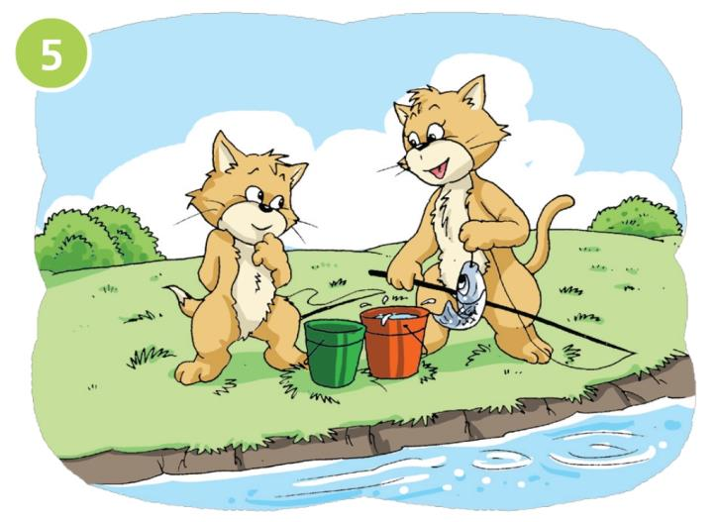
Story time
I'm sorry, Mum.

Slide 8
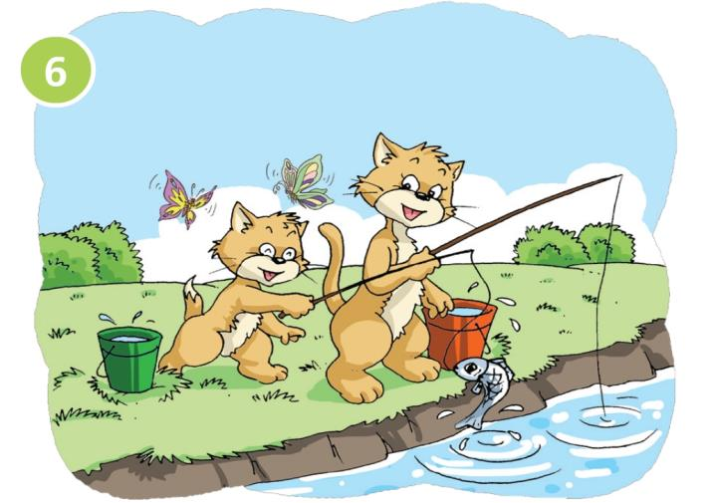
Story time
Well done!
Look,Mum!
A big fish!

Slide 9
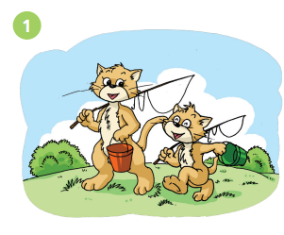
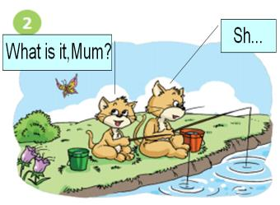
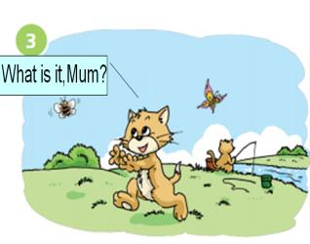
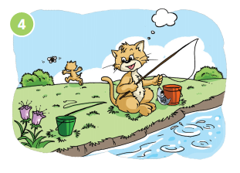
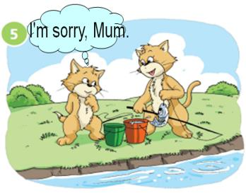
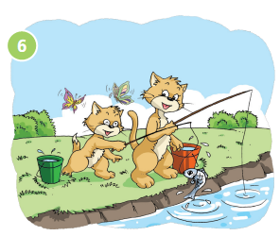
Read the story
Look , Mum!
A big fish!
Well done!

Slide 10
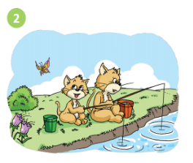
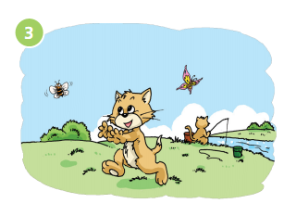
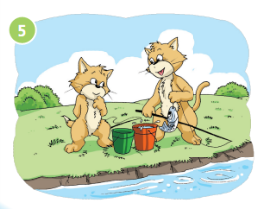
Number the story
A
B
C
（ 2 ）
（ 4 ）
（ 1 ）
D
E
F
（ 3 ）
（ 6 ）
（ 5 ）

Slide 11
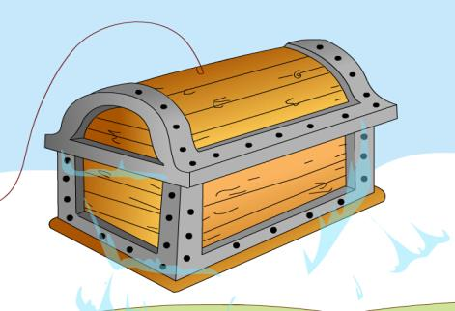
What’s in the box ?
It is a /an _______.
Its_____ is _____.
Its_____ are_____.

Slide 12
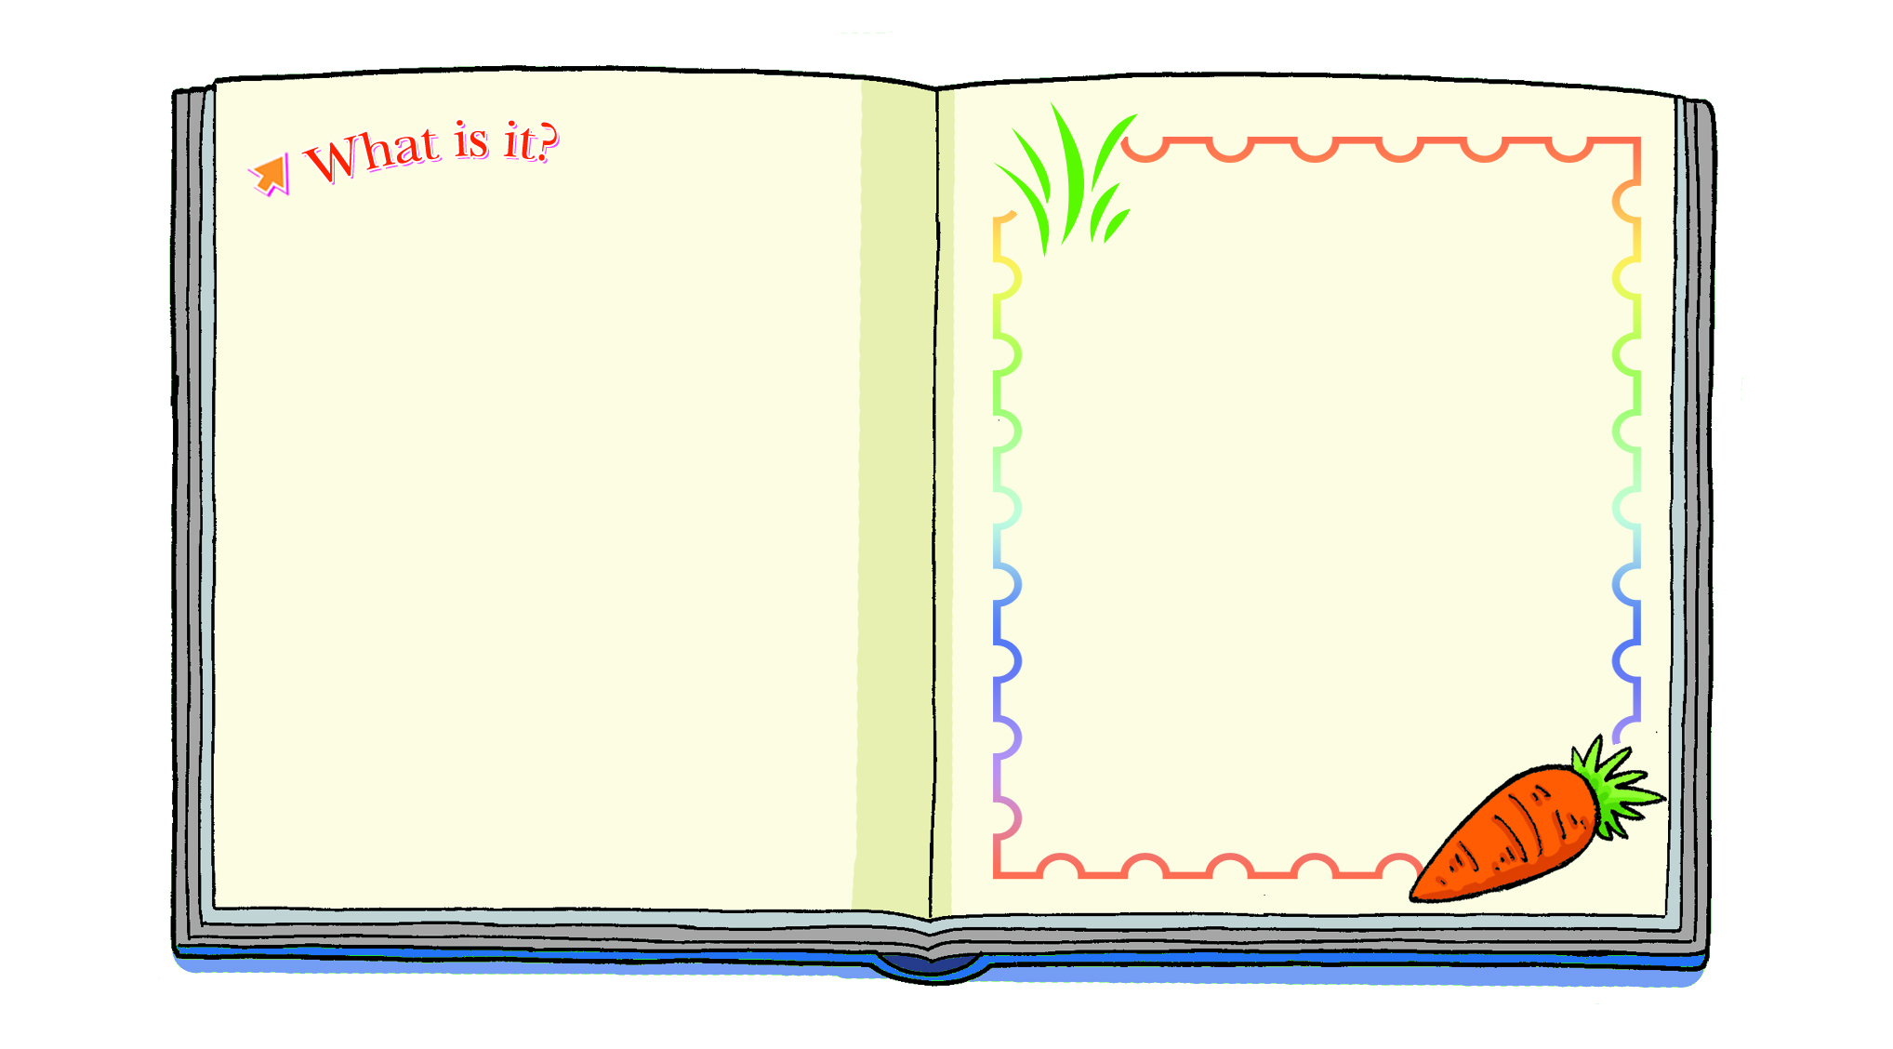
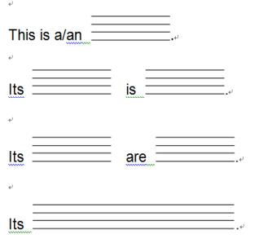
An animal book
Stick a picture

Slide 13
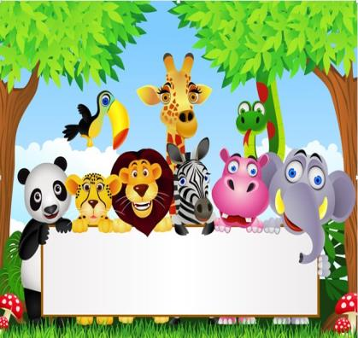
Show time
An animal book
Notes:
13

Slide 14
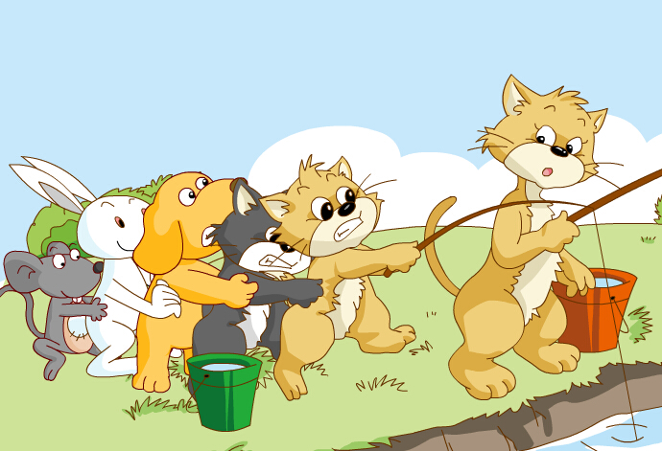
Small animals can help!
All the animals are friends!

Slide 15
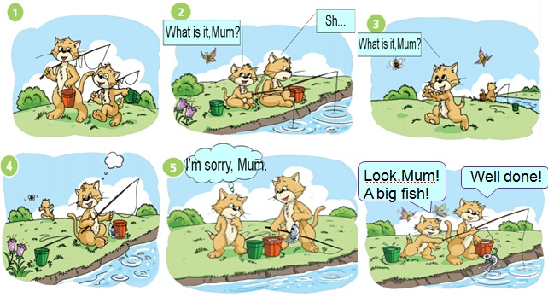
Homework
Write your story. 改一改，怎样的故事更有趣？
Look , Mum!
A big fish!

