Slide 1
陕旅版英语五年级上册
Unit5 Can You Tell Me the Way to the Supermarket?
第4课时
WWW.PPT818.COM

Slide 2
教学目标：
1. 能听懂、理解Part B Read and discuss部分的小故事I Don’t Know the Way，并能四人一组完成故事的表演。
2. 能在教师的引领下完成Part C Listen and match, Read and complete the map和 Look and write这三个部分的检测活动。

Slide 3
Free talk
Where is…?

Slide 4
I’m happy. I’d like to dance.

Slide 5
I’m tired. I’d like to sleep.

Slide 6
听课文录音，回答下列问题：
(1) What would Mr. Brown do? Why?
(2) Where do the man and the woman want to go?
(3) Does Mr. Brown sleep well? Why?
(4) Why does Grandma tell him the way to the supermarket?
(5) Does Mr. Brown know the way?

Slide 7
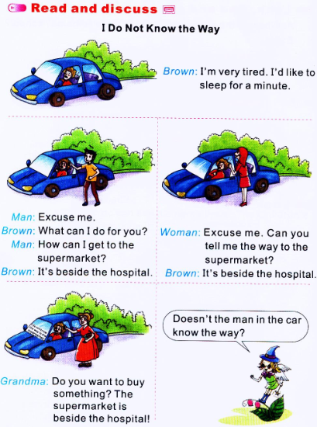

Slide 8
Role play
四人一组，分角色表演故事！
同学们表演的时候要注意人物的表情和语气哦！

Slide 9
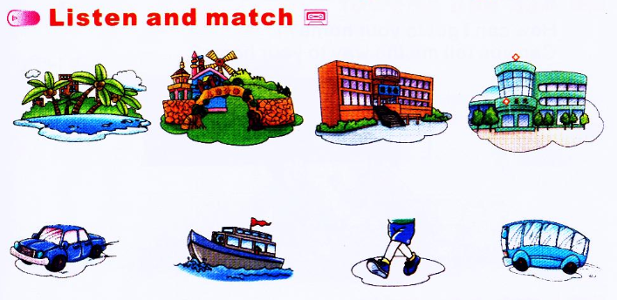

Slide 10
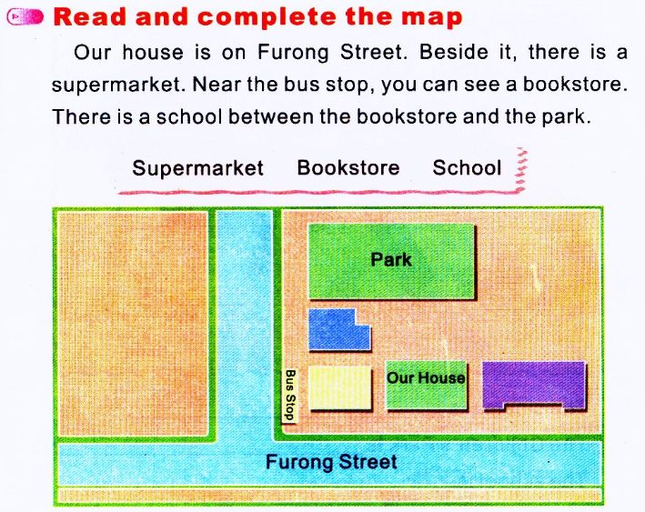
school
bookstore
supermarket

Slide 11
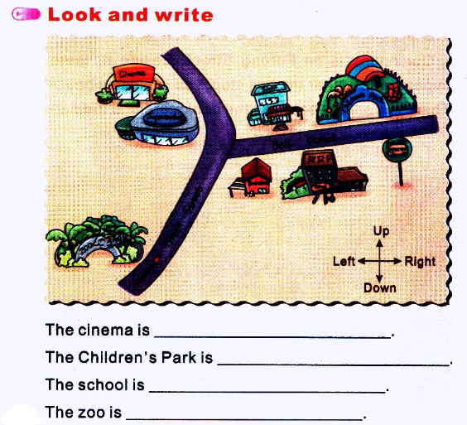

Slide 12
Let’s play(1)—字图接龙

Slide 13
Let’s play(2)—小组比赛

Slide 14
Let’s play(3)—优秀小警察

