Slide 1
Unit 2
Neighbours
WWW.PPT818.COM

Slide 2
Free talk
Where do you live?
What kind of home do you have?
Do you have any neighbours?

Slide 3
Listen and answer
Eddie and Hobe have a new neighbour,what are they going to do?
They are going to visit their new neighbours.

Slide 4
Read and answer
Will Eddie go and visit the new neighbours?
Yes ,he does.
What does Hobo think of Eddie’s visiting? Does he agree?
He doesn’t agree. He thinks the neighbours will not welcome the visitors like him.
why?
Because Eddie will …

Slide 5
Language points
Where are you going?
I am going to visit our new neighbours.
be going to do 打算做某事，将要做某事（将来时）
你打算做什么？我打算见我的新朋友。
What are you going to do?
I’m going to meet my new friends.
你们打算怎么度过周末？我们打算去看电影。
How are you going to spend your weekends?
We are going to watch a film.

Slide 6
I’m afraid they won’t welcome visitors like you.
恐怕他们不好欢迎像你这样的客人。
I’m afraid 恐怕，口语表达习惯
恐怕明天要下雨了。
I’m afraid it is going to rain tomorrow.
恐怕我妈妈没有时间陪我玩了。
I’m afraid my mother has no time to play with me.

Slide 7
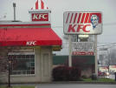
Do you know what they are and where they work?
waiter
cook
waitress
restaurant

Slide 8
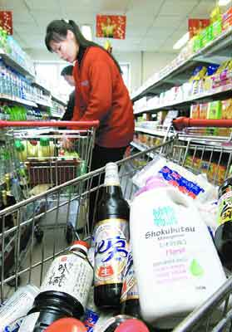
shopkeeper
shopper
supermarket/shop
cashier

Slide 9
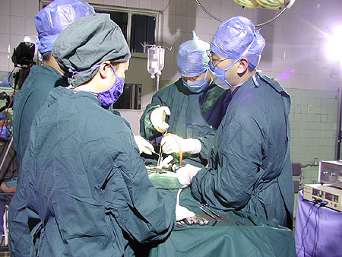
nurse
doctor
hospital

Slide 10
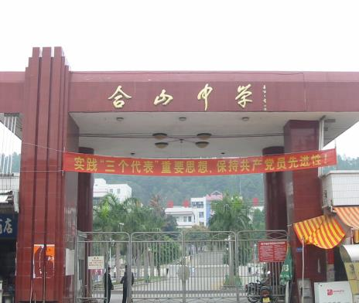
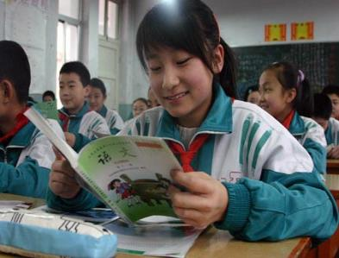
teacher
school
student

Slide 11
farmer
on a farm

Slide 12
office worker
in an office

Slide 13
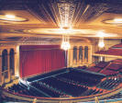
actor/actress
theatre

Slide 14
police station

Slide 15
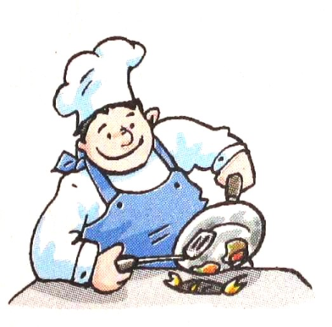
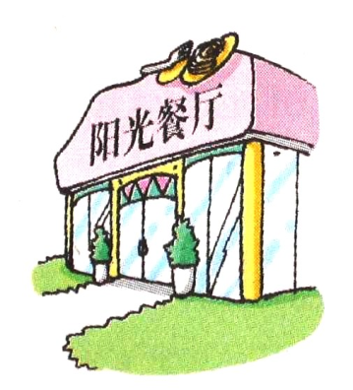
Pair work A: What is he?/What does he do?
B: Where does he work?
cook
restaurant

Slide 16
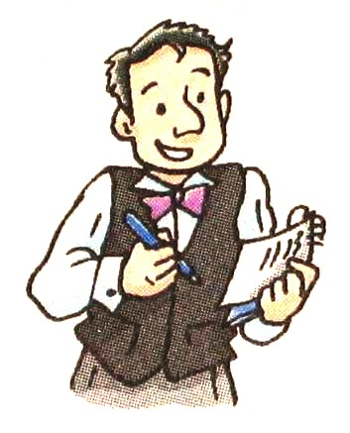
waiter
restaurant

Slide 17
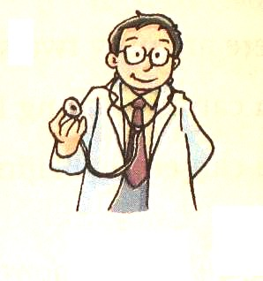
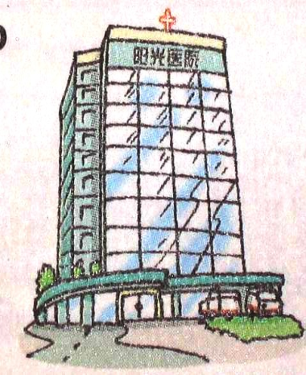
doctor
hospital

Slide 18
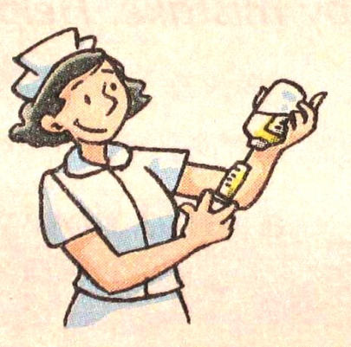
nurse
hospital

Slide 19
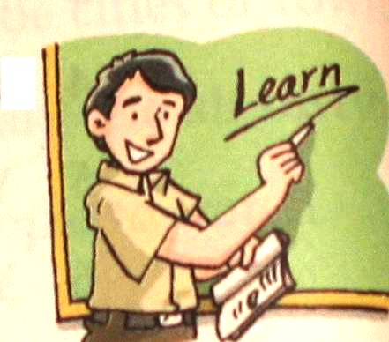
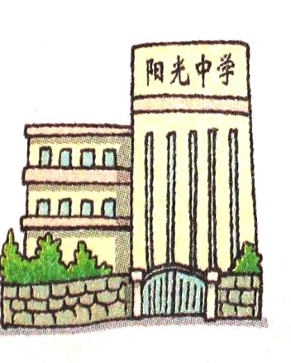
teacher
school

Slide 20
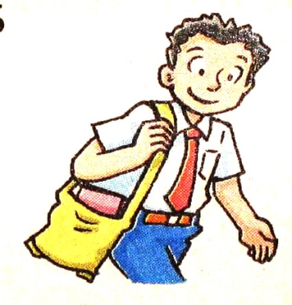
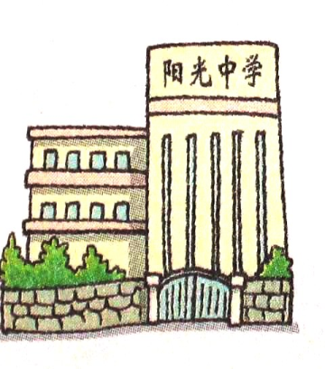
student
school

Slide 21
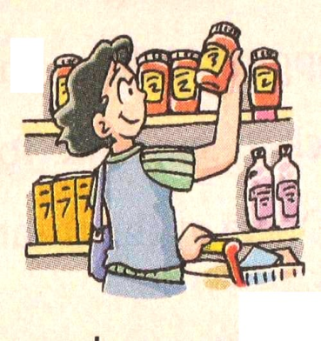
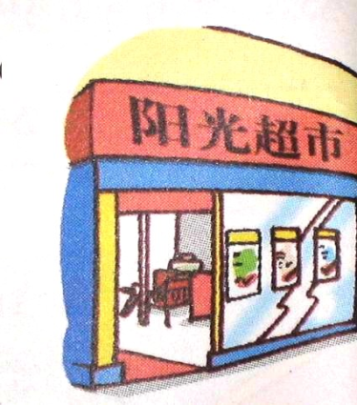
shopper
supermarket

Slide 22
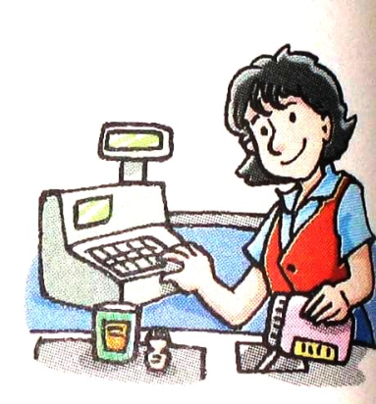
cashier
supermarket

Slide 23
A: Can you write the correct words according to the meaning of each sentence or first letters:
Mr Li is a d________. He works in a hospital.
Mr Ge is a t________. He teaches us English.
I am a s _________. I study in No.54 Middle School.
Miss Liu is a n______. Her job is to look after the sick persons.
My uncle is a c______. He works in a restaurant.
The w____ works in a fast food restaurant.
There are many s______ in the shopping mall on Sunday.
octor
eacher
tudent
urse
ook
aiter
hoppers

Slide 24
Guessing game
1.A place to go if you are sick
t ol a p h s i h_ _ p _ _ a _
2. A place to study and learn
l o c os h _c_ _ o _
3. You can buy food here.
e p t e m s r r u k a _ u _ _ _ m _ _ k _ _
4.You can eat a meal here.
u n a a t r e r s t r _ _ _ au _ _ _ _
o s i t l
s h o l
s p e r a r e t
e s t r a n t

Slide 25
5. A place to borrow books.
r i b l r a y _ _ _ _ _ _ _
6. People keep their money here .
k a n b _ _ _ _
7. You can buy stamps here.
s t o p f e o f i c _ _ _ _ _ _ _ _ _ _
8. You can watch films here.
a m c n i e _ _ _ _ _ _
l i b r a r y
b a n k
p o s t o f f i c e
c i n e m a

Slide 26
Who works in a-----?
hospital →
school →
supermarket →
restaurant →
nurse, doctor
teacher, student
shopper, cashier
waiter, waitress, cook

Slide 27
A discussion: What’s your neighbour?
A: What does your neighbour do?
B: He/She is a/an-----
A: Where does he/she work then?
B: He/She works -----.
A: What about you?
B: I want to be ---- and work -----

Slide 28
Listen and answer
Simom moves into a new flat, what’s his neighbours’ job?
Sorry ,we don’t know.

Slide 29
Read and answer
Where is Simon’s flat?
It’s in City Garden in Ninth Street.
How many buildings are there in his neighbourhood?
About 20buildings.
How many floors do the buildings have?
Most of them have 14 floors.

Slide 30
Read and answer
What does Simon have around his neighbourhoods?
Supermarket, restaurants, a school and a hospital.
What does Simon think of his neighbourhood?
He thinks it’s good to live in neighbourhood like that.

Slide 31
Check out
Translate the sentences.
1.你长大了想成为什么？一名舞蹈家。
2.恐怕我要迟到了。
3.我想住在像你的这样的房子里面。
4.你妈妈是做什么的？她是一名厨师。
5.你学校周围有什么？有超市和书店。

