Slide 1
Unit 8
Is there a post office near here?
R 七年级下册
第3课时
WWW.PPT818.COM

Slide 2
Lead-in
Do you know the meaning of the following signs?
应急避难设施( 场所)
人行横道
残疾人专用设施

Slide 3
直行车道
右转车道
左转车道

Slide 4
直行
向右转弯
向左转弯
表示一切车辆只准直行
表示一切车辆只准向右转弯
表示一切车辆只准向左转弯

Slide 5
禁止直行
禁止向右转弯
禁止向左转弯

Slide 6
直行和右转合用车道
直行和向左转弯
表示车道的行驶方向
表示一切车辆只准直行和向左转弯

Slide 7
1a
Match the words in the box with the signs.
a
c
1. _____ 2. ______ 3. ______
b
a. go along b. turn right c. turn left

Slide 8
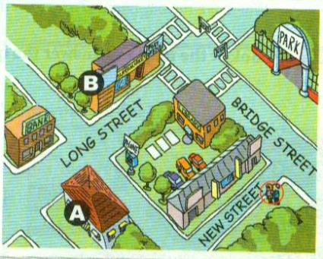
1b
Listen and write the correct place for each letter in the picture.
A ______________
B ______________
restaurant
hotel

Slide 9
1c
Listen again. Fill in the blanks.
A: Excuse me. Is there a _______ around here?
B: Yes, there is. Just go _______ Bridge Street and
turn _______ when you see the library. Go along
Long Street and it’s on the _______. It’s _______
the supermarket and across from the _______.
hotel
along
left
right
next to
bank

Slide 10
A: Thanks! And is there a restaurant near the
_______?
B: Yes. _______ along New Street. _______ right at
the first crossing and the restaurant is on your left, _______ _______ the pay phone.
A: Thank you very much.
B: You’re welcome.
hotel
Go
Turn
across from

Slide 11
Try to repeat the conversation with your partner according to the map.

Slide 12
Imagine you and your partner are the two people in the picture in 1b. Ask and answer questions about the places.
1d

Slide 13
Yes, there is. Go along Bridge Street and turn left when you see the park. Go along Long Street and it’s on the right. It’s between the hotel and the post office.
Is there a
supermarket
near here?
Thank you
very much!

Slide 14
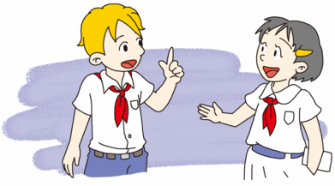
No, you should go along Bridge Street and turn left at first crossing. Go along Long Street until you can see the crossing, it’s in your left.
Where is restaurant? It’s near here?
Thank you very much!
You’re welcome.

Slide 15
Language points
1. Turn right at the first crossing and the restaurant is on
your left …
在第一个十字路口向右转，餐馆在你左边……
crossing（名词）：十字路口
在第几个十字路口向右/左转：
Turn right/left at the+ 序数词 +crossing.
= Take the+ 序数词 +crossing on the right/left.

Slide 16
Exercise
1. —Where is the Wenxin Grocery?
—_______ right ________ the second crossing.
A. Take；in B. Turn；at
C. Take；on D. Turn；to
2. He is sitting _____ my left.
A. on B. at C. in D.of
B
A

Slide 17
用所给词的适当形式填空。
1.Just ___________(go) straight and turn left.
2. ___________(be) there any people in the park?
3.Sunday is the ___________(one) day of a week.
4.The library is a good place ___________(read).
5.He ___________(like) reading, but his sister
___________ (not like) reading.
go
Are
first
to read
likes
doesn’t like

Slide 18
6.Mary wants ___________(go) to Shanghai.
7.I enjoy ___________ (work) in the city.
8.It’s the ___________ (begin) of the tour.
to go
working
beginning

