Slide 1
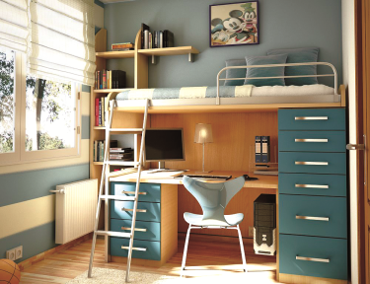
In my room
9
第二课时
WWW.PPT818.COM

Slide 2
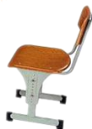
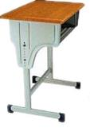
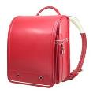
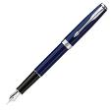
Point and say
desk
desks
chair
chairs
bag
bags
book
books
pen
pens
pencil
pencils
ruler
rulers
rubber
rubbers
pencil case
pencil cases

Slide 3
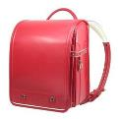
Match and say
pen
desk
book
ruler
chair
pencil
rubber
schoolbag

Slide 4
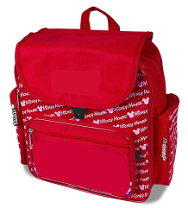
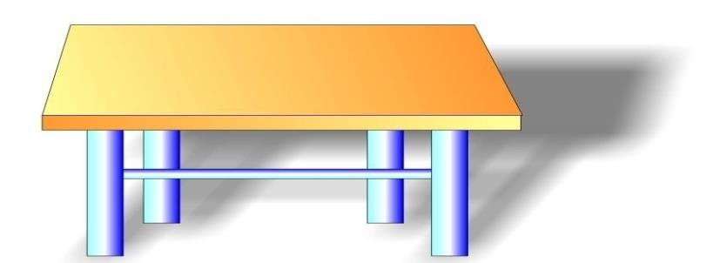
Think and say
Look! This is my … It is …
These are my … I have … They are …

Slide 5
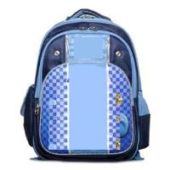
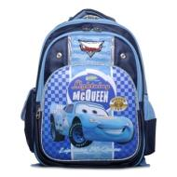
Play a game
Is this a schoolbag?
schoolbag
Yes, it is.
No, it isn’t.

Slide 6
Play a game
Is this a ruler?
pencil case
No, it isn’t.
Yes, it is.

Slide 7
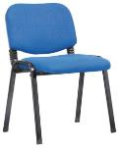
Play a game
ruler
rubber
chair
S1: Is this a _______?
S2: Yes,_____. / No, ______.
Yes, it is.
No, it isn’t.

Slide 8
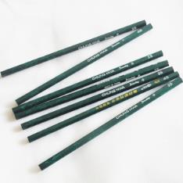
Play a game
Are these pencils?
pencils
Yes, they are.
No, they aren’t.

Slide 9
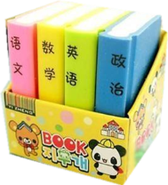
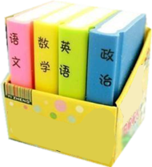
Play a game
Are these books?
rubbers
Yes, they are.
No, they aren’t.

Slide 10
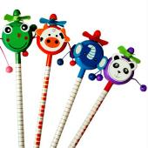
Play a game
desks
books
pencils
S1: Are these _______(s)?
S2: Yes, _____. / No, ______.
Yes, they are.
No, they aren’t.

Slide 11
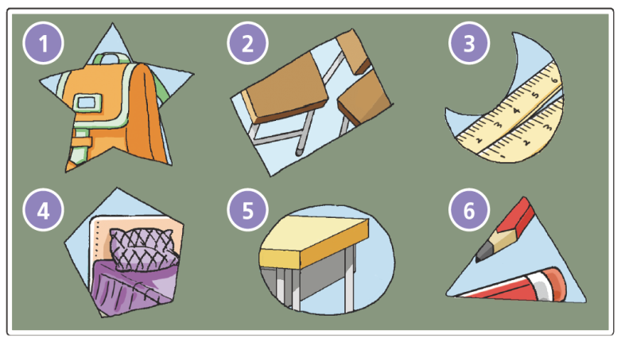

Slide 12
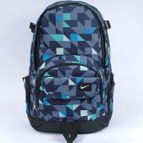
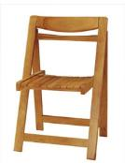
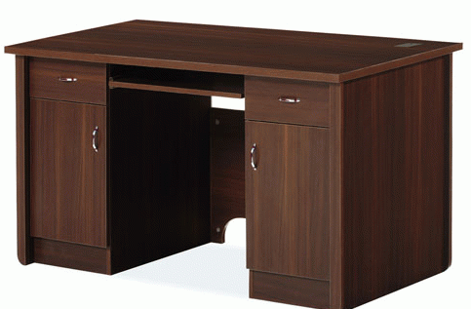
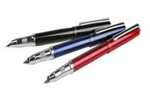
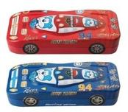
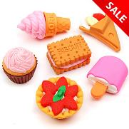

Slide 13
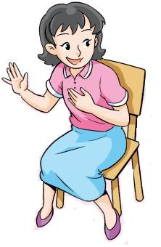
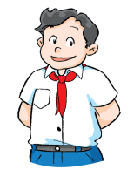
Ask and answer
Is this your book?
This is my book.
No, it isn’t.
Yes, it is.

Slide 14
Ask and answer
These are my pencils.
Are these your pencils?
Yes, they are.
No, they aren’t.

Slide 15
Ask and answer
Whose
S1: Is this your _____?/Are these your ____(s)?
S2: Yes, _____. / No, ______.
Yes, it is.
Yes, they are.
No, it isn’t.
No, they aren’t.

Slide 16
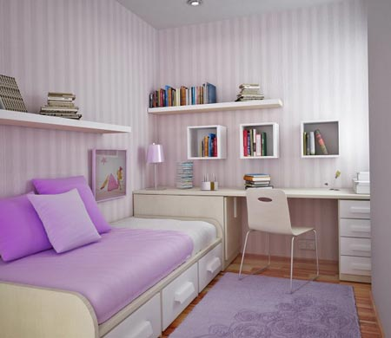
Ask and answer
Q: What’s in the room?
desk
books
chair
bed

Slide 17
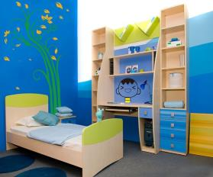
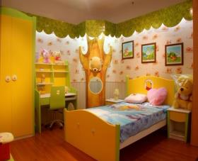
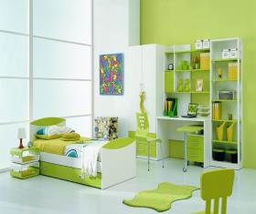
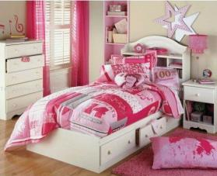
Ask and answer
Q: Which room do you like?

Slide 18
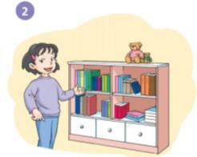
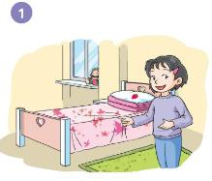
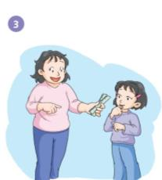
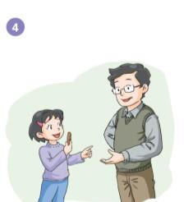
Ask and answer
Who’s she?
Are these books?
What’s this?
What’s this in her hand?
What are these?
Is this Dad’s pen?
Are these Mum’s rulers?

Slide 19
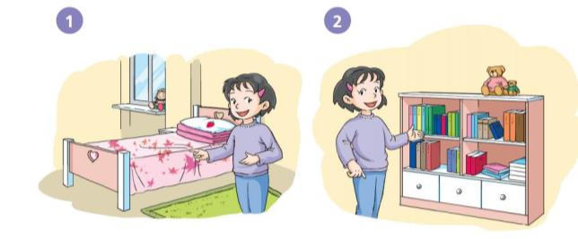
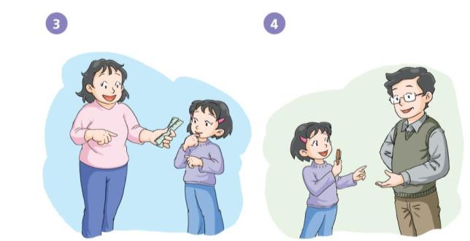
Say and act

Slide 20
Say and act
This is my …
A new dialogue
These are my …
S1
Is this your …?
Thank you.
No, they aren’t.
S2
Yes, it is.
No, it isn’t.
Here you are.
S3
Yes, they are.
Are these your …?

Slide 21
Homework
1 Copy the sentences.
This is my room. This is my book.
These are my books. These are my rulers.
Yes, it is. No, it isn’t.
Yes, they are. No, they aren’t.
2 Rewrite the sentences.
e.g., This is my desk. → Is this your desk?
These are my pens. → Are these your pens?

