Slide 1
Unit 4 Topic 3 China is the third nation that sent a person into space.
Section C
WWW.PPT818.COM

Slide 2
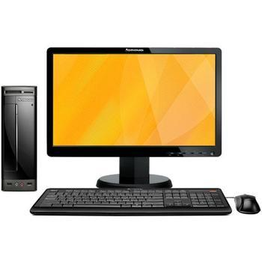
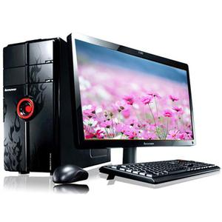
What are the computers used for?

Slide 3
1a 1. Tick the fields we use the computer in.
education business
industry communication
daily life medical care
entertainment sports

Slide 4
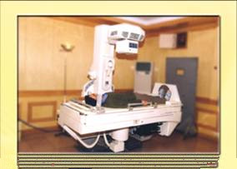
Can you give an example of the use of the computer in one of the fields above?
Doctors can find diseases easily with the help of computers.

Slide 5
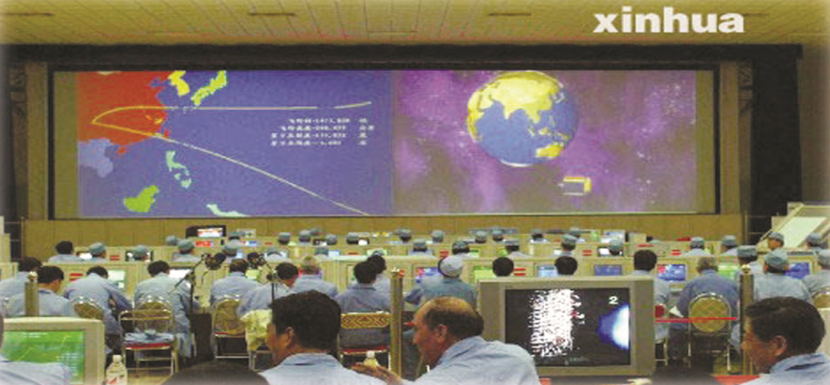
In space, computers have been used to control the speed and direction of a spaceship.

Slide 6
What is the passage about ?
The Importance of Computers

Slide 7
Underline the topic sentence of each paragraph.
1. Since computers were invented in the USA in the 1950s, they have become very important in many areas of work and leisure.
2. Since the Internet came into being, people’s lives at home have been changed, too.
3. Computers have improved our lives, but they have brought problems, too.

Slide 8
Paragraph 1
Place | The usage of computers
In space
In hospitals
In factories
In business
control the speed and direction
find diseases easily and solve other problems
do dangerous work
used to place and cancel orders

Slide 9
1.There is no doubt that computers are very useful in
technology and business.毫无疑问电脑在技术和贸易业都非常有用。
doubt n. & v. 怀疑，疑惑
Doubt is the key to knowledge.
(1)doubt (n.)
There is no doubt that we will be successful.
I doubt whether/if he'll change his mind.
(2)doubt (vt.)+ 从句
I don't doubt that they will be able to solve the problems.
(3)doubt (vi.)+ about / of
There is no reason to doubt of his honesty.
Paragraph 1

Slide 10
prep.在……内
adv.在里面
Paragraph 1
2.For example , tiny computers which are inside patients’ bodies can keep their hearts beating normally.例如，病人体内植入微电脑能帮助病人的心脏正常搏动。
tiny very small in size adj. 极小的，微小的
64英寸 超大型（Huge）
32英寸 大型（Large）
16英寸 中型（Medium）
8英寸 小型（Small）
4英寸 超小型（Tiny）
a tiny girl

Slide 11
Language points
Paragraph 2
3.The whole world is connected.网络连接了全世界。
connect v. 连接
connection n. 关系，联系
1.connect A with B 使A与B连接
2.connect sth. (to sth.) 使电、气、水等接通
3.connect sb./sth. (with sb./sth.) 与……有联系，把……联系起来

Slide 12
Paragraph 2
come into being
more and more
watch movies
thanks to
do business
instead of
chat online
make the world smaller
做买卖
形成，产生
越来越多
看电影
代替
网上聊天
使世界更小
多亏，由于

Slide 13
Paragraph 3
1. For instance, if we work on computers too long, we may get headaches or sore eyes.比如：如果我们使用的电脑工作的时间太长，我们就会头昏眼花。
for instance =for example 用来举例说明某一论点或情况，一般只举同类人或物中的“一个”为例。
such as 用来列举事物时，一般列举同类人或事物中的几个例子。 E.g.
（1）Many countries, Japan, for instance (for example),
has a lot of earthquakes.
（2）I like fruits, such as apples, pears and bananas.

Slide 14
2. Besides, not everything we read on the Internet is true or good for us.另外，我们在网上看到的东西并不都是真实的、有益的。
(1)besides与except用于肯定句时，except意为“除……之外（不
再有）”；besides意为“除……之外（还有）”。 如：
I have another blue pen besides this one. 除了这支外，我还有另一支蓝色钢笔。（1+1，共2支） We all passed the exam except Tom. 我们都通过了考试，汤姆除外。（整体中……汤姆一人不及格）
(2)except前几乎总有all、any、every、no及其复合词等词。如： He answered all the questions except the last one. 除了最后一个问题没答外，其余问题他都答了。
(3)except后接名词、代词、动名词和动词原形，这时except=but； 但except后跟副词、介词短语时，不能用but代替。如： The window is never open except in summer.
这扇窗户从来不开，除夏季外。 He did nothing except/ but clean the house.
他只是打扫了房子。

Slide 15
1a Read and understand.
动画1a

Slide 16
1b 2. Complete the following diagram.
control the speed and direction
____________________________ of a spaceship.
help doctors _____________________________.
_______________________________ in factories.
help businessmen _____________________.
find diseases easily
work
control the robots
place and cancel orders
usage
watch movies
play games and __________________________.
_______________ and _____________ at home.
___________________ by sending e-mails and _______________________________.
do shopping
do business
daily life
computers
communicate
chatting online
get headaches or _____________________.
don’t have enough time __________________.
something on Internet is not ________________.
sore eyes
problem
to study or exercise
true or good
Retell it!

Slide 17
properly, besides, brought, get, enough
Exercise
Computers have improved our lives, but they have _______problems, too. For instance, if we work on computers too long, we may _____ headaches or sore eyes. If we play computer games too much, we won’t have ______ time to study or exercise. ______ , not everything we read on the Internet is true or good for us. Computers help us at work and at home, but they must be used _______.
brought
get
enough
Besides
properly

Slide 18
2 Write a short passage with the title with One Day Without Computers. The following information may help you. Suppose you were on a special day in 2030. During the day, there were no computers in the world. What trouble would you have? You may begin like this:
One Day Without Computers
Today, when I got up, I just turned on the computer as usual, but it didn’t work. Then I tried my brother’s PC, my parents’, even my dog’s, but none of them worked. Later, it was reported on TV that all of the computers in the world broke down today…

Slide 19
One Day Without Computers
Today, when I got up, I just turned on the computer as
usual, but it didn’t work.
Then I tried my brother’s PC, my parents’, even my dog’s,
but none of them worked. Later, it was reported on TV that all
of the computers in the world broke down today. So the world
is quite different. For instance, we can’t play games, watch
movies or do shopping at home. Besides, we can’t
communicate by sending e-mails or chatting online. Without
the help of computers, businessmen can’t place or cancel
orders online. Teachers can’t give lessons to their students.
What’s worse, robots controlled by computers can’t do
dangerous work for humans. Even the doctors can’t find the
diseases easily.
In short, we almost have trouble with everything without
computers today.
You can write it like this:

Slide 20
Summary
We learn: 1. Some words: doubt, tiny, inside, brain,
cancel, connect
2. Some phrases: no doubt, for instance
3. Some sentences:
(1) There is no doubt that computers are very
useful in technology and business.
(2) Computers help us at work and at home, but
they must be used properly.
We can: 1. Talk about the importance of computers.
2. Write a composition by using our imagination.

Slide 21
Assignment
Read 1a.
Memorize the useful expressions and key sentences which we learned today.
Finish Section C in your workbook.
Review Sections A-C.

