Slide 1
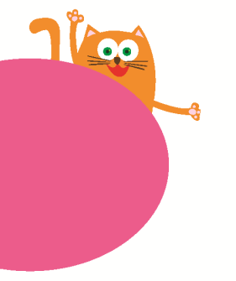
Hello!
1
第三课时
WWW.PPT818.COM

Slide 2
Quick Response
(反应大比拼）
游戏规则：
图片抽到的人，需迅速起立用英语跟大家打招呼并自我介绍。

Slide 3
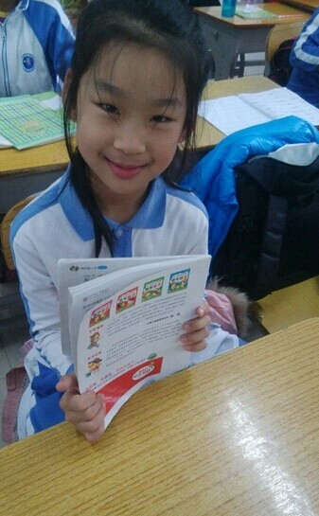
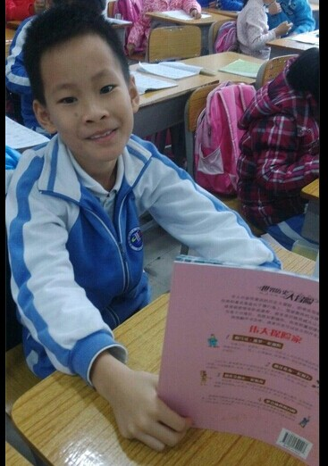

Slide 4
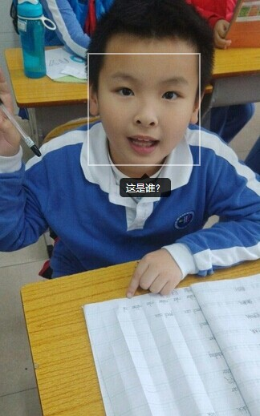
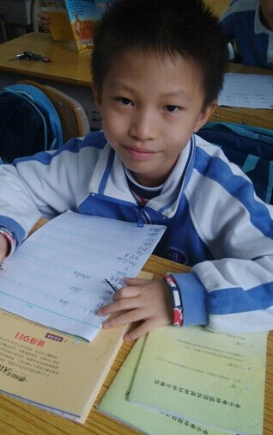

Slide 5
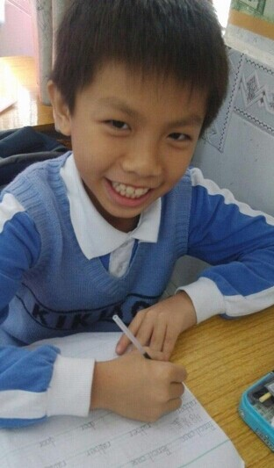
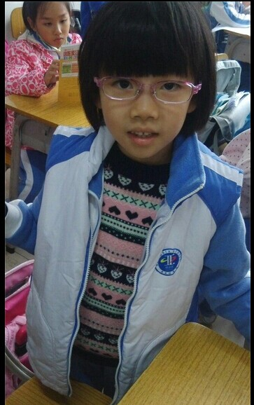

Slide 6
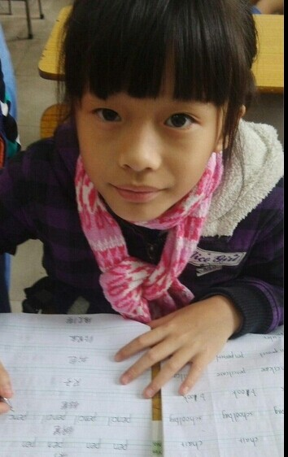
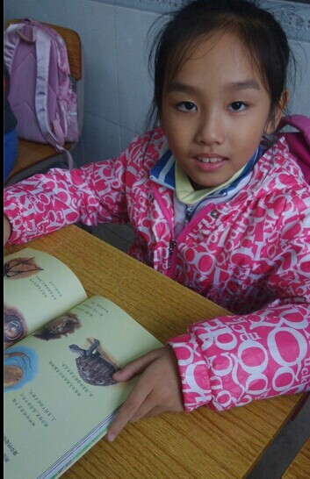

Slide 7
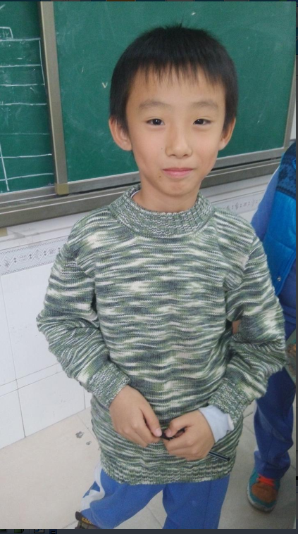
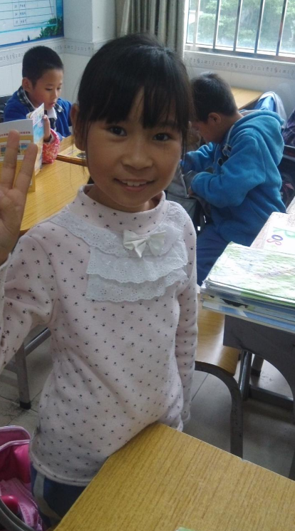

Slide 8
Sing a song!

Slide 9

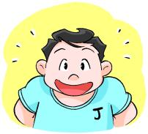

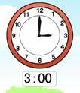

Hello, hello! I am Joe.
Good morning, good morning.
Hello, hello, I am Joe.
Good morning to you.
Hello, hello! I am Kitty.
Good afternoon, good afternoon.
Hello, hello, I am Kitty.
Good afternoon to you.

Slide 10




Make a song!
Hello, hello! I am ________.
Good _______, good ________.
Hello, hello, I am _______.
Good ________ to you.

Slide 11


Alice
A
a

Slide 12
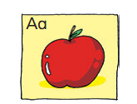
apple
a-p-p-l-e
Notes:
12

Slide 13
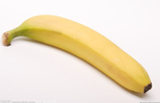

Banana
B
b

Slide 14

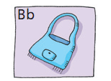
bag
b-a-g
Notes:
14

Slide 15

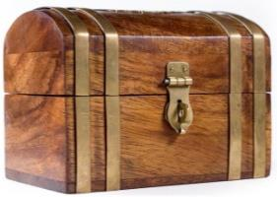
Look and circle
a
ant
Joe
A
Alice
boy
b
dog
bike
b
apple
a
Peter
big
Kitty
b
B
Ben
Notes:
15

Slide 16



Attention!(好消息）
Reporter Wanted
（小记者招募）
Time(时间）：4 pm
Place（地点）: Meeting Room
Join us~ 加入我们吧

Slide 17
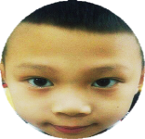



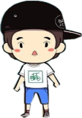



Reporter Wanted（小记者招募）
Our school needs some reporters，Leo and his friends want to join it.But they need to pass three rounds,can you help them?
学校招募小记者，Leo和朋友们准备去竞选，
他们需要通过三关，你可以帮助他们吗？

Slide 18
Round 1
1. 见到面试官黎老师，你可以说：
A. Hello, Mr Li. B. Hello, I am Mr Li.
2. 如果是在早上面试，见到面试官黎老师还可以说
Good moring, Mr Li.
3. 如果黎老师想问你几岁了，可以说：
A. How old are you? B. How are you?
4. 如果黎老师想问你喜欢什么，可以说：
A. What do you like? B. What can you do?
5. 如果黎老师想问你能做什么，可以说：
A. What do you like? B. What can you do?

Slide 19
Watch and think
How’s a interview going?
看一看，想一想面试是怎样进行的？

Slide 20
Round 2: Pair work: role play
A -面试官interviewer
B - 面试者interviewee
A：Good morning.
B: Good morning. I’m…
A ： How old are you?
B : I am ..... ( 数字）
A: What do you like?
B: I like .... (apples / football / blue…)
A: What can you do?
B: I can .... ( run / write / skip / draw...)

Slide 21
Round 3:
Write and say
Self-introduction
（自我介绍）
Hello, I am ________.
I am ______ .(几岁）.
I like __________.
I can __________.
Thank you.

Slide 22
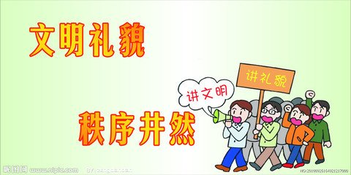
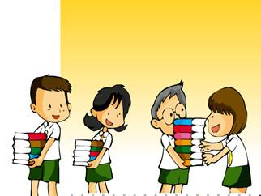
Politeness is a habit.
To be a polite people.
礼貌是一种习惯。
做一个讲礼貌的人。

Slide 23

Homework
1. 写一个自我介绍
2. 找一找生活中含有a,b的物品单词。
Notes:
23

