Slide 1
陕旅版英语五年级上册
Unit6 How Much Is It?
第3课时
WWW.PPT818.COM

Slide 2
教学目标
1. 能听懂、会说句型Can I help you? Yes. I would like ... How much are they? We’ll take them.并能用这些句型进行交流。
2. 小组合作，能完成Part B Let’s learn more部分的对话表演。
3. 能在教师的组织下，完成Part B Let’s play部分的活动。

Slide 3
Chant together

Slide 4
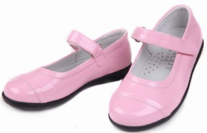
Miss Li
教师拿出一双童鞋、一双成人鞋，引入话题，导入新课
20码
26码
24码

Slide 5
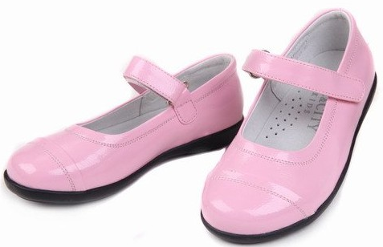
教师拿出一双童鞋、一双成人鞋，引入话题，导入新课
They look too small for her.

Slide 6
They look too big for her.

Slide 7
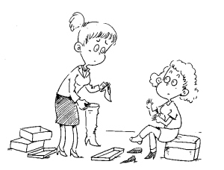
What should I do?
I would like to buy a pair of new shoes.
Let’s go shopping.

Slide 8
Let’s learn more
How much are the shoes?
老师提醒同学们带着问题听课文录音
Why don’t they buy the blue ones?

Slide 9
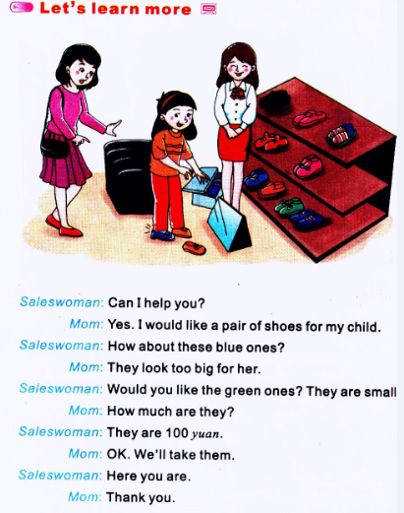

Slide 10
How much are the shoes?
They are 100 yuan.
Why don’t they buy the blue ones?
They are too big.

Slide 11
课文应用：
---Can I help you?我能帮助您吗？
---Yes. I would like a pair of shoes for my child.
我想给我的孩子买一双鞋。
I would like…for…
我想为……买……

Slide 12
Role play
同桌之间分角色扮演妈妈和售货员，看哪组表演的好！

Slide 13
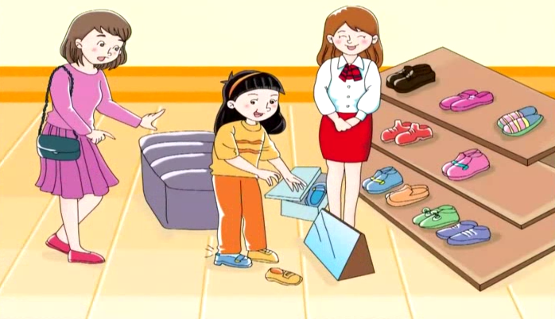
观看动画并大声跟读

Slide 14
Let’s play—跳骚市场

Slide 15
我是小编剧
用简单的语言把一次真实的购物经历编成一段对话

