Slide 1
Unit 7 Know Our World
Let’s Learn Geography!
WWW.PPT818.COM

Slide 2
Learning Targets
Key words:
population, abroad, Japan, Japanese, Antarctica, island, Pacific, learn about, be abroad
Key sentences:
1. Do you like to study geography?
2. Recently, we have learned about the population of the world.
3. I think travelling is a good way to learn geography.

Slide 3
4. Have you ever been abroad, Danny?
5. They speak Japanese in Japan, not Chinese.
6. He has been to every continent except Antarctica.
7. It’s fun to travel.
8. I can’t wait to go！
Grammar: present perfect tense

Slide 4
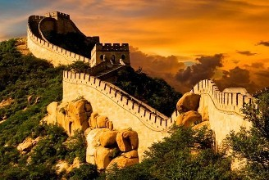
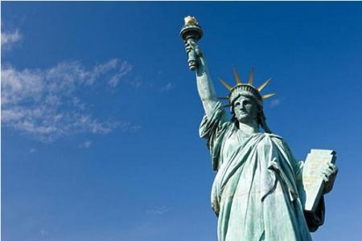
Warming up
Can you name the places?
The Great Wall in China
The Statue of Liberty in America

Slide 5
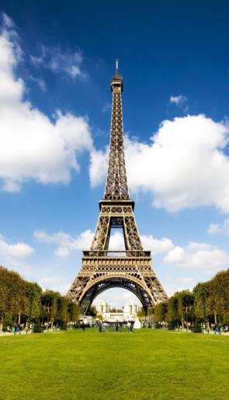
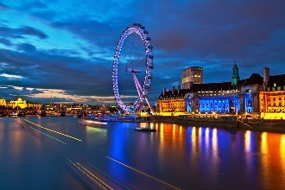
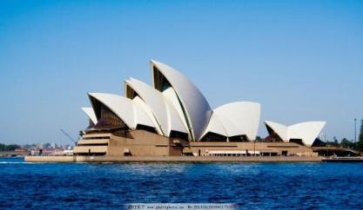
The London Eye in England
The Eiffel Tower in France
The Sydney Opera House in Australia

Slide 6
Words and expressions
population
abroad
Japan
Japanese
n. 人口
adv. 到国外；在国外
n. 日本
n. 日语；日本人
adj. 日语的；日本人的

Slide 7
Antarctica
island
Pacific
learn about
be abroad
n. 南极洲
n. 岛；岛屿
n. & adj. 太平洋（的）
了解
在国外

Slide 8
THINK ABOUT IT
What places would you like to visit？Why？
Do you like to study geography？Why or why not？

Slide 9
Presentation
Listen and read
Jenny: I really like to study geography. In geography class, we learn about rivers, mountains and oceans. We also learn about countries and cities. Recently, we have learned about the population of the world.
Brian: I think travelling is a good way to learn geography. Have you ever been abroad, Danny?
Danny: Yes. Jenny and I have been to China twice.

Slide 10
Brian: That’s great! Have you been to any other countries in Asia?
Danny: No, but maybe I will go to Japan one day. I could talk to the people there. I speak a little Chinese.
Jenny: They speak Japanese in Japan, not Chinese.
Danny: Oh, I see! Have you ever been abroad, Brian?
Brian: I’m abroad now! I’m from the U.K., remember?
Danny: Oh, yes. Have you visited any other countries?

Slide 11
Brian: No, but my father has travelled a lot. He has been to every continent except Antarctica.
Danny: Really? That’s cool!
Jenny: My mother has a friend from an island in the Pacific. She has gone to visit her.
Danny: It’s fun to travel. I can’t wait to go!

Slide 12
Let’s Do It!
1
Which countries have they been to？Listen and tick the country that each person has visited.
Jenny | China | the U.K.
Danny | China | Japan
Brian | the U.S. | Canada

Slide 13
2
Read the lesson and write true (T) or false (F)．
Brian wants to visit Japan someday.
( )
2. Jenny has never been to any Asian countries.
( )
3. Brian’s father has travelled to several different continents.
( )
4. Danny’s mother has a friend in Antarctica.
( )
F
F
T
F

Slide 14
3
Fill in the blanks with the words in this lesson. The first letter is given.
population
A: Which country has the largest ___________?
B: China, of course.
2. A: Is Taiwan an _________?
B: Yes. It is in the Pacific.
3. A：I like all fruits __________ bananas.
B：Really? I don’t like them, either.
4. Mr. Wang has gone __________, so I won’t see him this week.
5. The people in Japan speak ___________.
island
except
abroad
Japanese

Slide 15
What country or place are you most interested in? Search the Internet and find some facts about it. Then share your information with the class.
4
Task tips: Have you ever been there? What language do people speak there? Describe some places of interest.

Slide 16
Language points
1. Do you like to study geography?
geography n．地理(学)
例: The students in the classroom are learning geography.
教室里的学生正在学习地理。

Slide 17
2. Recently, we have learned about the population of the world.
1) Learn about 了解
2) population n．人口
它是集合名词，是人口的总称，没有复数形式。使用时要注意以下四点：
①表示 “某地有多少人口”，常使用固定结构：
Sp. has a population of…＝The population of sp. is…

Slide 18
例：The population of Canada is 35 million.
＝ Canada has a population of 35 million.
加拿大有三千五百万人口。
② “人口的多/少” 用形容词large/big或者small来表示，不能用many/much或few/little。
例: China has a large/big population.
中国人口众多。
③population在句中作主语的时候，谓语动词使用单数形式。

Slide 19
例：The population of China is more than 1.3 billion. 中国的人口超过13亿。
④询问人口多少的句型：
What’s the population of…？/ How large is the population of…？
注意：不能用how many或how much来对人口数量进行提问。
例: What’s the population of India？
印度人口有多少？

Slide 20
学以致用
1. The population of the world ______ getting larger and larger.
2. China is a country with a ______ population. (多)
3. Japan is a country with a _______ population. (少)
4. Our city has a population _____ two million.
What’s the population _____ Beijing?
is
large
small
of
of

Slide 21
3. I think travelling is a good way to learn geography.
该句是一个含宾语从句的复合句，在宾语从句中，travelling是动名词作主语，其后的谓语动词用单数形式；to learn geography 为动词不定式短语作后置定语，修饰a good way。
例：Learning English well is good for our future.
学好英语对我们的未来有好处。

Slide 22
4. Have you ever been abroad, Danny?
abroad adv.在国外，到国外，出国
固定搭配：go abroad 去国外
be abroad在国外
例: Lucy’s sister has been abroad for several months.
露西的姐姐已经在国外待了几个月了。
I have never been abroad.
我从未去过国外。

Slide 23
5. They speak Japanese in Japan, not Chinese.
Japanese n．日语；日本人
当其作 “日本人” 讲时，单复数同形。
例：I can’t speak Japanese.
我不会说日语。
These Japanese are visiting the Great Wall.
这些日本人正在参观长城。

Slide 24
6. He has been to every continent except Antarctica.
【辨析】except、besides、except for与but
except | 意为“除了”，表示从整体中除去同类事物。
besides | 意为“除了……之外还有”，表示包括所排除事物在内。
except for | 意为“除了”，用于对某种基本情况进行具体细节方面的修正，排除不同类事物。
but | 意为“除了”，只能用在no、none、nobody等词之后。

Slide 25
例：Everyone is here except Ben.
除了本之外，大家都在这儿。
I like maths besides physics.
除了物理，我还喜欢数学。
Your English handwriting is good except for a few spelling mistakes.
除了几处拼写错误之外，你的英语书写很好。
There is nothing but a card in the box.
除了一张卡片之外盒子里什么也没有。

Slide 26
7. It’s fun to travel.
该句的句型结构为：It‘s(＋not)＋adj.＋to do sth.
意为“做某事(不)是……的”。
其中it 作形式主语，is是系动词，fun作表语，后面的动词不定式短语作真正的主语。
例：It’s important to protect the environment.
保护环境很重要。

Slide 27
8. I can’t wait to go!
can’t wait to do sth. 迫不及待要做某事。
例：I can’t wait to open my birthday gifts.
我迫不及待要打开我的生日礼物。

Slide 28
Grammar
现在完成时
现在完成时表示过去发生或者未发生的事对现在造成的影响或结果。

Slide 29
1. Recently, we have learned about the population of the world.
2. Have you ever been abroad, Danny?
3. Jenny and I have been to China twice.
4. Have you been to any other countries in Asia?
5. Have you visited any other countries?
6. He has been to every continent except Antarctica.
7. She has gone to visit her friend.

Slide 30
现在完成时——构成
肯定句：主语 + have / has + 过去分词 + 其他。
否定句：主语 + haven’t / hasn’t + 过去分词 + 其他。
一般疑问句：Have / Has + 主语 + 过去分词 + …？
肯定答语：Yes, 主格代词 + have / has.
否定答语：No, 主格代词 + haven’t / hasn’t.

Slide 31
现在完成时——用法
1. 表示动作到现在为止已经完成或刚刚完成。
例：He has turned the light off .他已把灯关了。
2. 动作发生在过去，强调对现在的结果、影响等。
例：He has been away from the city.
他已离开这个城市。(结果：他不在这个城市。)
I have lost my pen.
我把钢笔丢了。(结果：我现在无钢笔用。)

Slide 32
3.表示动作发生在过去，并且一直持续到现在，甚至还可能继续下去，句中使用持续性动词，且常与表示一段时间的时间状语连用。
例：He has taught in our school for 30 years.
他在我们学校教书已有30年了。
He has been busy since last week.
自上个星期以来他一直很忙。

Slide 33
现在完成时时与since和for连用
1. 现在完成时 + since + 时间点状语(名词、短语、从句，其中从句用一般过去时)
例：He has worked for us ever since he left school. 他离开学校以后就一直为我们工作。
2. 现在完成时 + for + 一段时间状语
例：He has had this book for two months.
他买这本书已有两个月了。

Slide 34
现在完成时——标志词
already, yet, just, ever, never
1. already 已经，常用于肯定句中。
例：I have already seen the film.
我已经看过这部电影了。
2. yet
1) 已经，常用在疑问句中。
例：Has Linda read the book yet?
琳达已看过这本书了吗?
2) 还，仍然，常用于否定句和疑问句。

Slide 35
例：He has not begun to work yet. 他还未开始工作。
3. just 刚刚，常用于肯定句中
例：I have just finished lunch. 我刚吃过午饭。
4. never 从来没有，表示否定
例：He has never seen such a tall building.
他从未见过这么高的楼。
5. ever 曾经，主要用于疑问句
例：Have you ever wanted to travel around the world?
你曾经想要周游世界吗？

Slide 36
现在完成时——拓展
have / has been to 到过某地，已回
have / has been in + sp. 一段时间待在某地
have / has gone to 去了某地，未回
例:他去过巴黎三次。
He has been to Paris three times.
他去看他叔叔了。
He has gone to see his uncle.
我已经在伦敦待了两年了。
I’ve been in London for two years.

Slide 37
学以致用
根据提示完成下列句子。
1. I ______ already ______ (see) the film. I ______ (see) it last week.
2. — ______ he ________ (finish) his work today?
— Not yet.
3. My father ______ just _______ (come) back from work. He is tired now.
4. — Where’s Li Ming?
— He ________ (go) to the teacher’s office.
have
seen
saw
Has
finished
has
come
has gone

Slide 38
Exercises
一、根据句意及汉语提示完成下列句子。
I have a _________ (日本) friend, and she comes from _________ (日本).
2. The __________ (人口) of our city is 2,000,000.
3. How many __________ (岛) are there in your country?
4. The _________ (太平洋) Ocean is the largest ocean on the earth.
5. Does your uncle live __________ (在国外)?
Japanese
Japan
population
island
Pacific
abroad

Slide 39
二、单项选择
—_______ the population of China?
—1.3 billion. Everyone knows China has the ________ population in the world.
A. What is; most B. What is; largest
C. How many; most D. How many are; largest
2. —How long has he _______?
—About two years.
A. be abroad B. go abroad
C. been abroad D. gone abroad

Slide 40
3. All the people went home _______ Mr. Wang, for he had to finish his work.
A. with B. besides C. except D for
4. —May I speak to Mr. Wang?
—Sorry, he _______ to the city.
A. went B. goes C. has gone D. has been
5. —Have you _______ read the poem?
—Yes, I really enjoy it.
A. still B. ever C. yet D. never

Slide 41
三、连词成句
they, one succeed, will, day (注意词形变化)
____________________________________.
2. would, what, you, like, to, places, visit (注意词形变化)
____________________________________?
3. I, her, about, very, learn, much
_____________________________________.
4. can’t, I, wait, open, to, the, gift
_____________________________________.
5. you, in, have, to, other, been, country, any, America (注意词形变化)
__________________________________________?
They will succeed one day
What places would you like to visit
I learn about her very much
I can’t wait to open the gift
Have you been to any other country in America

Slide 42
Summary
1. Learn some new words and expressions.
2. Learn to talk about the places which you have been.
3. Master the present perfect tense.

Slide 43
Homework
1. Recite the words and phrases in this lesson.
2. Complete the related exercises.
3. Search for more information of a foreign country.
4. Preview next lesson

