Slide 1
Unit 2 Good Behaviour
They are in the zoo.
WWW.PPT818.COM

Slide 2
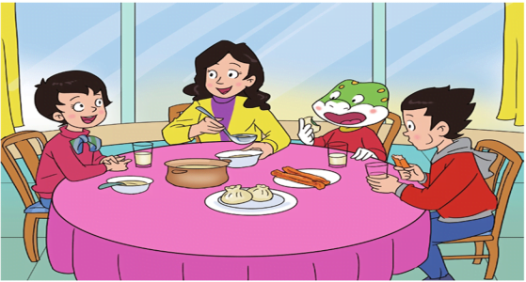
Recall it .
They wanted to go to the zoo.

Slide 3
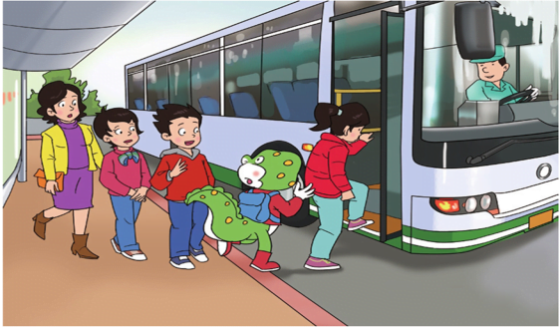
Recall it .
Then they got on the bus.

Slide 4
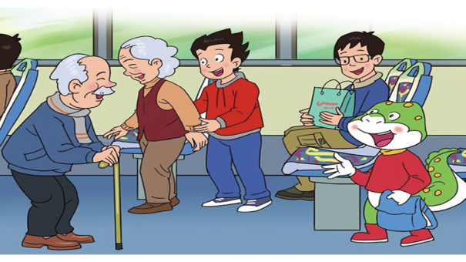
Recall it .
Li Ming took his seat for grandma.
Danny took his seat for grandpa.

Slide 5
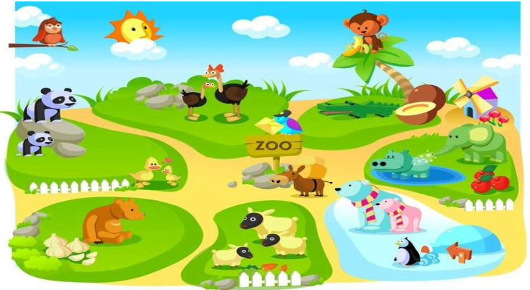
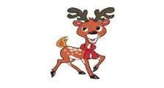
Watch and choose
What animals did they see?

Slide 6
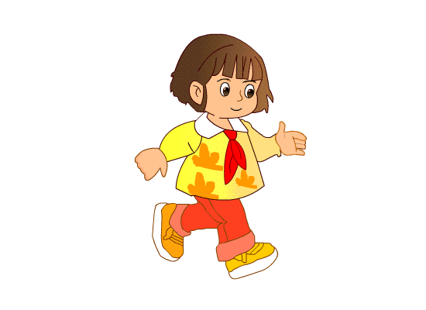
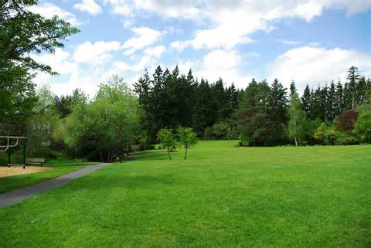
walk
grass

Slide 7
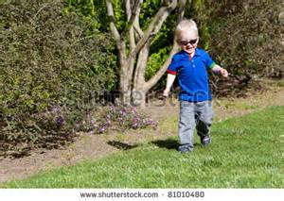
Don’t walk on the grass.

Slide 9
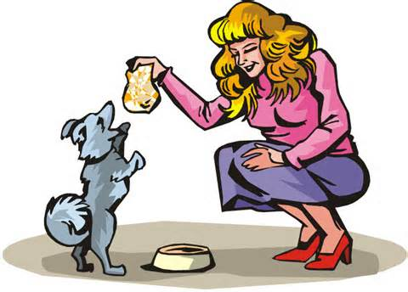
feed

Slide 10
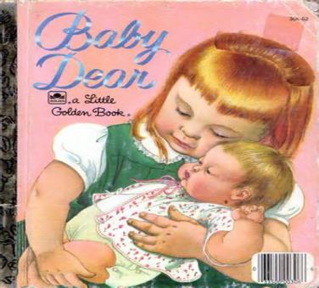
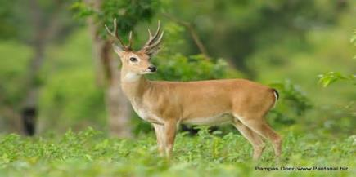
deer
dear

Slide 11
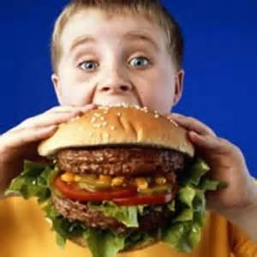
too much

Slide 12
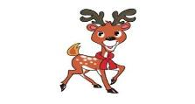
Watch and choose
What animals did they see?
pandas
deer

Slide 13
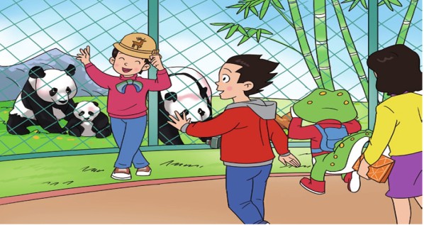
Look and say
There are three pandas in the zoo.
Li Mei is happy to see them.

Slide 14
Read and fill
（自读第一段）
What does Li Mei want to do?
She wants to ____________ with the pandas.
take a picture

Slide 15
Read, find and underline
（读一读，找一找，划一划）
What does Li Mei say?
Let’s take a picture with them.
What does Li Ming say?
OK. But don’t walk on the grass.

Slide 16
talk
（谈话，交谈）
walk
（走，行走）
salk
（沙克疫苗）
balk
（阻止）

Slide 17
walk
They ____ to school.
walk
It marks the _____.
（标志）

Slide 18
Read, find and underline
（读一读，找一找，划一划）
What does Li Mei say?
Let’s take a picture with them.
What does Li Ming say?
OK. But don’t walk on the grass.

Slide 19
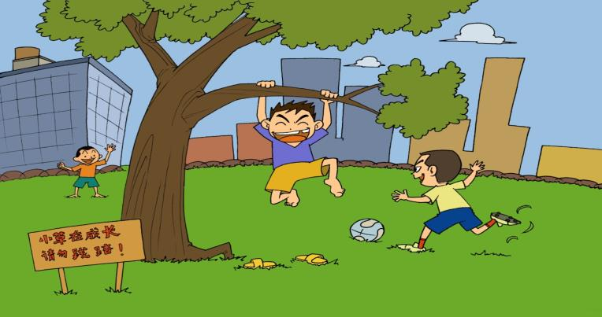
walk on the grass
Don’t _______________.

Slide 20
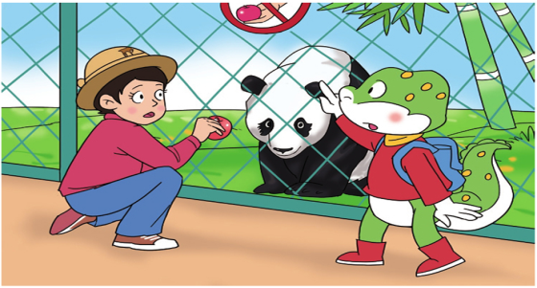
Look and fill
A panda comes to them.
give
Li Mei wants to ____ it an apple.
（给）

Slide 21
Read, find and underline
（读一读，找一找，划一划）
（自读第二段）
What does Danny say?
Don’t feed it, please.

Slide 22
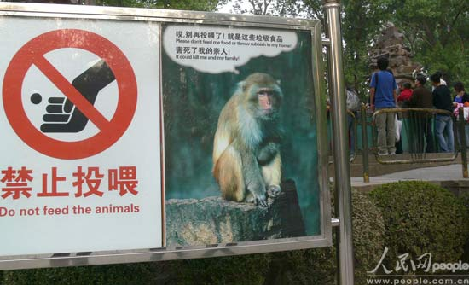
Don’t ____ the monkeys, please!
feed

Slide 23
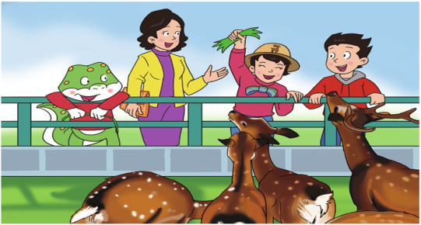
Look and fill
deer
They go to see the ____.
grass
Li Mei ____ them some _____.
gives
（给）

Slide 24
Read, find and underline
（读一读，找一找，划一划）
（自读第三段）
What does Li Mei’s aunt say to her?
Don’t feed them too much, my dear.

Slide 25
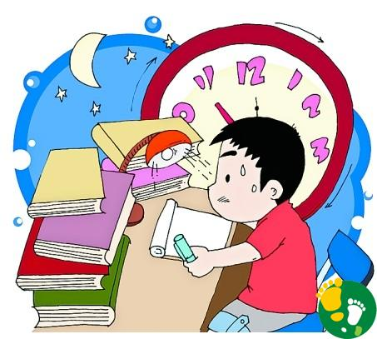
too much
He has _________ homework.

Slide 26
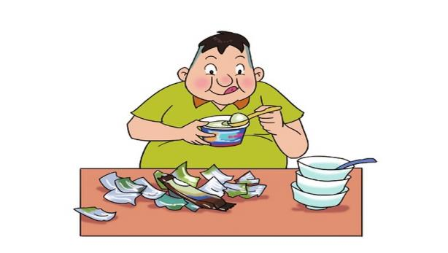
too much
Don’t eat _________ .

Slide 27
Read, find and underline
（读一读，找一找，划一划）
（自读第三段）
What does Li Mei’s aunt say to her?
Don’t feed them too much, my dear.

Slide 28
near
（近的，接近的）
dear
（亲爱的人）
ear
hear
（耳朵）
（听见）
tear
（眼泪）

Slide 29
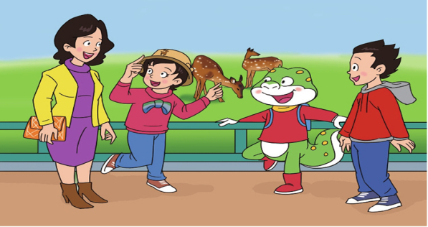
Read and fill
dear
deer
（自读第四段）
Ha-ha. I’m your ____, but I’m not a ____.

Slide 30
They ___ laugh.
all

Slide 31
Listen and repeat

Slide 32
(1) It’s Li Mei.
(2) No, he doesn’t.
(3) Don’t feed them too much, my dear.
Tips:
小组内先把问题认读一下，理解问题后商讨答案，最后写下来。
看哪一小组最先完成并坐好。

Slide 33
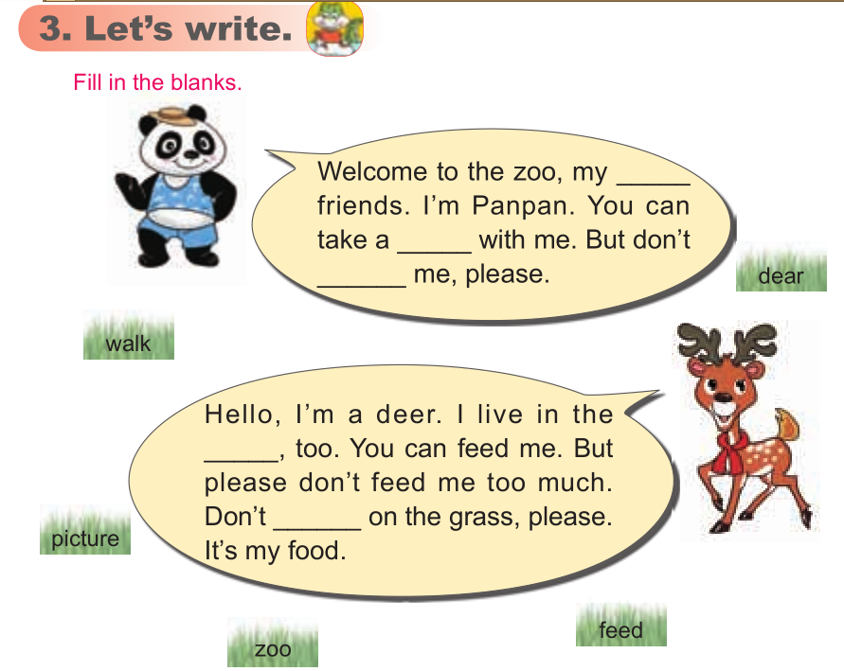
dear
picture
feed
zoo
walk

Slide 34
Homework:
听音跟读L3，读熟签字。
L3新单词3，重点句型1，汉。
3. 完成一起作业网。

