Slide 1
Section B Using language
外研版高中英语必修二
Unit 4 Stage and screen
WWW.PPT818.COM

Slide 2
Ⅰ
Ⅱ
Ⅲ
Ⅰ.知识体系图解
applaud
grateful
extremely
overcome
ballet
absorbed
romantic
comedy
documentary
absolutely
episode
appealing

Slide 3
Ⅰ
Ⅱ
Ⅲ
plot
rude
transport
arrangement
熬夜
放弃
从……借入
迫不及待做某事
演出
浪费时间
过去常常做
……的数目

Slide 4
Ⅰ
Ⅱ
Ⅲ
Ⅱ.释义匹配
1.applaud A.showing or feeling thanks,especially to another person
2.grateful B.to a very high degree
3.extremely C.to hit your open hands together to show that you have enjoyed a play,concert,speaker etc.
4.transport D.successfully control a feeling or problem that prevents you from achieving something
5.overcome E.to take goods or people from one place to another
答案:1.C 2.A 3.B 4.E 5.D

Slide 5
Ⅰ
Ⅱ
Ⅲ
Ⅲ.单句填空
1. (win) the championship,he was awarded a million dollars.
2. (have) only book knowledge,you will not be able to work well.
3. (wait) in the queue for half an hour,I suddenly realized that I had left my wallet at home.
4.“We can’t go out in this winter,” said Ted, (look) out of the window.
5.“What on earth have you done?” Mother said, (point) to the broken vase on the ground.
Having won
Having
Having waited
looking
pointing

Slide 6
重点词汇
重点语法
随堂练习
1.overcome v.控制(感情),克服(困难)
【课文原句】But thanks to the support of my teacher,parents and friends,I overcame my fears,knowing that I did the best I could.
但多亏了我的老师、父母和朋友的支持,我战胜了恐惧,知道我尽了最大的努力。
【词汇精讲】overcome是及物动词,意为“控制(情感),克服(困难)”。
Can you give me some advice on how to overcome the fear?
你能给我一些如何战胜恐惧的建议吗?
In order to succeed here you will need to overcome
your prejudices.
你需要消除偏见,才能在这里获得成功。

Slide 7
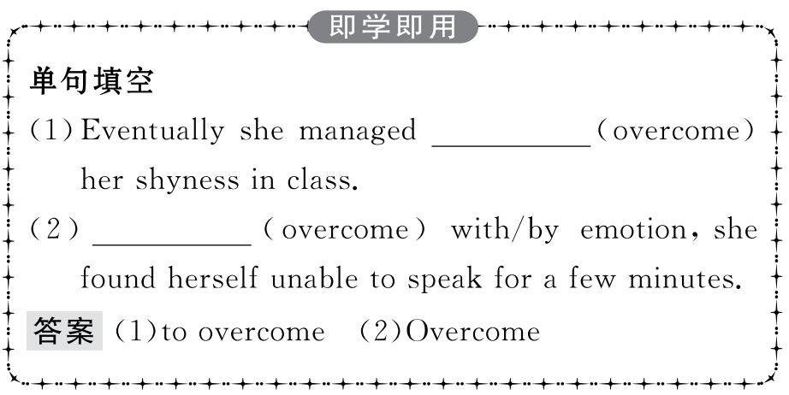
重点词汇
重点语法
随堂练习

Slide 8
重点词汇
重点语法
随堂练习
2.absorbed adj.专心致志的
【课文原句】As soon as the curtain rose,I was absorbed.
幕布一升起,我便被吸引了。
【词汇精讲】句中的absorbed是形容词,意为“专心致志的;被吸引了”。
When he got absorbed in his world of music,he felt as if he could “see” the beauty of the world around him.
当他沉浸于他的音乐世界时,他觉得好像他可以“看到”周围世界的美。
Every time I went to see her,she was absorbed in her research work.
每次我去看她时,她都全神贯注于研究工作。

Slide 9
重点词汇
重点语法
随堂练习
【词汇拓展】
Plants absorb carbon dioxide from the air and moisture from the soil.
植物从空气中吸收二氧化碳并从土壤中汲取水分。
The surrounding small towns have been absorbed into the city.
四周的小城镇已并入这座城市。

Slide 10
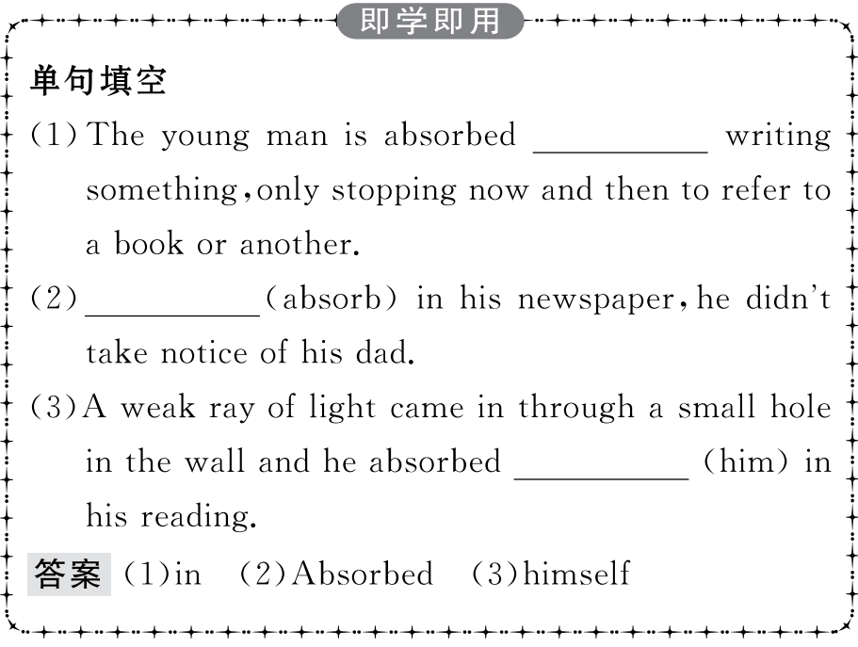
重点词汇
重点语法
随堂练习

Slide 11
重点词汇
重点语法
随堂练习
3.put on 表演(节目)
【课文原句】Each of the contestants put on a wonderful performance—they all really wanted to win!
每个参赛者都表现得很出色——他们都很想赢!
【词汇精讲】句中的put on意为“表演”,除此之外,put on还有“穿上,增加”的意思。
The band is hoping to put on a show before the end of the year.
那个乐队希望年底之前举办一场演出。
I can eat what I want but I never put on weight.
我能想吃什么就吃什么,但是体重从来不增加。
Hearing the news,she put on her coat and went out.
听到那个消息,她穿上外套,出去了。

Slide 12
重点词汇
重点语法
随堂练习
【词汇拓展】

Slide 13
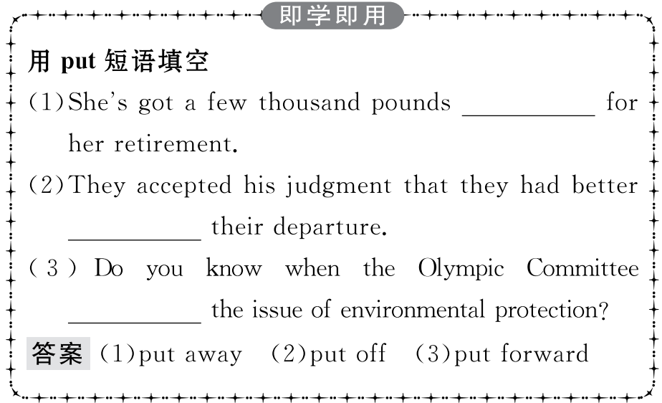
重点词汇
重点语法
随堂练习

Slide 14
重点词汇
重点语法
随堂练习
4.appealing adj. 有吸引力的,有趣的
【课文原句】Leopards are such appealing creatures.
猎豹是如此吸引人的生物。
【词汇精讲】句中的appealing是形容词,意为“有吸引力的,有趣的”。
There was a sense of humour to what he did that I found very appealing.
他举手投足间流露出一种幽默感,我觉得很有魅力。
She gave him a soft appealing look that would have melted solid ice.
她温柔地看了他一眼,那眼神足以融化坚冰。

Slide 15
重点词汇
重点语法
随堂练习
【词汇拓展】
I’m sure it will appeal to you,for you’ve been enthusiastic about sports.
我确信它会对你有吸引力,因为你一直热衷于体育运动。
I think what appeals to me about his painting is the colours he uses.
我认为他的画吸引我的地方是他采用的颜色。

Slide 16
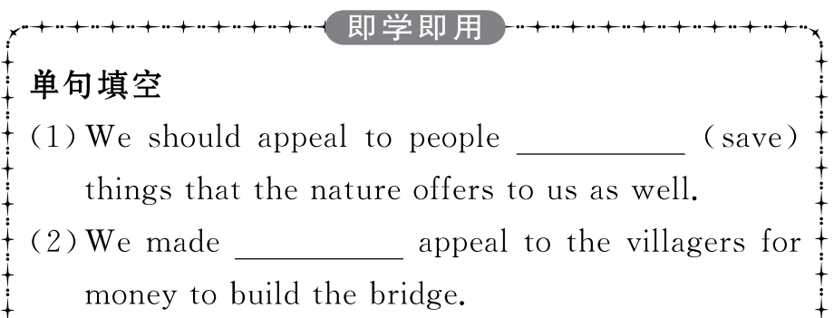
重点词汇
重点语法
随堂练习

Slide 17
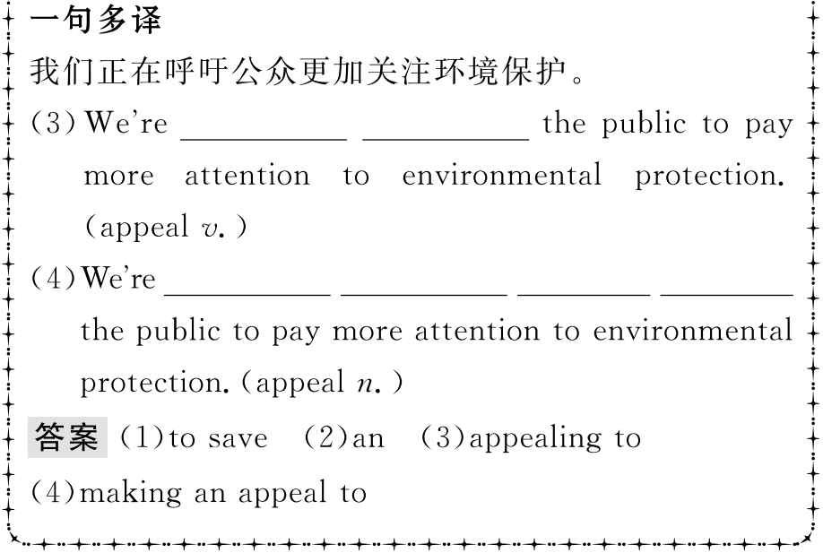
重点词汇
重点语法
随堂练习

Slide 18
重点词汇
重点语法
随堂练习
5.arrangement n.安排,筹划
【课文原句】Now talk about how Josh makes arrangements.
现在谈谈乔什是怎么安排的。
【词汇精讲】arrangement是可数名词,意为“安排,筹划”。
I’ll make arrangements for you to be met at the airport.
我会安排人到机场接你。
There are special arrangements for people working overseas.
对赴海外工作的人员有特别安排。

Slide 19
重点词汇
重点语法
随堂练习
【词汇拓展】
We arranged to meet at the cinema at 7:30,but he failed to turn up.
我们约定7点30分在电影院见面,但他没来。
I have arranged for a car to pick them up at the station.
我已安排车子去车站接他们。

Slide 20
重点词汇
重点语法
随堂练习
【温馨提示】(1)表示“安排某人做某事”用arrange for sb to do sth,而不用arrange sb to do sth。
(2)make arrangements (for sth/for sb to do sth)中的arrangement常用复数形式。

Slide 21
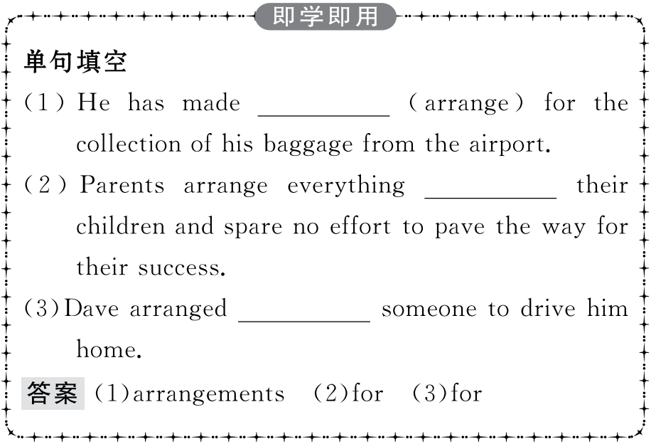
重点词汇
重点语法
随堂练习

Slide 22
重点词汇
重点语法
随堂练习
动词-ing形式作状语
动词-ing形式作状语可以修饰谓语动词或整个句子,表示时间、原因、结果、条件、让步、行为方式、伴随情况或补充说明等。
1.表示时间
动词-ing形式作时间状语,相当于一个时间状语从句。
Speaking of all the songs he has written,I think this is probably his best-known one.
谈到他所写的所有歌曲,我认为这可能是最出名的一首。
(= When I speak of...)
While reading the book,he nodded from time to time.
他看书的时候不停地点头。
(= While he was reading the book...)

Slide 23
重点词汇
重点语法
随堂练习
2.表示原因
表示原因的动词-ing形式一般置于句首,相当于一个原因状语从句。
Being ill,he couldn’t go to school yesterday.
他昨天病了,不能上学。
(= Because he was ill...)
Having lived in London for years,I almost know every place quite well.
在伦敦住过多年,我几乎对每个地方都很熟悉。
(= Because I have lived...)
Not realizing that he was in great danger,Eric walked deeper into the forest.
由于没有意识到身处险境,埃里克一步步向森林深处走去。
(= Since he did not realize that...)

Slide 24
重点词汇
重点语法
随堂练习
3.表示结果
动词-ing形式作状语表示结果,可扩展为一个含有并列谓语的简单句。
The fire lasted nearly a month,leaving nothing valuable.
大火持续了近一个月,几乎没剩下什么有用的东西。
(=...and left nothing valuable)
China has a population of more than 1.3 billion,making it the largest country in the world by population.
中国有13亿多人口,这使得它成了世界上人口最多的国家。
(=...and makes it...)

Slide 25
重点词汇
重点语法
随堂练习
4.表示条件
动词-ing形式作条件状语,相当于一个条件状语从句。
Opening the window,you will see the garden below.
打开窗户,你就能看见下面的花园。
(= If you open the window,...)
Turning to the left,you will find the path leading to the park.
如果向左转,你将找到通向公园的小道。
(= If you turn to the left,...)
5.表示让步
动词-ing形式作让步状语,相当于一个让步状语从句。
Admitting what you say,I still think you are wrong.
虽然承认你所说的话,但我仍然认为你错了。
(=Though I admit what you say...)

Slide 26
重点词汇
重点语法
随堂练习
6.表示行为方式、伴随情况或补充说明
动词-ing形式表示行为方式、伴随情况或补充说明时,常置于句末,可以扩展成一个并列成分。
He was walking along the street,looking this way and that.
他左顾右盼地在街上走着。
(= and looked this way and that)
Some girls sat there laughing and chatting.
几个女孩坐在那边,又说又笑。
He was busy writing a story,only stopping once in a while to smoke a cigarette.
他正忙于写故事,只是偶尔停下来抽支烟。

Slide 27
重点词汇
重点语法
随堂练习
7.修饰形容词
有少数动词-ing形式常放在某些形容词前面,起副词的作用,意思是“极”或“非常”,表示其程度或状态。
It was freezing/biting cold that day. 那天天气很冷。
The weather has been burning/steaming hot this week.
这个星期天气极热。
8.动词-ing形式作插入语
动词-ing形式可在句中作独立成分,表明说话人的态度。
Properly speaking,a whale is not a fish.
正确地说,鲸并非鱼类。
Generally speaking,Chinese prefer tea to coffee.
一般说来,中国人爱喝茶胜过喝咖啡。
Judging from this fact,he must be an honest man.
从这一事实判断,他必是一个诚实的人。

Slide 28
重点词汇
重点语法
随堂练习
【温馨提示】动词-ing形式作状语时,其动作的逻辑主语就是句子的主语。当句子的主语不是动词-ing形式的逻辑主语时,那就是误用,我们在表达时要避免。
(×)While reading the book,the telephone rang.
(√)While she was reading the book,the telephone rang.
她看书的时候,电话铃响了。(reading的动作不应是the telephone发出)
(×)Looking out through the window,the garden was beautiful.
(√)Looking out through the window,we saw a beautiful garden.
从窗户看出去,我们看见一个漂亮的花园。(looking的动作不是garden发出)

Slide 29
重点词汇
重点语法
随堂练习
【帮你归纳】
英语中有一些固定的动词-ing结构,如generally speaking,judging from...等,它们的逻辑主语可以和句子的主语不一致,这种结构已经成为固定的用法。常见的不需要逻辑主语的动词-ing形式结构有:
considering (that)...考虑到……
supposing (that)...如果……
generally speaking一般说来
frankly speaking坦白说
judging from...从……判断
talking of...说到……
concerning...关于……
setting aside...除开……
coming to...谈到……
allowing for...考虑到……

Slide 30
重点词汇
重点语法
随堂练习
Ⅰ.介(副)词填空
1. first,I didn’t take much interest in playing the piano.
答案:At
2.Our English teacher is very strict us,but he is kind to us.
答案:with
3.When I came into Zhong Ning’s room,she was absorbed her homework.
答案:in
4.What he said had a great influence all of us.
答案:on
5.On TV,we can see what is going all over the world.
答案:on

Slide 31
重点词汇
重点语法
随堂练习
Ⅱ.完成句子
1.由于没有收到他的信,我给他打了电话。
any letter from him,I gave him a call.
答案:Not receiving
2.跟着几个学生,老师进了教室。
,the teacher enter the room.
答案:Following several students
3.从山顶上看,我可以看到那个公园。
the top of the hill,I can see as far as the park.
答案:Seeing from

Slide 32
重点词汇
重点语法
随堂练习
4.听到那个消息,我高兴地跳了起来。
,I jumped with joy.
答案:Hearing the news
5.以前去过那里,他对那里很熟悉。
there before,he is familiar with it.
答案:Having been

