Slide 1
Unit7
We will go by train
WWW.PPT818.COM

Slide 2
课前温习
如何表达交通方式：
1 by +交通工具：
by trian by taxi
by bike by car
by plane by shipb
by school bus on foot

Slide 3
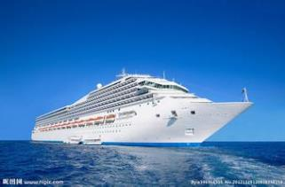
Key words
Hainian Island __ by ship
海南岛 乘坐轮船
—How will you go there?
—We will go by ship.

Slide 4
Hainian Island

Slide 5
W indow of the world—by taxi
世界之窗
乘坐出租车
-How will you go there
-We will go by taxi

Slide 6
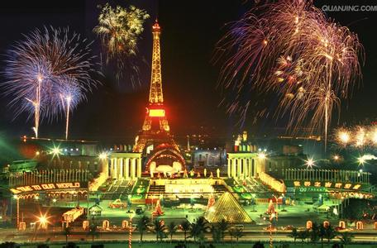
Window of the world

Slide 7
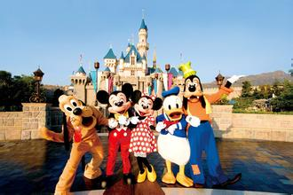
Hong Kong__ by train
香港 坐火车
How will you go there?
We will go by train.

Slide 8
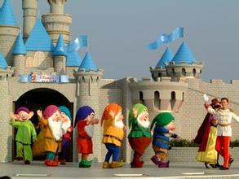
Hong Kong
香 港

Slide 9
Hangzhou——by bus
杭州 乘坐汽车
How will you go there？
We are go by bus.

Slide 10
Hang zhou
杭 州

Slide 11
Library —— on foot
图书馆 步行
How will you go there?
we will go there on foot.

Slide 12
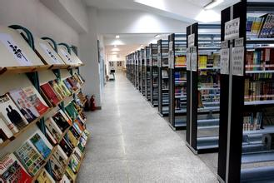
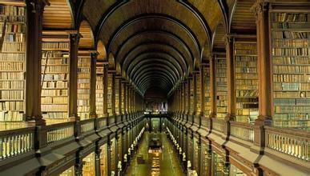
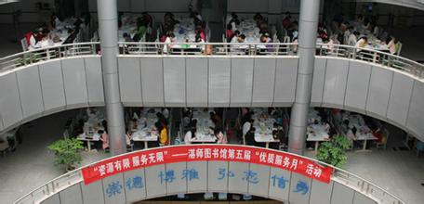
Library

Slide 13
Set a dialogue for listening to the dilogue:
1 Ben is going to place for the holiday？
2.What is the place?
3 How will he go there?

Slide 14
Do you have any plans for the holiday？
你假期有什么计划吗？

Slide 15
有。我将和我的家人一起去旅游。我们打算去深州。
Yes.I will go travelling with my family.We are going to shengzhen.

Slide 16
How will you go there?
你们打算怎么去哪里？

Slide 17
We will go by train.We will leave on October 2nd.I can't wait.
我们将坐火车去。我们将于10月2号出发。我都等不及啦。
Ben

Slide 18
这（旅行）是很激动人心的。
你们在深州将做什么？
It's very exciting.What will you do in shengzhen?

Slide 19
Well...we are going to visit Window of the Would,of course.
恩...我们当然要去参观世界之窗。
And I want to go to Happy Valley,too
而且我还想去欢乐谷

Slide 20
When will you come back home?
你们打算在什么时候回家？

Slide 21
We will come back home on October 4th
我们将在10月4号回家。

Slide 22
Key sentences：
1. ——How will you go there？
2. ——We will go there by train.
3. ——How are you going there？
4. ——By taxi.

Slide 23
Pay attention!
1.how：用于询问动作执行的方式，手段等。
eg：How will you go there？
=How are you going there？
2.by：表示“乘，坐”时，其后接交通工具（如，bus，bike，car…）
3. by+交通工具=take a+交通工具
Eg：by bus=take a bus
4.exciting和excited，bored和boring
以ing结尾的是用来形容物，以ed结尾的是用来形容人的（interesting和interested）

Slide 24
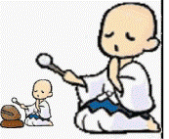
小练笔：
找出划线部分读音不同的单词。
1. A. tea B. meat C. weather D. beach
2. A. back B. fast C. have D. map
3. A.warm B. garden C. market D. party

Slide 25
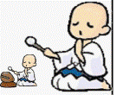
4.
—How does he go to Hong Kong? —________.
A. Take a plane B. Take plane C. By the plane D. By foot
5. I usually go to school ________.
A. ride bike B. on bike C. on the bike D. by my bike
6. We will go _________ on June 21st.
A. travelling B. travel C. travelled C. travels
7. ---_________ will you go there? ---By underground.
A. How B. What C. How long C. When

