Slide 1
Section B Reading and Thinking
人教版高中英语必修二
UNIT 3 The internet
WWW.PPT818.COM

Slide 2
Ⅰ
Ⅱ
Ⅲ
Ⅰ.知识体系图解
convenient
cash
update
database
software
network
stuck
surf
benefit
distance
inspire

Slide 3
Ⅰ
Ⅱ
Ⅲ
access
charity
tough
province
conference
resident
plus

Slide 4
Ⅰ
Ⅱ
Ⅲ
陪伴某人
经历;度过;通读
既然
尽可能……
引起……的注意
排队等候
为……付款
和……一起
可利用;接近
申请

Slide 5
Ⅰ
Ⅱ
Ⅲ

Slide 6
Ⅰ
Ⅱ
Ⅲ
Ⅱ.释义匹配
1.resident A.the amount of space between two places or things
2.conference B.someone who lives or stays in a particular place
3.inspire C.an advantage,improvement,or help that you get from something
4.distance D.to encourage someone by making them feel confident and eager to do something
5.benefit E.a large formal meeting where a lot of people discuss important matters
答案:1.B 2.E 3.D 4.A 5.C

Slide 7
Ⅰ
Ⅱ
Ⅲ
Ⅲ.阅读导学
根据P28 课文内容,选择正确答案。
1.What does the first paragraph mainly tell us?
A.The reason why people use the Internet.
B.How the Internet came into being.
C.The database which is stored in the Internet.
D.The changes the Internet has made to people’s lives.
答案:D

Slide 8
Ⅰ
Ⅱ
Ⅲ
2.What was one of the greatest benefits of the Internet Jan found?
A.It could bridge the distance between people.
B.It could make her less lonely and bored.
C.She could listen to music and watch videos.
D.She could explore the world.
3.What made her decide to start the IT club?
A.The convenience of the Internet.
B.Her eagerness to learn about computers.
C.The people she met on the Internet.
D.The profits she made on the Internet.
答案:A
答案:C

Slide 9
Ⅰ
Ⅱ
Ⅲ
4.What is Jan Tchamani’s next goal?
A.To set up a website to help kids in poor countries.
B.To teach old people how to use computers.
C.To learn more about computers.
D.To have access to new technology.
答案:A

Slide 10
重点词汇
重点句式
随堂练习
1.convenient adj.方便的;近便的
【课文原句】There are countless articles telling us how the Internet has made our lives more convenient.
有无数篇文章告诉我们,互联网如何使我们的生活更加方便。
【词汇精讲】convenient是形容词,意为“方便的;近便的”。
Subways are fast and convenient,but rush hours can be terrible.
地铁快捷方便,但是,交通高峰时段情况就可能非常糟糕。
Our house is very convenient for schools and stores.
我们的房子离学校和商店很近。

Slide 11
重点词汇
重点句式
随堂练习
【词汇拓展】

Slide 12
重点词汇
重点句式
随堂练习
Can you telephone me at your convenience to arrange a meeting?
你能不能在方便时给我打个电话,安排一下见面?
For disabled customers it would be more convenient to place the toilets near the entrance to the cinema.
在影院入口处的附近设置厕所会让残疾人顾客感觉更加方便。
【温馨提示】convenient作表语时,不可用人作主语,而要用物或形式主语作主语。“当你方便的时候”应译成“when it is convenient for you”而不能译成“when you are convenient”。
Would it be convenient for you to pick me up at four o’clock and take me to the airport?
四点钟你方便来接我再送我去机场吗?

Slide 13
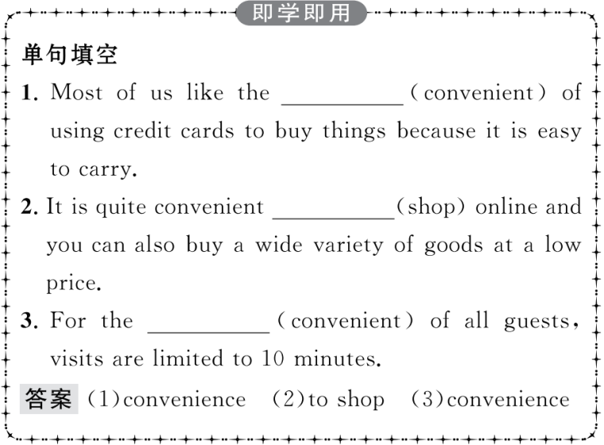
重点词汇
重点句式
随堂练习

Slide 14
重点词汇
重点句式
随堂练习
2.stuck adj. 卡住;陷(入);困(于)
【课文原句】At age 50,she found herself out of work and stuck at home with only her computer to keep her company.
50岁时,她发现自己失业了,困在家里,只有电脑相伴。
【词汇精讲】stuck是形容词,意为“卡住;陷(入);困(于)”。
Have you ever been stuck in a traffic jam?
你曾经遇上过交通堵塞吗?

Slide 15
重点词汇
重点句式
随堂练习
【词汇拓展】
If you stick to the truth,you have nothing to fear.
如果你坚持真理,你就没有什么好怕的。
The bus got stuck in the snow and we had to walk the rest of the way.
公共汽车陷在雪中开不动了,剩下的路我们只好步行。

Slide 16
重点词汇
重点句式
随堂练习

Slide 17
重点词汇
重点句式
随堂练习
3.benefit n.益处 vt.使受益 vi.得益于
【课文原句】She realised that one of the greatest benefits of the Internet was its ability to remove the distance that usually exists between people.
她意识到互联网的最大好处之一就是能够消除通常存在于人和人之间的距离感。
【词汇精讲】句中的benefit是可数名词,意为“益处”;benefit作及物动词,意为“使受益”,作不及物动词,意为“得益于”。
The new railway will benefit the people living here.
新建的铁路将有益于住在这里的人们。
He told me that he benefited from daily exercise.
他告诉我他受益于每天的锻炼。

Slide 18
重点词汇
重点句式
随堂练习
【词汇拓展】
As everyone knows,sports are beneficial to building up our bodies.
众所周知,体育运动对增强我们的体质有益。
You need people working for the benefit of the community.
你们需要为社区谋利益的人。

Slide 19
重点词汇
重点句式
随堂练习

Slide 20
重点词汇
重点句式
随堂练习
4.inspire vt.鼓舞;激励;启发思考
【课文原句】She was so inspired by the people she met online that she decided to start an IT club to teach older people how to use computers and the Internet.
她受到网友的启发,决定成立一个IT俱乐部来教年长一些的人们学习使用电脑和互联网。
【词汇精讲】inspire为及物动词,意为“鼓舞;激励;启发思考”。
Parents should encourage their children to overcome difficulties and inspire them to develop by themselves.
父母应该鼓励他们的孩子克服困难,并且激励他们自我发展。

Slide 21
重点词汇
重点句式
随堂练习
【词汇拓展】

Slide 22
重点词汇
重点句式
随堂练习
Nature is the biggest inspiration and I’m always inspired by things of beauty and harmony.
大自然是最大的灵感,我总是被美丽和谐的事物所启发。
Listening to his inspiring speech,we were inspired to make great efforts.It gave us not only hope but also inspiration.
听到他鼓舞人心的演讲,我们受到了很大的激励,并将更加努力。它不仅给了我们希望,也给了我们灵感。

Slide 23
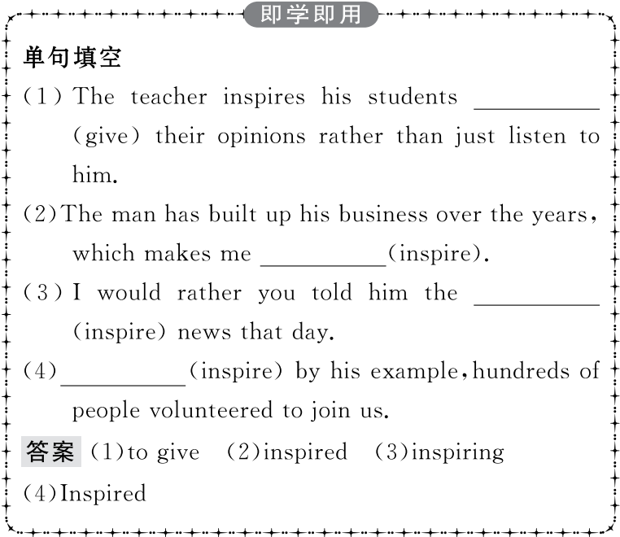
重点词汇
重点句式
随堂练习

Slide 24
重点词汇
重点句式
随堂练习
5.access n.通道;(使用、查阅、接近或面见的)机会 vt.进入;使用;获取
【课文原句】She believes that it is highly important to bridge the digital divide and make sure that everyone has access to the Internet and knows how to use new technology.她认为,消除数字鸿沟、确保每人都能使用互联网并且知晓如何运用新技术,是非常重要的。

Slide 25
重点词汇
重点句式
随堂练习
【词汇精讲】access作名词,意为“通道;(使用、查阅、接近或面见的)机会”;作动词,意为“进入;使用;获取”。
The only access to the farmhouse is across the fields.
去那座农舍的唯一通路是穿过田野。
The World Wide Web is a computer network that allows computer users to access information from millions of websites via the Internet.
万维网是一种计算机网络,它允许电脑用户通过因特网来获取众多网站的信息。

Slide 26
重点词汇
重点句式
随堂练习
【词汇拓展】
People have better access to health care than they used to,and they’re living longer as a result.人们有了比过去更便捷的医疗服务,因此,人们更长寿了。
He put the medicine in the top drawer to make sure it would not be accessible to the kids.
他把药放在上层的抽屉里,以确保孩子们够不到。

Slide 27
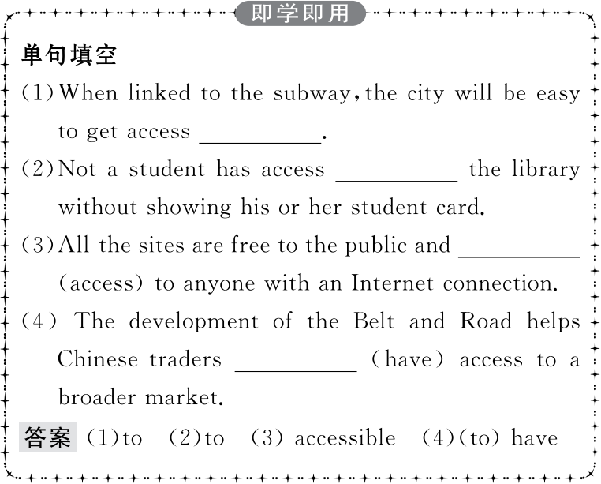
重点词汇
重点句式
随堂练习

Slide 28
重点词汇
重点句式
随堂练习
6.go through经历;度过;通读
【课文原句】When you go through tough times,you meet others who are facing similar challenges.
当你经历困难的时候,你会遇到其他面临类似挑战的人。
【词汇精讲】go through是动词短语,意为“经历;度过;通读”,还可意为“检查,完成”等。
Jane Goodall must have gone through a lot in the African forest.
简·古德在非洲丛林中一定经历了许多磨难。
If you had gone through your papers before handing them in,you wouldn’t have made so many mistakes.
假如你交试卷前检查一下,你就不会犯那么多错误了。

Slide 29
重点词汇
重点句式
随堂练习
【词汇拓展】

Slide 30
重点词汇
重点句式
随堂练习
Do you think the housing price will keep going up in the years to come?
你认为在未来几年内房价会持续上涨吗?
To get a better grade,you should go over the notes again before the test.
要想获得更好的成绩,你应该在考试之前再复习一下笔记。
I go in for music and tennis while my brothers go in for swimming.
我热衷于音乐及网球,而我兄弟们喜欢游泳。

Slide 31
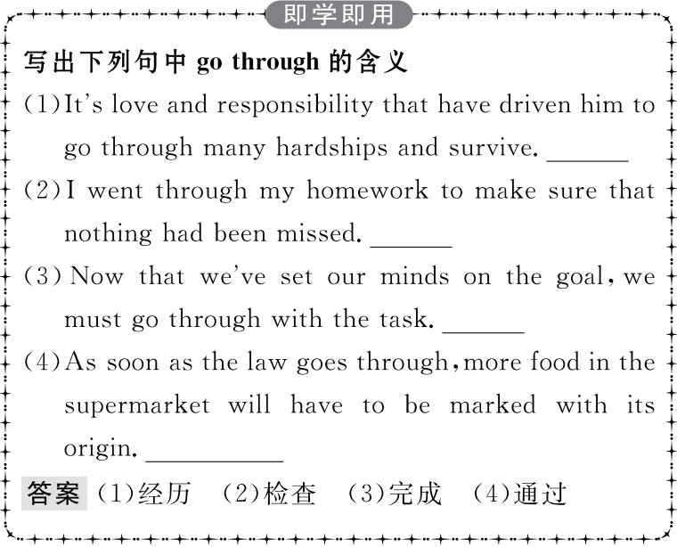
重点词汇
重点句式
随堂练习

Slide 32
重点词汇
重点句式
随堂练习
1.At age 50,she found herself out of work and stuck at home with only her computer to keep her company.
50岁时,她发现自己失业了,困在家里,只有电脑相伴。
【句式剖析】find herself out of work为“find+宾语+宾语补足语”,out of work和stuck at home是句子的宾语补足语,说明宾语herself的处境。
I called at her house but I found her out.
我去她家时发现她不在家。
We found the map quite out of date.
我们发现这张地图已完全过时。

Slide 33
重点词汇
重点句式
随堂练习
【句式拓展】
He found the city much changed.
他发现这个城市发生了巨大的变化。
When I went to see her,I found her lying in bed.
我去看望她的时候,我发现她躺在床上。

Slide 34
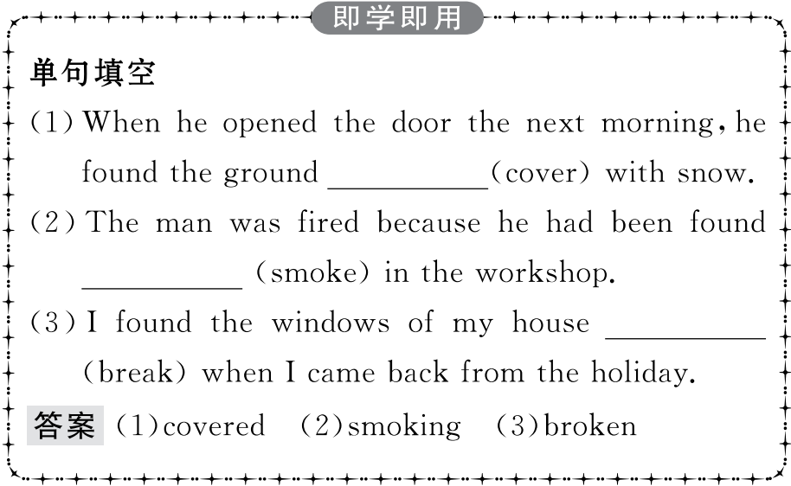
重点词汇
重点句式
随堂练习

Slide 35
重点词汇
重点句式
随堂练习
2.She was so inspired by the people she met online that she decided to start an IT club to teach older people how to use computers and the Internet.
她受到网友的启发,决定成立一个IT俱乐部来教年长一些的人们学习使用电脑和互联网。
【句式剖析】句中的so...that...意为“如此……以至于……”,so为副词,that 为连词,引导结果状语从句。
She’s kind and patient,and she explains English grammar so clearly that even I can understand it!
她既友好又耐心,并且她的英语语法解释得如此清楚,以至于连我都能明白!
The moon is so far away from the earth that it looks rather small.
月球离地球那么远,以至于它看起来很小。

Slide 36
重点词汇
重点句式
随堂练习
【句式拓展】
There were so many people in the room that I couldn’t get into it.
房间里有那么多人,我进不去。
This is such an interesting book that all the students in our class want to read it.
=This is so interesting a book that all the students in our class want to read it.
这本书如此有趣,我们班所有的学生都想读。

Slide 37
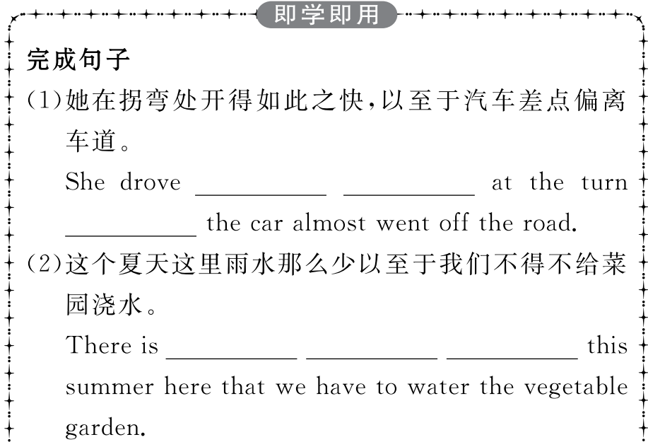
重点词汇
重点句式
随堂练习

Slide 38
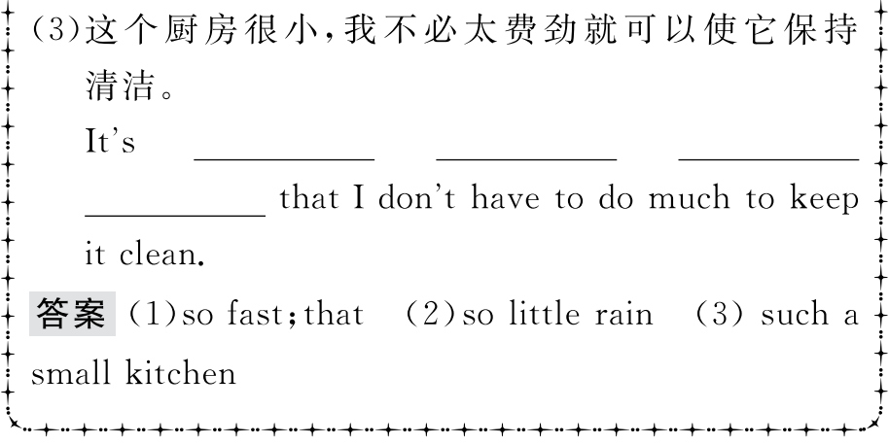
重点词汇
重点句式
随堂练习

Slide 39
重点词汇
重点句式
随堂练习
3.Now that he works and can take care of himself,his daughter has time to study at university.
现在他工作了,又可以照顾自己,他的女儿就有时间在大学学习了。
【句式剖析】now that意为“由于;既然”,引导原因状语从句。
Now that I have made this first visit,I hope I can come many more times.
既然我开始了这第一次拜访,那么我希望能够来更多次。
Now that you’ve passed your test,you can drive on your own.
你驾驶考试既已合格, 就可以独自开车了。

Slide 40
重点词汇
重点句式
随堂练习
【易混辨析】

Slide 41
重点词汇
重点句式
随堂练习
We couldn’t go out because it was too cold.
因为天气太冷,我们不能外出。
Since you can’t answer the question,I’ll ask someone else.
既然你回答不出这个问题,我就问别人了。
It must be morning for the birds are singing.
一定是清晨了,因为鸟儿在叫。
As there was no answer,we wrote him a letter again.
鉴于他没有回复,我们又给他写了封信。

Slide 42
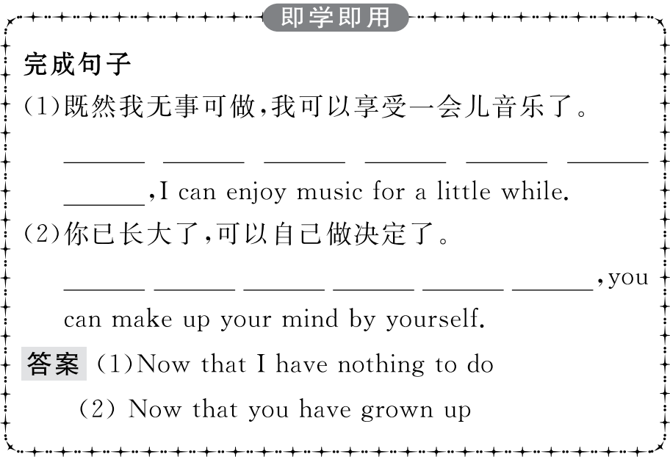
重点词汇
重点句式
随堂练习

Slide 43
重点词汇
重点句式
随堂练习
Ⅰ.单词拼写
1.If we hadn’t made adequate preparations,the (会议) wouldn’t have been so successful.
答案:conference
2.This tag carries information specific to that object,and the data can be (更新).
答案:updated
3.This (软件) is very useful and you can download it from the Internet free of charge.
答案:software

Slide 44
重点词汇
重点句式
随堂练习
4.China has been pushing the reform of public hospitals for the (利益) of all its citizens.
答案:benefit
5.Whoever wins the election is going to have a (艰难的) job getting the economy back on its feet.
答案:tough

Slide 45
重点词汇
重点句式
随堂练习
Ⅱ.语篇填空
Not only has the Internet made our lives more 1.______________ (convenience),but also people’s lives have been changed by online communities and social networks.Take Jan Tchamani,a 50-year-old English teacher,2. example.She had to quit her job because she was suffering a serious illness.With only her computer to company her,she felt lonely and 3. (bore).However,by
4. (surf) the Internet,she found her life greatly changed since the Internet was able to keep people closer no matter 5.______ they lived.
convenient
for
bored
surfing
where

Slide 46
重点词汇
重点句式
随堂练习
6. (inspire) by the people she met online,she made up her mind to start an IT club to teach older people how 7._________ (use) computers and the Internet.In order to learn more about how to use the Internet to make the society 8. (good),Jan herself has started taking online classes.She believes that it is 9._________ (high) important to bridge the digital divide and make sure that everyone has access 10. the Internet and knows how to use new technology.Her next goal is to start a charity website to raise money for children in poor countries.Due to the Internet,Jan’s life has been greatly improved.
Inspired
to use
better
highly
to

Slide 47
重点词汇
重点句式
随堂练习
Ⅲ.概要写作
根据教材P28课文内容,写一篇60词左右的内容概要。
参考范文
The Internet has not only made our lives more convenient,but also made people’s lives improved.(要点1) Jan Tchamani is a 50-year-old teacher who was confined at home because of illness.(要点2) She benefited greatly from the Internet.(要点3) In order to make her life more meaningful,she started an IT club to teach older people how to use computers and the Internet.(要点4) Jan’s life has been greatly improved by the Internet.(要点5)

