Slide 1
Unit 12
What did you do last weekend?
R 七年级下册
第3课时
WWW.PPT818.COM

Slide 2
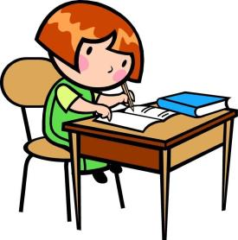
Lead-in
What did you do last weekend?
I did my homework.

Slide 3
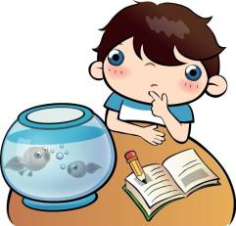
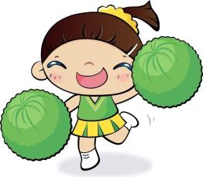
Who did her/ his homework?
The boy did.

Slide 4
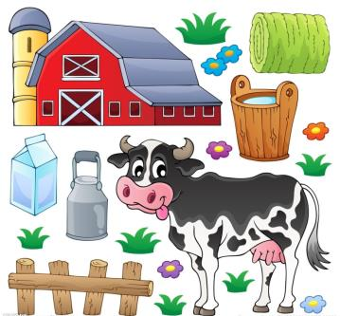
Where did she go last weekend?
She went to a farm.

Slide 5
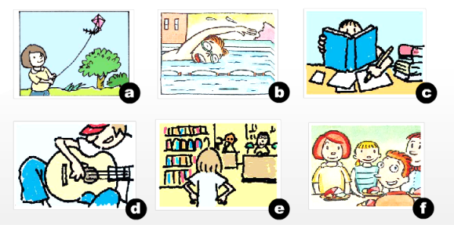
Here are some things that Sally and Jim did yesterday. Match the activities with the pictures.
1a

Slide 6
1. ______ sang and played the guitar
2. ______ studied for a test
3. ______ had dinner with friends
4. ______ went to the library
5. ______ flew a kite
6. ______ swam in a swimming pool
d
c
f
e
a
b

Slide 7
Do you think the activities in 1a are fun? Draw a happy face or an unhappy face under each picture.
1b
_________
_________
_________

Slide 8
________
________
________

Slide 9
Listen. What did Sally and Jim do last weekend? Complete the chart.
1c
Sally
Jim
did her homework
sang and played the guitar
__________________
_______________________
studied for a test
flew a kite in the park
__________________
_______________________
had dinner with friends
__________________
______________________
went to the library

Slide 10
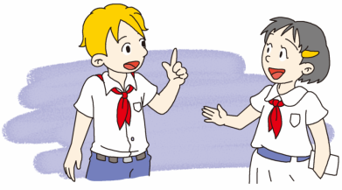
Make a conversation with a partner. Talk about what Sally and Jim did last weekend.
1d
Who went to the library?
Sally did.

Slide 11
No, she didn’t. She did her homework and studied for a test.
Did Sally go out on Saturday?

Slide 12
Then what did she do on Sunday?
She went to the library.

Slide 13
How was Jim’s last weekend?
It was relaxing.

Slide 14
Well. He sang and played the guitar on Saturday morning.
Really? What did he do on Saturday?

Slide 15
Did Jim do his homework on Sunday?
No, he didn’t. He flew a kite in the park on Sunday afternoon.

Slide 16
What about Sunday evening?
Well, he had dinner with friends.

Slide 17
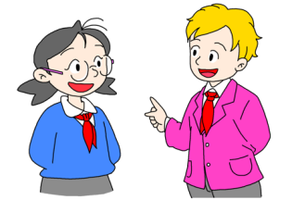
1e
Make a conversation. Ask what your partner did last weekend.
Did you do anything interesting last weekend?
Not really, but I visited my sister.

Slide 18
How about you? What did you do last weekend?
I studied for a test and had dinner with my friends.

Slide 19
Language points
1. Did you do anything interesting last weekend?
该句是一般过去时的疑问句。
句型结构：Did+主语+动词原形+其他？
例句：你昨天早上做家庭作业了吗？
Did you do your homework yesterday morning?

Slide 20
含be动词的一般疑问句构成是：Be(was/were)+主语+其他？
例句：他是我们去年的英语老师吗？
Was he our English teacher last year?

Slide 21
2. anything 任何事，任何（东西）
anything是不定代词，通常用于否定句或疑问句，后如果有形容词，nothing 在意义上等于 not anything。
例句：这个盒子里什么都没有。
There isn’t anything in the box.

Slide 22
Exercise
1. —____ had dinner with friends?
—My brother _____.
A. What; did B. Who; did
C. Who; does D. Where; does
B

Slide 23
2. ____ he ____ volleyball last Friday?
A. Does; play B. Did; played
C. Is; playing D. Did; play
D

Slide 24
3. —____ did you go last Saturday?
— I went to the Great Wall.
A. What B. How
C. When D. Where
D

Slide 25
4. —Excuse me，is there _______ in today’s newspaper?
—No, nothing.
A. something new
B. new something
C. anything new
C

Slide 26
5. I was looking for a birthday gift for my mother, but I couldn’t find _______ suitable.
A. something B. anything
C. nothing D. everything
B

Slide 27
6. Frank moved to Lanzhou in 2012.（对画线部分提问）
_______ did Frank move to Lanzhou?
7. The teacher explained to us the puzzling problem
yesterday afternoon.（改为一般疑问句）
_______ the teacher _______ to you the puzzling problem
yesterday afternoon?
When
Did explain

Slide 28
8. They went to Yunnan last summer. （对画线部分提问）
_______ _______ they go to Yunnan?
9. We went to the Great Wall three days ago.
（改为一般疑问句）
_______ you ______ to the Great Wall three days ago?
10. — Did you sleep well last night, Jack? （作肯定回答）
— _______, _______ _______.
When did
Did go
Yes I did

