Slide 1
陕旅版四年级上册
Unit8 Boys Like to Play Ball 第2课时
WWW.PPT818.COM

Slide 2
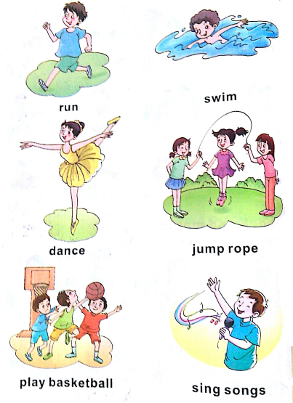
Review

Slide 3
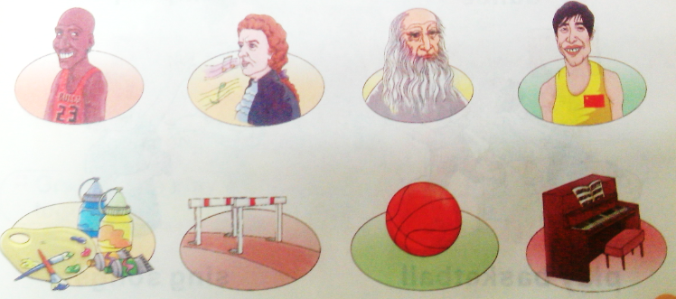
Look and match
What do they like?

Slide 4
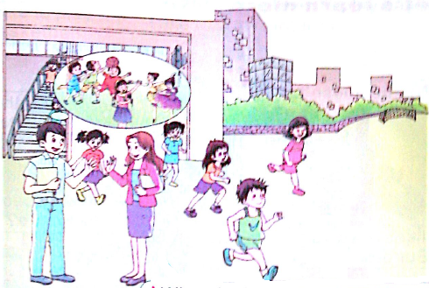
Let’s talk
听录音，回答问题：
What do the boys like to do after school? What about the girls?

Slide 5
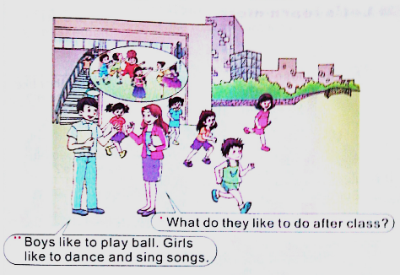
Let’s talk

Slide 6
Let’s talk
听录音，回答问题：
What does Su Nan like to do ?
What about Liu Zhaoyang?

Slide 7
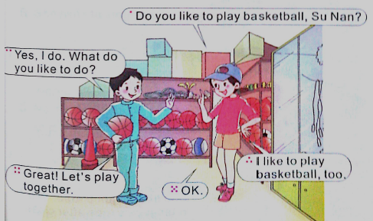
Let’s talk

Slide 8
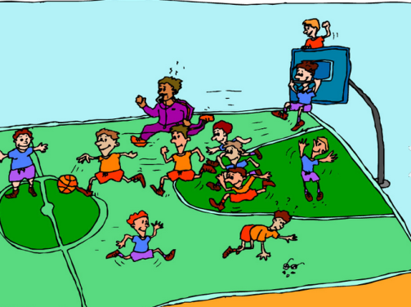
A: What __ they like to do? B: They ___ to…
Practice
do
like

Slide 9
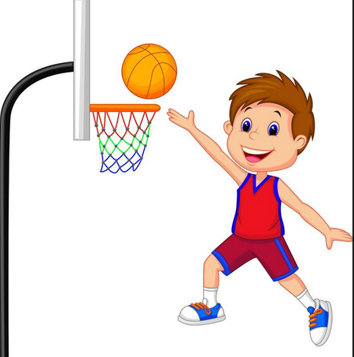
A: What ____ you like to do ? B: I ___ to…
Practice
do
like

Slide 10
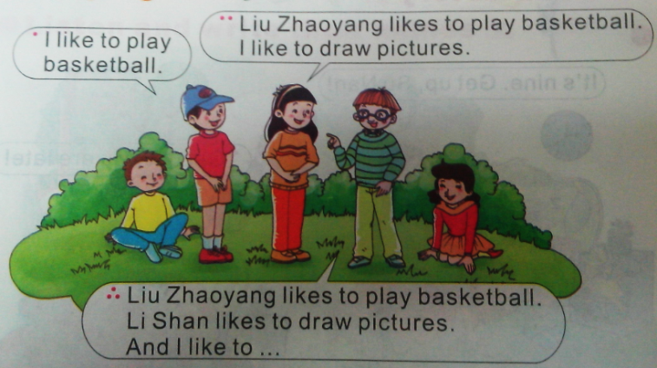
Play a game

Slide 11
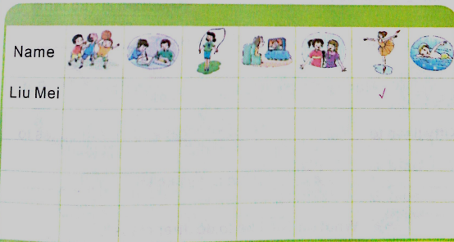
Do a survey
A: What do you like to do, Liu Mei?
B: I like to dance.

