Slide 1
Section Ⅰ Starting out & Understanding ideas
WWW.PPT818.COM

Slide 12
教材
原句
What if the only way of getting news from faraway friends was writing letters that took ages to be dolivered?
倘若得到远方朋友消息的唯一方式是写信，会花很长时间邮递，那会怎么样？
句式
解构
What if ...? 意为“如果……将会怎么样？”。
佳句
背诵
What if he doesn't agree with me?
要是他不同意我的看法怎么办？

Slide 13
教材
原句
Whatever our hobbies, the Internet can connect us with others who also enjoy doing them, even if they live on the other side of the world.
不论我们的爱好是什么，因特网都能把我们和有着相同爱好的其他人联系起来，即使他们生活在世界的另一端。
句式
解构
疑问词＋­ever引导让步状语从句；even if ＝ even though引导让步状语从句，意为“即使；尽管”。
佳句
背诵
①Whichever day you come, we'll be pleased to see you.
无论你哪一天来，我们都高兴见到你。
②Even if/though he suffered from a lot of difficulties, he never gave in.
尽管遇到了许多困难，但他从不屈服。

Slide 17
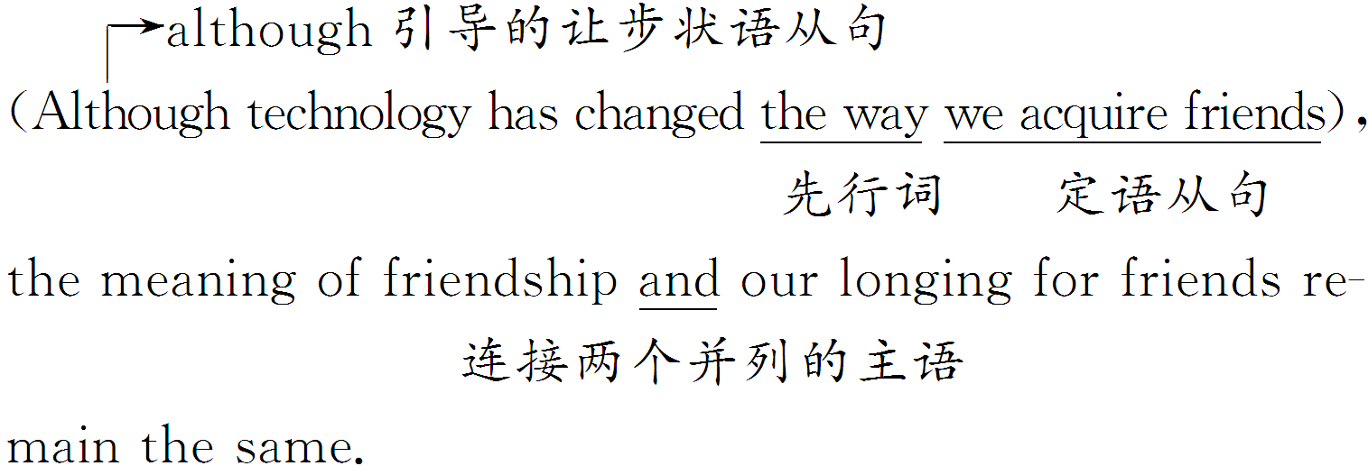

Slide 27
Ways of making friends | in the past | Moving to a new town meant losing 1. of friends. To get news from faraway friends, people had to 2. .
 | at present | Advances in 3. have changed the way of making friends significantly. Social media tools help us remain friends and 4. friendships. The digital age 5. us to find people with the same interests and hobbies.
track
write letters
technology
maintain
enables

Slide 28
Online friendship： real or not | People exchanging true personal 6. online may be your real friends.
 | What we see on social media sites is often not the 7. truth about a person.
 | People tend to post only 8. things; smiling photos can hide real 9. .
 | We should not 10. the baby out with the bathwater.
information
whole
good
problems
throw

Slide 57
谢 谢 观 看

