Slide 1
Unit 3
I am more outgoing than
my sister.
SectionB 3a-Self Check
WWW.PPT818.COM

Slide 2
Can you retell 2b?

Slide 3
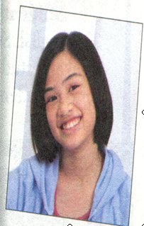
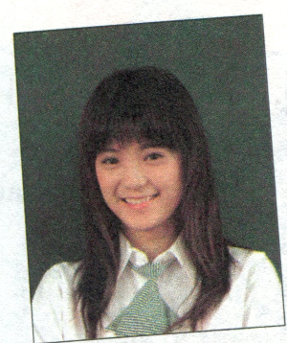
3a Wang Lingling and Liu Lili are best friends.
Look at the chart below and compare them.
Wang Lingling
Liu Lili

Slide 4
3a Wang Lingling and Liu Lili are best friends.
Look at the chart below and compare them.
Wang Lingling | Liu Lili
tall | tall
 | short straight hair
like reading | like sports
popular
outgoing | outgoing
serious
hard-working
both tall
long straight hair
popular
is as popular as
more serious
funny
funnier
smart
smarter
more hard-working

Slide 5
Wang Lingling’ best friend is Liu Lili.
They are both tall, but
_________________________________
_________________________________
_________________________________
_________________________________
_________________________________
_________________________________
_________________________________
Wang Lingling has longer straight hair than Liu Lili. Wang Lingling likes reading and LiuLili likes sports. Both of them are popular and outgoing. Wang Lingling is more serious, and Liu Lili is funnier. Wang Lingling is more hard-working, and Liu Lili is smarter than Wang Lingling.

Slide 6
Wang Lingling and Liu Lili are best friends.
In some ways they look the same. But in some
ways they are different.They are both tall, but
_________________________________
_________________________________
_________________________________
_________________________________
_________________________________
_________________________________
_________________________________
_________________________________
Wang Lingling has longer straight hair than Liu Lili. Wang Lingling likes reading and LiuLili likes sports. Both of them are popular and outgoing. Wang Lingling is more serious, and Liu Lili is funnier. Wang Lingling is more hard-working, and Liu Lili is smarter than Wang Lingling.

Slide 7
3b Make notes about two of your friends. One
friend should be similar to you; the other
friend should be different.
A friend who is similar to me | A friend who is different from me
Name: | Name:

Slide 8
4 Read the job ad. Then compare two of your
classmates. Decide which classmate is better
for the job.
Student Helper Wanted
The English Study Center needs a weekend
student helper for primary school students.

Slide 9
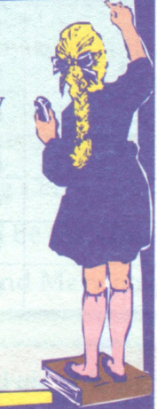
You must:
-be a middle school student
-have good grades in English
-be good with children
-be outgoing
Call the English Study Center at
443-5667 for more information.

Slide 10
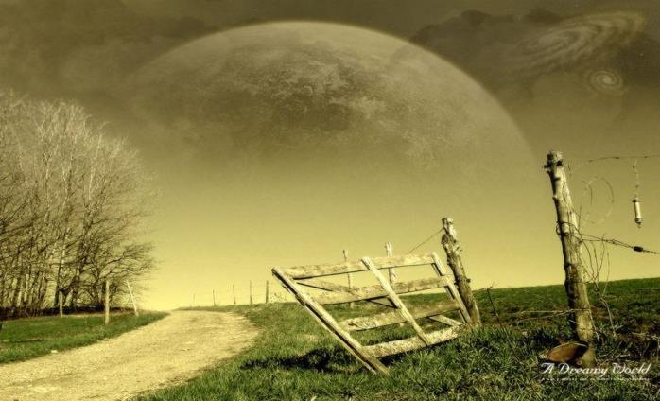
Learn the Words!
quiet

Slide 11
funny

Slide 12
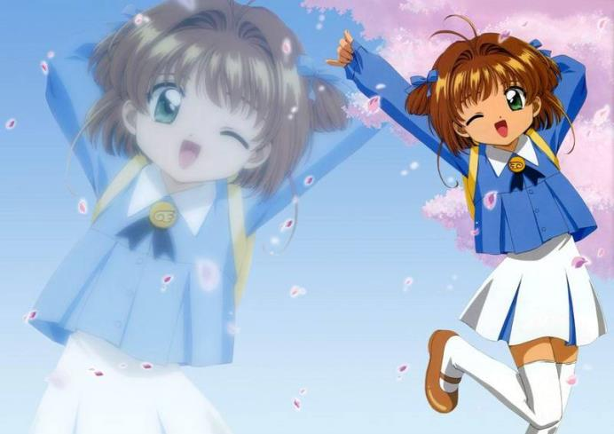
outgoing

Slide 13
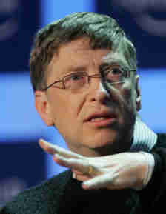
smart

Slide 14
Words review
serious
mirror
kid
as long as
necessary
be different from
both
adj. 严肃的；稳重的
n. 镜子
n. 小孩；年轻人
只要；既然
adj. 必需的；必要的
与……不同；
与……有差异
adj.&pron. 两个；两个都

Slide 15
Words review
bring out
grade
should
the same as
saying
reach
hand
使显现；使表现出
n. 成绩等级；评分等级
model v. 应该；应当；可以
和……相同；与……一致
n. 谚语；格言；警句
n. 伸手；到达；抵达
n. 手

Slide 16
Words review
touch
heart
fact
in fact
break
arm
laugh
v. 感动；触摸
n. 内心；心脏
n. 现实；事实
确切地说；事实上；实际上
v. (使)破；裂；碎；损坏
n. 手臂；上肢
v. 笑；发笑
n. 笑声

Slide 17
Words review
share
loud
similar
be similar to
primary
primary school
information
v. 分享；共享；共用；分摊
adj. 响亮的；大声的
adj. 相像的；类似的
与……相像的、类似的
adj. 最初的；最早的
小学
n. 信息；消息

Slide 18
Look at the following pictures,
let's review the comparative forms

Slide 19
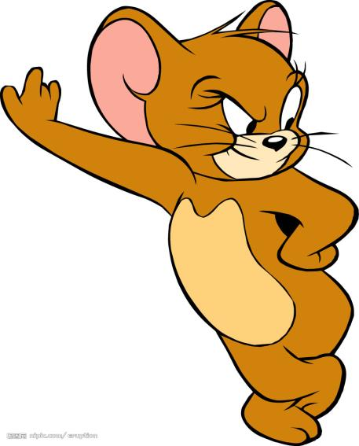
bigger
smaller
bigger or smaller

Slide 20
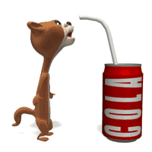
Which is fatter? A or B?
Which is thinner? A or B?
fatter
B
thinner
A
stronger or thinner

Slide 21
heavier
thinner
heavier or thinner

Slide 22
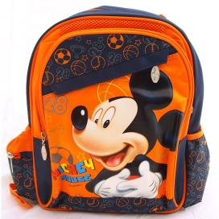
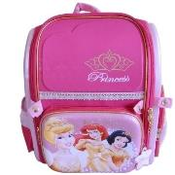
It’s smaller.
It’s shorter.
It’s bigger.

Slide 23
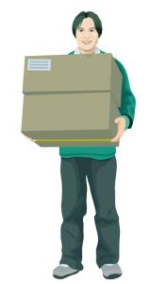
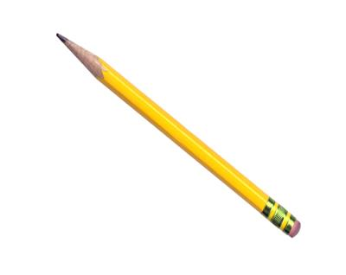
It’s longer.
It’s heavier.

Slide 24
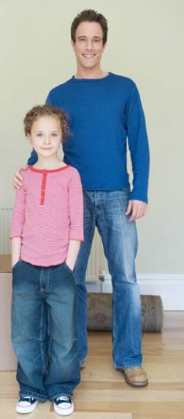
Who is taller?
He is taller.
Who is thinner?
He is thinner.

Slide 25
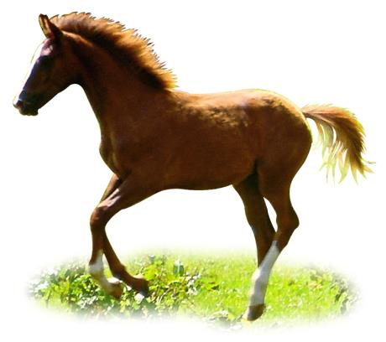
Which is taller?
A horse is taller than a dog .
a dog
a horse

Slide 26
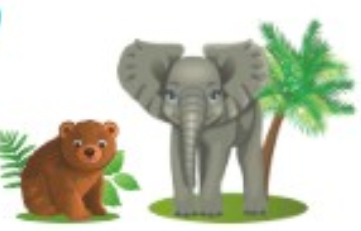
Which is heavier?
An elephant is heavier than a bear .
a bear/bεə/
an elephant

Slide 27
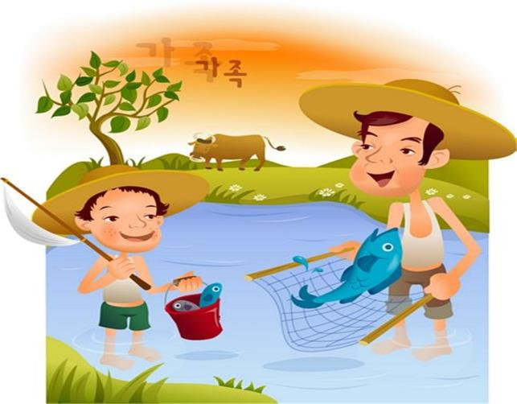
Who is shorter, the father or the son?
The son is shorter than the
father.

Slide 28
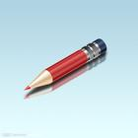
Which is longer,
the yellow one or the red one?
The yellow one is longer than the red one.

Slide 29
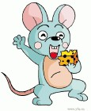
[‘bɪgə ]
Which is bigger,
the mouse or the elephant?
The elephant is bigger
than the mouse.

Slide 30
Which is smaller,
the mouse or the elephant?
The mouse is smaller
than the elephant.

Slide 31
[‘hevɪə]
Which is heavier,
the fox or the bird?
The fox is heavier than the bird.

Slide 32
1 Put the words in the correct columns.
hard-working run fast quiet
serious jump high smart
what people are like | what people can do
hard-working,
quiet,
serious, smart
run fast
jump high

Slide 33
2 Fill in the blanks using the correct forms of the
words in brackets.
1. My brother is _________(funny) than me.
He makes laugh a lot.
2. I’m outgoing, but my best friend is a lot
_______________(outgoing) than me.
funnier
more outgoing

Slide 34
3. My brother is as_______________ (serious)
as my sister. They both like to study.
4. My cousin can run __________(fast) than
me. She is taller than me, too.
5. Jim is_________________ (friendly) than
Tom, so Tom has more friends than Jim.
serious
faster
less friendlier

Slide 35
I Fill in the blanks.
quiet funny outgoing kind
quiet
Paul is never _____ ! He can’t stop talking.
Lu Xiang is really ______. She is very good
at math, physics and chemistry.
3. Mary is a ______ girl. She always makes me
laugh.
4. Jane isn’t very _________ . She likes to stay
at home and read.
smart
funny
outgoing

Slide 36
Ⅱ. 根据所给词的正确形式填空
1. Seen from the mountain, the town looks
________________ (beautiful).
2. She has made far ________ (great) progress
(进步) this term than she did last year.
3. She is a head ________ (tall) than I.
4. This room is 3 times ________ (big) than
that one.
more beautiful
greater
taller
bigger

Slide 37
taller
5. Jim is _______ (tall) than Mary.
6. Baobao is ____________ (young) boy
in his class.
7. I think English is _______________
(interesting) than any other subject.
the youngest
more interesting

Slide 38
Ⅲ. 单项选择
1. Which is ______ classroom, this
classroom or that one?
A. bigger B. the bigger
C. a bigger D. bigger
C

Slide 39
2. This apple is ________ that one.
A. as big twice as B. as big as twice
C. as twice big as D. twice as big as
3. There are more books in our library
than ________.
A. theirs B. those in theirs
C. that in theirs D. those in their
D
B

Slide 40
Ⅳ. 翻译
1. 他比我大三岁。
2. 我喜欢像我妹妹那样的人。
3. 我像他一样强健。
He is three years older than me.
I like someone who are like my sister.
I am as athletic as he is.

Slide 41
4. We have a lot in common.
5. Black and white are opposites.
6. I don’t know him well though I've
known him for a long time.
我们有很多相同之处。
黑和白相反。
我对他并不了解, 虽然我认识
他已经很长时间了。

