Slide 1
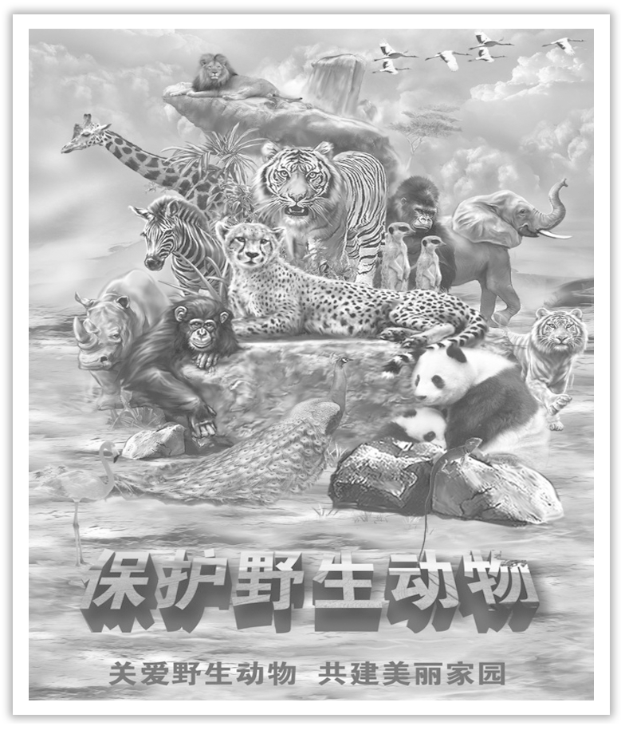
Unit 2 Wildlife Protection
Section Ⅷ Assessing Your Progress
WWW.PPT818.COM

Slide 2
Ⅰ.单词拼写
1.After a few days’ rest, she has ____________ (恢复) her health.
2.The progress of the society is based on ____________(和谐).
3.At one time silk was ____________ (保留) only for the Chinese emperor.
4.I once got a chance to ____________ (观察) how a detective actually works.
5.We need to master this technology ____________(立刻), otherwise we will fall behind.
recovered
harmony
reserved
observe
immediately

Slide 3
6.The number of people shopping online is growing at an ____________ (惊人的)rate.
7.Loss of ____________ (生活环境) in lowland areas has forced pandas to live only in the mountains.
8.As a result, some large museums have to take ____________ (措施) to limit the number of visitors.
9.Dragon represents the image of China.But in western countries, dragon is not a nice ____________(生物).
10.On the contrary, the father holds a ruler，____________(想要) to punish his son who doesn’t behave well.
alarming
habitat
measures
creature
intending

Slide 4
Ⅱ.单句语法填空
1.With time going by, I gradually adapted myself ____________ the school life.
2.My mother reminded me ____________(eat) this cold medicine twice a day.
3.In a word, everybody should have the ____________(aware) of reducing waste.
4.Nowadays people are more ____________(concern) about the environment where they live.
5.What’s worse, many animals are over ____________(hunt) for money and are being killed without mercy.
to
to eat
awareness
concerned
hunted

Slide 5
6.As a result of global warming, a growing number of animals are in danger of ____________(extinct).
7.The panda is an ____________ (endanger) species, which means that it would become extinct without protection.
8.With about 30，000 kinds of animals reduced ____________ average each year, as a result, there were only 1.5 million left till 2010.
9.One of the most ____________ (effect) ways to reduce stress is to talk about feelings with someone you trust.
10.Besides the electric shock, she ________________ (threaten) with physical violence.
extinction
endangered
on
effective
was/is threatened

Slide 6
Ⅲ.用现在进行时的被动语态补全句子
1.The spring sport meeting ____________________ in our school.
我校正在举行春季运动会.
2.Another bridge ___________________ over the Yangtze River at present.
目前长江上正在建造另一座大桥。
3.________________________________ at such a speed, they will disappear soon.
如果以如此速度捕杀动物，它们很快就会消失。
is being held
is being built
If these animals are being hunted

Slide 7
Is the whale being attacked by
4._____________________________________________ some other killers?
这头鲸鱼是否正遭受到其他杀手的攻击呢？
5.The young trees _______________________________ now.
现在没有在栽种小树苗。
are not being planted

