Slide 1
How much are these socks?
Section B 第1课时
WWW.PPT818.COM

Slide 2
number 数字 | noun 名词 | 其他
ten 十 | price 价格 | buy 购买；买
eleven 十一 | boy 男孩 | sell 出售；销售；卖
twelve 十二 | clothes 衣服；服装 | all 所有的；全部的
thirteen 十三 | sale 特价销售；出售 | very 很；非常
fifteen 十五 | store 商店 | Mr. (用于男子的姓氏或姓名前)先生
eighteen 十八 |  | a pair of 一双
twenty 二十
thirty 三十

Slide 3
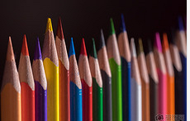
How many pencils can you see?
I can see 18.
eighteen /ˌeɪ'ti:n/ num. 十八
thirteen /ˌθɜ:(r)'ti:n/ num. 十三
fifteen /ˌfɪf'ti:n/ num. 十五
ten /ten/ num. 十
eleven /ɪ'levən/ num. 十一
twelve /twelv/ num. 十二
13—19后都有-teen

Slide 4
20—90后都有-ty
巧计数字1—100
twenty /'twenti/ num. 二十
1到12个个记
十几后面都有teen
几十后面跟ty
几十几中间有“-”
一百说成 one hundred
thirty /'θɜ:(r)ti/ num. 三十

Slide 5
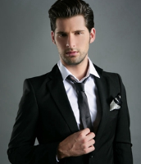
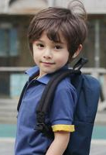
John is a clever boy.
/bɔɪ/ n. 男孩
Mr. Lee is his father.
/mɪstə (r) / 先生
(用于男子的姓氏或姓名前)
He wants to buy a pair of trousers for John.
/baɪ/ v. 购买；买
a pair of
two pairs of
buy sth. for sb. 给某人买某物
glasses/shorts/socks/
trousers/shoes…

Slide 6
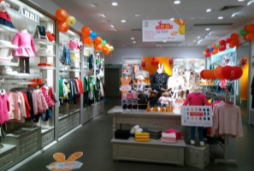
They are at a clothes store.
/kləʊðz, kləʊz/ n. (pl.) 衣服；服装
/stɔ:(r)/ n. 商店

Slide 7
sell /sel/ v. 出售；销售；卖
all /ɔ:l/ adj. 所有的；全部的
very /'veri/ adv. 很；非常
We sell all our clothes at very
good price.
price /praɪs/ n. 价格
What’s the price of the trousers?

Slide 8
The trousers at the store are at a great sale.
sale /seɪl/ n. 特价销售；出售
on sale

Slide 9
单项选择
1. I want ______ two rulers.
A．buy B．to buy
C．buys D．buying
2. This pair of shoes ____ 150 yuan.
is B. are C. am D. /
3. These clothes are ______, they are very cheap.
sell B. sale C. on sale D. on sell
4. My mother buys a skirt _____ me.
A. to B. at C. for D. with
B
A
C
C

Slide 10
用适当的英文数字填空。
fifteen + three =
twenty + ten =
eleven + two =
eighteen – six =
This is my math teacher, he is ______years old. (thirteen, twelve, thirty)
eighteen
thirty
thirteen
twelve
thirty

Slide 11
数字
13—19后都有-teen
20—90后都有-ty
其他
buy
sell
all
very
Mr.
a pair of
名词
on sale
clothes
store
What’s the price of…?

