Slide 1
Lesson 34 The Fisherman and the Goldfish (Ⅱ)
WWW.PPT818.COM

Slide 2
Think About It!
1. What characters in the play do you like? Which do you dislike?
2. What happened in the last lesson?

Slide 3
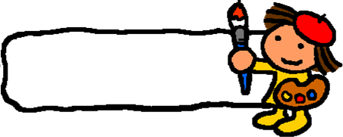
New words
coast n. 海岸
handbag n. 手提包
among prep.在……之间
guard n. 守卫
queen n. 女王
serve v. 服务
mad adj. 发怒的
servant n. 仆人
crash v. 坠落

Slide 4
Listening Task: write it is true or false.
( ) 1. The goldfish gave the fisherman a new house at first.
( ) 2. The fisherman’s wife was angry when he came back.
( ) 3. The fisherman’s wife wanted to be a Queen on land.
( ) 4. Everything was the same at last.
T
T
F
T

Slide 5
Reading tasks:
Read and finish Exercise on Page 89.

Slide 6
Language Points
1. The lights go off. 灯灭了。
go off意为“熄灭，消失”，go on意为“（灯）亮，进行”。
The street lights go on at dusk and go off at dawn. 路灯在黄昏时开，拂晓时关。

Slide 7
2. The wife is wearing beautiful new clothes and sitting among servants and guards. 妻子正穿着漂亮的衣服坐在仆人和卫士中间。
among指“在三者（或以上）之中”，between指“两者”之中，强调个体，指“两两之间”。
It’s pleasant to walk among trees. 走在树丛间令人惬意。
Let's toast the friendship between two countries.
让我们为两国间的友谊干杯。

Slide 8
3. Go right now or I will punish you! 立刻走，否则我会惩罚你！
本句是“祈使句+and/or”结构，相当于“If…,…”结构。
Study hard, and you will pass the exam.=If you study hard, you will pass the exam.努力学习，你会考试及格的。
Study hard, or you will fail the exam.=If you don’t study hard, you will fail the exam. 努力学习，否则你会考试不及格。

Slide 9
Practice
根据句意及提示补全单词。
1. Mother went ______ (生气) when she saw the broken window.
2. Thanks for ________（服务）us so well.
3. I am familiar with the _____ (门卫) in my school.
4. The man likes standing on the ________ (海岸).
5. Women likes beautiful _________ (手提包).
mad
servicing
guard
coast
handbags

Slide 10
THANK YOU

