Slide 1
Unit4 How is the weather today?
WWW.PPT818.COM

Slide 2
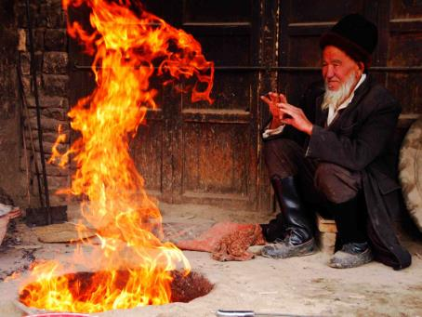
warm

Slide 3
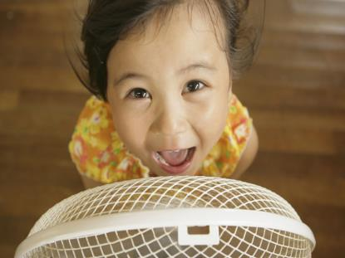
cool

Slide 4
课本内容
It's cool today.
shall we go to the zoo?
Ok!

Slide 5
课本内容
It's warm here.
Yes, it is. The fish like it.

Slide 6
文章译文
妈妈，今天很凉爽，我们去动物园好吗？
好啊！
妈妈。这里很暖和。
是的，鱼儿喜欢这种环境。

Slide 7
新学单词啦！
warm 温暖的
cool 凉爽的
fish 鱼

Slide 8
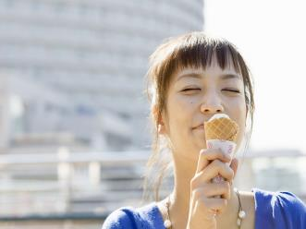
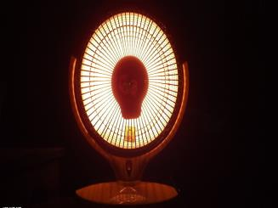
说一说
小朋友们，你们都喜欢什么样的天气呢？

Slide 9
练习
一、单项选择。
( )1.I like apples，how ________ you?
A．about B．are C．is
( )2.—Shall we go to the zoo?—________
A．That's all right. B．OK! C．Thanks.
( )3.It's ________ in spring(春天)．
A．cool B．warm C．cold

Slide 10
练习
二、选择恰当的选项补全对话。
John：Hello！This is John.
Amy：Hi，John.__1.__？
John：__2.__．What about Shanghai?
Amy：__3.__．
John：I like monkeys.__4.__？
Amy：I like elephants，__5.__？
John：She likes bears.
A．How is the weather in Tianjin
B．What about you
C．It's cool，too
D．and your sister
E．It's cool today

Slide 11
see you

