Slide 1
陕旅版四年级上册 Unit1 What Is Your Father? 第2课时
WWW.PPT818.COM

Slide 2
教学目标：
1、能听懂Let’s talk对话中表示职业的词汇。
2、能用下列对话谈论家庭成员的职业。
（1）—What is your...?
—He/ She is a...
—What about...?
—He/ She is a...
（2）—Is your mother a...?
—No, she isn’t. She is a...
（3）—What is she/he?
—She/ He is a...

Slide 3
Think and match
What is your…?

Slide 4
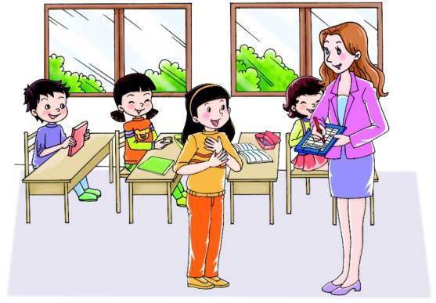
Let’s talk
听录音，回答问题：
What is Li Shan’s father?
What about Li Shan’s mother?

Slide 5
跟读课文
Li Shan, what is your father?
He is a cook.
She is a doctor.
What about your mother?

Slide 6
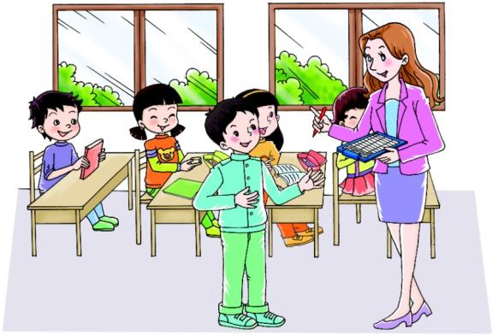
Let’s talk
听录音，回答问题：
What is Su Nan’s father?
Is Su Nan’s mother a worker, too?

Slide 7
跟读课文
Su Nan, what is your father?
My father is a worker.
No, she isn’t.
She is a nurse.
Is your mother a worker, too?

Slide 8
Summary
英语中对某人的职业进行提问时，用：What is…?
回答用：He/ She is…

Slide 9
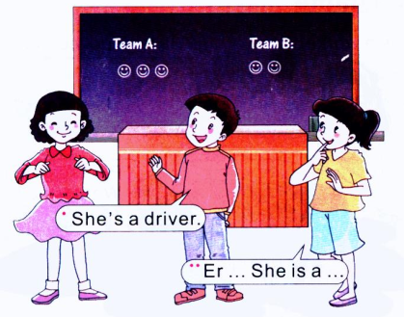
Let’s play-看关键词表演对话
policeman
farmer
doctor
worker
driver
nurse
cook

Slide 10
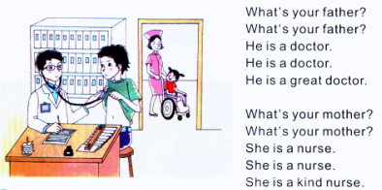
Let’s chant

Slide 11
Let’s chant
根据本节课所学内容改编chant
例如：
What’s your sister?
What’s your sister?
She is a driver.
She is a driver.
She is a great driver.

