Slide 1
Starter Module 2 My English lesson
Unit 1 Open your book.
WWW.PPT818.COM

Slide 2

学习目标
1. 掌握以下重点词汇：sit, down, open, book, listen, draw, put等。
2. 掌握以下英语指令：
Sit down. Stand up. Open your book.等。
3. 能够书写英语课堂指令。

Slide 3

Warming-up
Enjoy a song

Slide 4


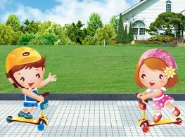
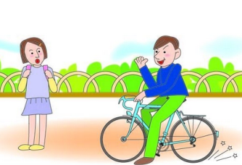
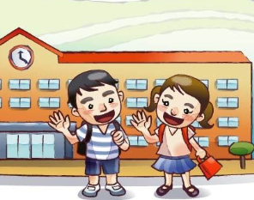
Pair work
看图编对话
根据图片的场景两人一组编对话。
1
2
3
4
5

Slide 5
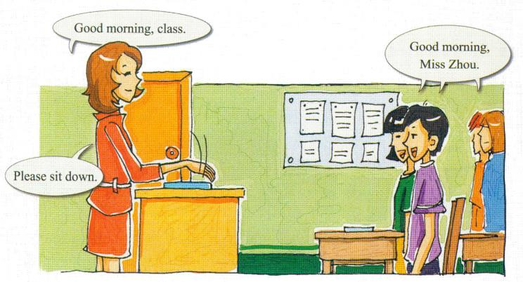
Presentation
Listen and read.

Slide 6

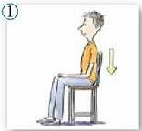

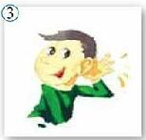
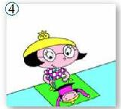
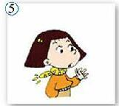
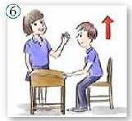

Listen and repeat.
Sit down.
Open your book.
Listen.
Draw.
Put up your hand.
Stand up.
Open your book.

Slide 7

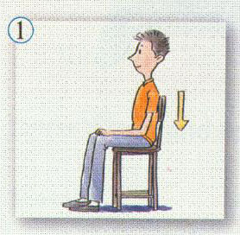
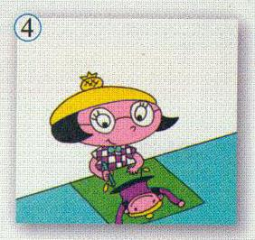
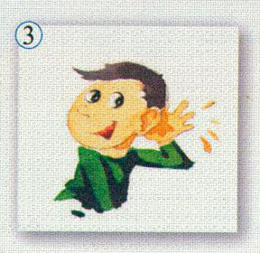
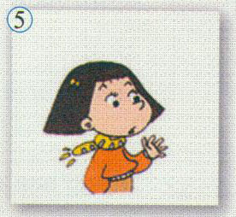

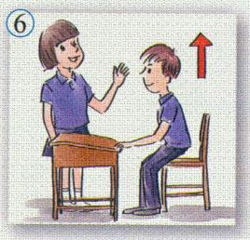
快速抢答
根据图片内容，快速说出图片代表的英语指令。答对的小组有奖励哦！

Slide 8
Play a game ——Simon says
Stand up.
Sit down.
Open your book.
Open the door.
Put up your hand.
Listen.
Draw.
Close your book.
Close your eyes.
Are you ready?

Slide 9

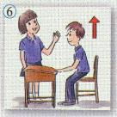


Match the verbs with the pictures
1. Put up …
2. Open …
3. Stand …
4. Sit …

Slide 10
Write and listen.
1.
2.
____________________________________________________________________________________________________________________________________________________________________________________________________________________________________________________________________________________________________________________________________
———————————————————————————————————————————————————————————————————————————————————————————————————————————————————————————————————————
—————————————————————————————————————————————
————————————————————————————————————————————————————————————————————————————————————————————————————————————————————————————————————————————————————————————————————————————————————
Close your book.
Listen.
3.
4.
Open your book.
Put up your hand.
5.
6.
Sit down.
Stand up.

Slide 11







Summary
sit, open, draw, put, stand, close
v.
Words
n.
book, hand
adv.&
prep.
up, down
Unit1
Sit down.
English instructions
Open your book.
Listen.
Close your book.
Stand up.
Put up your hand.
Draw.

Slide 12
Exercise
选择答语
Stand up. Sit down. Open your book. Listen. Draw. Put up your hand. Close your book.
1、你上课提问题或回答问题前得先_________________
2、客人到你家，你应该让客人____________________.
3、 老师走进教室上课，你马上___________ 向老师问好。
4、听写单词时你先得____________________.
5、 早上你早读要先______________________.
Put up your hand.
Sit down.
Stand up.
Close your book.
Open your book.

