Slide 1
Unit 9
What does he look like?
Section A 第1课时
WWW.PPT818.COM

Slide 2
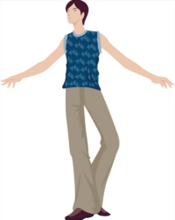
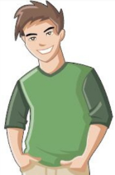
Look at the pictures and learn the new words.
He is _____.
of medium height
tall
He is ________________.
short
He is______.
中等身高

Slide 3
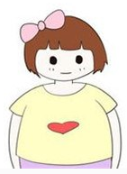
What does she look like?
heavy
She is _____.
She is ______.
medium build
thin
She is of _____________.
中等身材

Slide 4
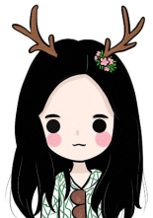
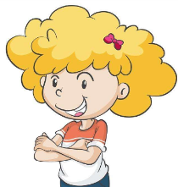
What does she look like?
straight hair
curly hair
She has _____________.
She has __________.

Slide 5
Summary
He
is
____ tall.
____ short.
____ heavy.
____ thin.
____ of medium height.
____ of medium build.
She
has
____ short hair.
____ long hair.
____ straight hair.
____ curly hair.
He
is
She
has
He
is
She
has
He
is
She
has
He
is
He
is
adj.
(高矮胖瘦……）主语 + be + ____
（有……头发）主语 + have/has + ____ + ____
adj.
n.

Slide 6
Free talk
Ask and answer.
A: What does … look like?
B: He/she is (of) …
And he/she has …

Slide 7
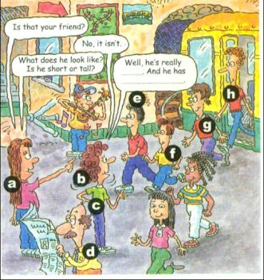
Match the words with the people in the picture. You can use some letters more than once.
1a
1.short hair ____
2.curly hair ____
3.long hair ____
4.straight hair ____
5.tall ____
e
b
a
a f
h

Slide 8
6.short _____
7.medium height ____
8.thin ____
9.heavy ____
f
g
c h
a d

Slide 9
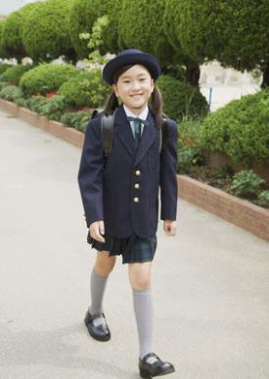
What does she look like?
She has straight black hair.
She is of medium height.
She is thin.

Slide 10
Listen and fill in the blanks in the picture above. Can you find Amy’s friend?
1b
A: Is that your friend?
B: No, it isn’t.
A: What does he look like? Is he short or tall?
B: Well, he’s really ______. And he has _________.
tall
curly hair
I think ___ is Amy’s friend.
h

Slide 11
One of the people in 1a is your friend. Describe your friend. Your partner will find him/her.
1c

Slide 12
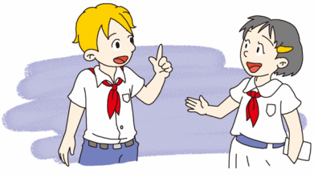
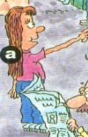
What does your friend look like?
She’s of medium height, and she has long straight yellow hair.
Is she your friend?
Yes, you’re right.

Slide 13
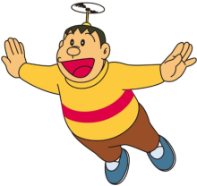
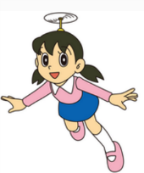
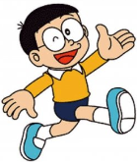
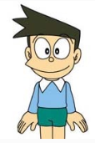
A:
What does your friend look like?
B:
He/ She’s ... He/ She has ...
A:
Is he /she your friend?
B:
Yes, you’re right./ No, he/ she isn’t.

Slide 14
2a
Listen and answer the questions.
1. Is David tall or short?
2. Does Sally have long or short hair?
3. Is Peter tall or short?
1. David is tall.
2. Sally has long straight hair.
3. Peter is short.

Slide 15
2b
Listen again. Fill in the chart.
 | David | Sally | Peter
is
has
heavy
of medium height, thin
short
tall
long straight hair
curly hair
short hair

Slide 16
Listen again and fill in the blanks.
Conversation 1
A: Is that your brother David?
B: No, it isn’t.
A: What does David look like? Is he _____or _____?
B: He’s ____. He’s ______. And he _____________.
tall
short
tall
heavy
has curly hair

Slide 17
Conversation 2
A: Is that Sally?
B: No, it isn’t.
A: Does Sally have _____ or _____ hair?
B: She ___________________. She’s ________________.
And she’s _____.
long
short
has long straight hair
of medium height
thin

Slide 18
Conversation 3
A: Is your friend Peter short or tall?
B: He’s _______. And he _____________.
short
has short hair

Slide 19
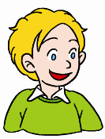
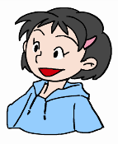
Student A looks at the chart in 2b. Student B asks Student A questions about one of the people and then draws a picture of the person.
2c
He’s of medium height.
What does he look like?

Slide 20
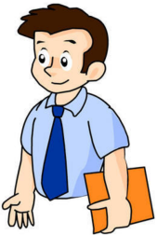
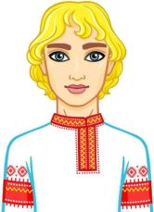
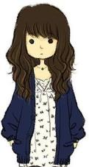
B: What does he/she look like?
A: He /She is…
B: Does he/she have …?
A: He /she has …
Peter
David
Sally

Slide 21
Task 1
2d
Role-play the conversation.
Mike: Hi, Tony. Are you going to the movie tonight?
Tony: Yes. We’re meeting at seven, right?
Mike : Yeah, but I may be a little late. My friend David
is going, too. Just meet him in front of the
cinema first.
go to the movie
去看电影
= go to the cinema
go to see a film/movie
对吗；是吧
表示对此前陈述内容进行核实或确认
完整的表达方式是: Is that right?
有点儿（= a bit）
修饰形容词或副词

Slide 22
Tony : Oh, but I don’t know him. What does he look
like?
Mike : Well, he has brown hair and wears glasses.
Tony : OK. Is he tall or short?
Mike : He isn’t tall or short. He’s of medium height.
Tony : OK, sure. See you later then.
棕色的；褐色的

Slide 23
Task 2
2d
Read again and answer the questions.
1. Who is going to the movie with Mike?
2. What color is David’s hair?
3. Is David short or tall?
Tony and David.
He has brown hair.
He is of medium height.

Slide 24
2d
Retell 2d and fill in the blanks.
Task 3
Tony and Mike are going to the movie tonight. They are going to meet at seven. But Mike may be _______late. His friend David is going, too. And Tony is going to meet him ___________ the cinema first. But Tony doesn’t know him. Mike tells Tony that David has __________and____________. He isn’t tall or short. He’s _________________.
a little
in front of
brown hair
wears glasses
of medium height

Slide 25
Language points
1. What does he look like? 他长什么样？
What does/do+主语+look like? ……看上去什么样?
用来询问某人的外貌特征
回答方式有两种：
1.主语+be+描述人物外貌特征的形容词
2.主语+have/has+名词（名词前可以有多个形容词修饰）

Slide 26
辨析:look like与be like
look like
be like
常指人的外观或外貌
常指人的性格、人品，也可以用来描述人的外观或外貌。

Slide 27
例：你的父亲长什么样子？ 他很高。
— What does your father look like？
— He is tall.
你的父亲是个什么样的人？他非常友好。
— What is your father like?
— He is very friendly.

Slide 28
2. She’s of medium height, and she has long
straight hair. 她中等个子，留着长长的直发。
此句是用来描述外貌的常用句型。
表示某人中等个头或中等身材时的结构为:
sb. + be + of + medium height / build
表示人的相貌特征，尤其是五官、头发时。
常用结构:sb.+have/has +（a/an）+（形容词）+名词
某人长着/留着……

Slide 29
例：这个男人中等身材。
The man is of medium build.
我的语文老师中等身高。
My Chinese teacher is of medium height.
我的妈妈留着长发。
My mother has long hair.

Slide 30
3. Are you going to the movie tonight?
今晚你去看电影吗？
用谓语动词的现在进行时表将来。
主要用于表示按计划或安排将要发生的动作如：
come, go, arrive, leave, start, return等。

Slide 31
4. Yeah, but I may be a little late.
对，但是我可能会晚一点儿。
may(情态动词)：可能，后接动词原形表推测。
辨析：may be 与 maybe
may be
maybe
短语结构
在句中成分
解释
情态动词+be动词结构
谓语
也许是
副词(常用于句首)
状语
也许

Slide 32
5. Is he tall or short? 他个高还是矮？
这是一个选择疑问句。
选择疑问句是指说话人提出两种或两种以上的情况,问对方选择哪一种，最后两个选择项用or连接。不能用yes或no回答。
选择疑问句的常见结构:
一般疑问句+供选择项+or+供选择项？
特殊疑问句+供选择项+or+供选择项？

Slide 33
例: 你喜欢直发还是卷发？ 我喜欢卷发。
— Do you like straight hair or curly hair?
— I like curly hair.
你喜欢哪种颜色,红色还是黑色？我喜欢红色。
— What color do you like, red or black?
— I like red.

Slide 34
Exercise
1.Li Lei _____short and _____ straight hair.
A. is; is B. is; has C. has; has D. is; have
2. — What______ your sister _____?
— She is tall.
A .is; look like B. /; like
C. does; look D. does; look like

Slide 35
3. — Is your friend tall______?
— He’s tall.
A. and short B. or short
C. but short D. with short
4. — What does she look like?
— She _____ long straight black hair.
A. is B. has C. have

Slide 36
5. — What does your friend look like?
— ______.
A. He is thin B. She is a kind girl
C. She likes music
6. My sister ______of medium height, but she ______
big eyes.
A. is; is B. is; with C. is; has D. has; has

Slide 37
选词完成句子。
1. I have a new look. Now I wear _______.
Her hair is very straight. It is not _________.
He is not short or tall. He’s of _____________.
4.She is not thin or heavy. She is of _____________ .
5.Her hair is not black or brown. It is _______.
blonde（亚麻色的） medium height
curly medium build glasses
glasses
curly
medium height
medium build
blonde

