Slide 1
Unit 7
I’m writing an email.
WWW.PPT818.COM

Slide 2
New words
write
email
sure
写，写字；写信
Dear Tom,
电子邮件
的确，一定，当然

Slide 3
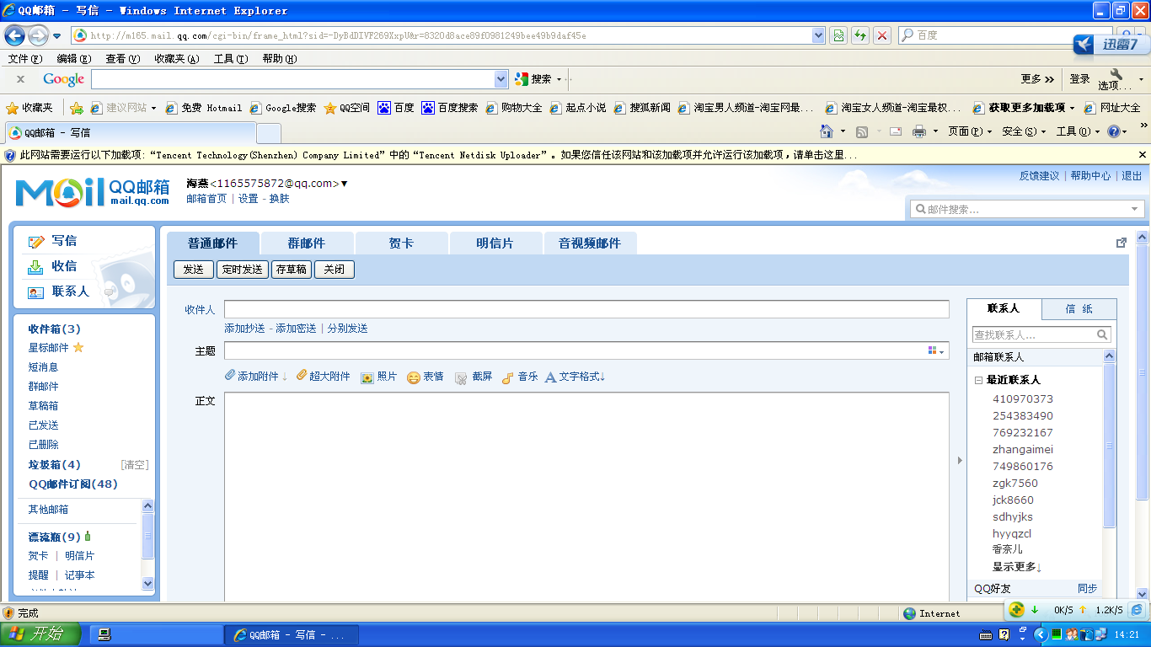
an Email

Slide 4
Think about these questions after reading the text.
Danny : How to ask Liming? (丹尼是怎样问李明的？）
Liming : How to answer? （李明是怎样回答的？）

Slide 5
Do you find the answers?
Danny : How to ask Liming? (丹尼是怎样问李明的 ？）
What are you doing?
Liming : How to answer? （李明是怎样回答的？）
I am writing an Email.

Slide 6
What are you doing?
I’m writing an email.

Slide 7
What are you doing?
I’m doing my homework.

Slide 8
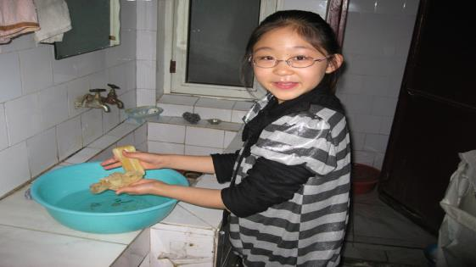
What are you doing?
I’m washing my socks.

Slide 9
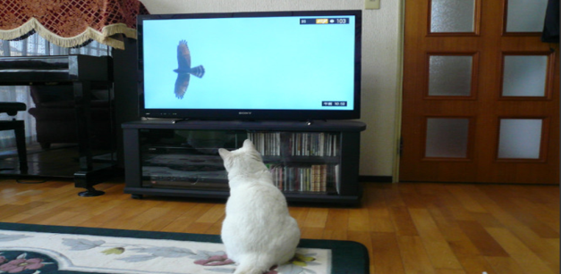
What are you doing?
I’m watching TV.

Slide 10
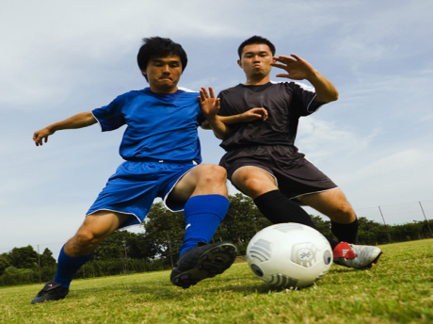
What are you doing?
I’m playing football.

Slide 11
What are you doing?
I’m swimming.

Slide 12
Practice
What are you doing?
1)_____________________?
你现在正在干什么？
2) I’m ______________to my friend.
我正在给朋友写信。
3) I’m_______.
我在跳舞。
4) I’m_______.
我在唱歌。
5) I’m _______basketball.
我在打篮球。
writing an email
dancing
singing
playing

Slide 13
What are you doing now?
I’m having English class.
I’m listening.
I’m looking at you.
I’m thinking.(正在想)
I’m sitting.(正在坐)
I’m speaking.(正在说话)

Slide 14
Let’s chant！
What are you doing? I am running.
What are you doing? I am singing.
What are you doing? I am reading.
What are you doing? I am skipping
What are you doing? I am drawing.

Slide 15
Homework
1. Read after the tape and imitate it.
2. New Year is coming. Write an Email to your parents, friends or your teacher.

