Slide 1
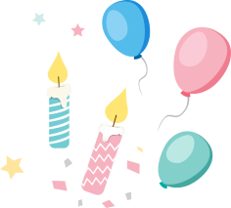
Unit 1
In China, we open a gift later.
WWW.PPT818.COM

Slide 2
Revision
1. When you are travelling, bring a map because it _____
help you.
A. can't B. mustn't C. used to D. may
2. —What will the weather be like tomorrow?
—It _______ be rainy, cloudy or sunny. I'm not sure.
A. must B. should C. can't D. might
3. Mary will _________ go to New York in the autumn.
probably

Slide 3
Lead in: Free talk
Do you know the differences of ways of life between people in China and in the west?

Slide 4
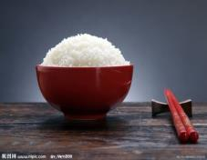
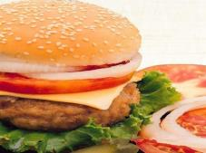
Eating habits
In China
In the West
rice
hamburgers

Slide 5
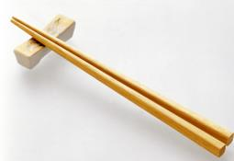
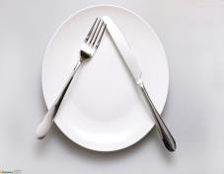
Eating habits
In China
In the West
chopsticks
knife
fork

Slide 6
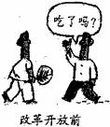
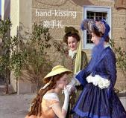
Greetings（问候）
In China
In the West
— Hi, have you had your meal?
— Where are you going?
— Shake hands
— Greet with a “Hi”
— Give each other a smile
— Kiss

Slide 7
Learning Objectives
To listen and understand the conversation on customs and social behaviours.
To get specific information from the listening material.
To talk about rules and customs at school and at the dining table.

Slide 8
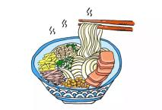
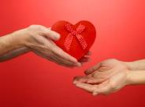
Pre-listening
seriously
taste
Betty says _________ that the noodles _____ great.
/ˈsɪəriəs/
/teɪst/
tradition
accept
It is our ________ to ______ a gift with both hands.
/trəˈdɪʃn/
/əkˈsept/

Slide 9
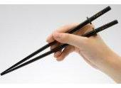
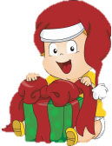
Pre-listening
chopsticks
Betty’s mum gave her a pair of ___________ as her birthday _______.
gift
/ˈtʃɒpstɪk/
/ɡɪft/
surprise
immediately
To our ________, Betty open her gift ____________.
/səˈpraɪz/
/ɪˈmiːdiətli/

Slide 10
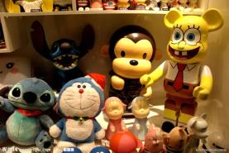
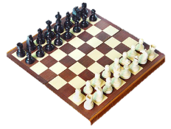
Guessing Game
toys
chess set
These are some ______. The kids like them.
This is a ___________. We can play chess on it.

Slide 11
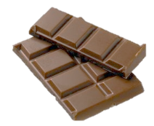
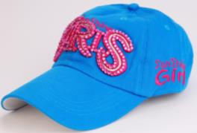
Guessing Game
chocolate
baseball cap
This is a bar of _________. We can eat it and it tastes sweet.
This is a ____________ .
We can wear it on our head.

Slide 12
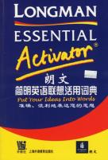
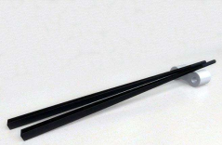
Guessing Game
This is a __________.
We can look up new words in it.
chopsticks
dictionary
This is a pair of __________.
We Chinese eat with them.

Slide 13
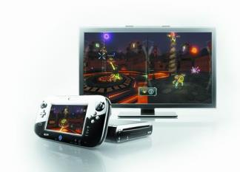
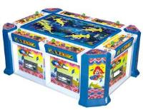
Guessing Game
video game
This is a ____________. We can play with it.

Slide 14
While-listening: Listen and number
baseball cap chess set chocolate
chopsticks dictionary toy
video game
6
2
3
4
7
1
5

Slide 15
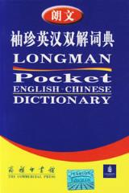
What gift do they want to buy for Lingling?
Can you guess what Lingling will do when she accepts the gift?
An English dictionary.

Slide 16
While-listening: Listen and fill in the table
 | In China | In the West
Receive a gift | Accept it with 1._______ hands. Open it 2._______. | Do not pay much 3._________ to that.
Festivals | On the first day of the _____________ you mustn’t do any _________. | /
both
attention
later
Spring Festival
cleaning

Slide 17
Read the dialogue in groups.

Slide 18
Check what you usually do in China
1. Open a present immediately when you receive it.
2. Accept a present with both hands.
3. Use red paper for hongbao.
4. Do cleaning on the first day of the Spring Festival.
5. Break something during the Spring Festival.
6. Have your hair cut during the Spring Festival month.
√
√

Slide 19
Fill in the blanks and find out the rules.
open
In China, when we receive a gift, we should_______ (open) it later. But in the US, people can ______ (open) the gift immediately. What's more, in China we should _______ (accept) a gift with both hands; but in the West, people needn't ______ (pay) much attention to that.
In some places of China, people mustn't _____ (do) any cleaning on the first day of the Spring Festival and mustn't _______ (break) anything because it's bad luck. And we must only ____ (use) red paper for hongbao because red means luck. In addition, people had better not ______ (have) your hair cut during the Spring Festival month. In the north of China, many people will _____ (eat) jaozi. They taste great.
open
accept
pay
do
break
use
have
eat

Slide 20
Post-listening
Think and talk about what you must and mustn’t/can’t do in the situations.
 | Must | Mustn’t/Can’t
At school | put up your hand before you talk
At the dining table |  | talk with food in your mouth

Slide 21
Summary
To listen and understand the conversation on customs and social behaviours.
To get specific information from the listening material.
To talk about rules and customs at school and at the dining table.

Slide 22
Assignment
Recite the dialogue after class.
Search the Internet and talk about the differences of customs and social behaviours between Chinese and foreigners.

Slide 23
Reserved activity
accept attention surprise taste traditions
It is always a(n) (1) ________ to receive gifts from family members and friends. In China, we usually (2) _______ a gift with both hands and open it later. But in the West, people usually do not pay much (3) ________ to that. During the Spring Festival, there are many (4) _________. For example, people in the north of China eat lots of jiaozi. They (5) _____ great.
surprise
accept
attention
traditions
taste

Slide 24
THANK YOU

