Slide 1
Unit 10
I can’t wait to see you
WWW.PPT818.COM

Slide 2
New words

Slide 3
excited

Slide 4
present

Slide 5
famous
著名的

Slide 6
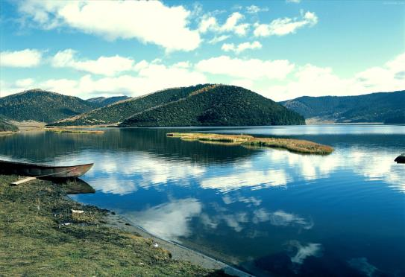
lake

Slide 7
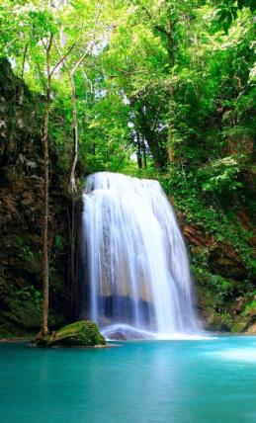
waterfall

Slide 8
Let’s learn…

Slide 9
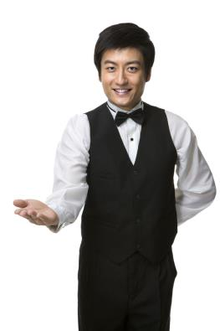
Thanks so much for inviting me.

Slide 10
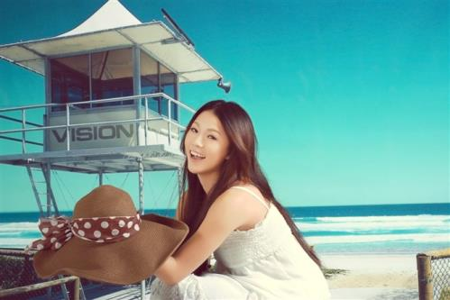
I can’t wait to see you.

Slide 11
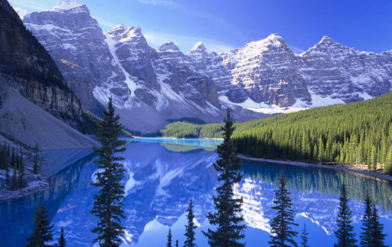
Canada is famous for its natural beauty.

Slide 12
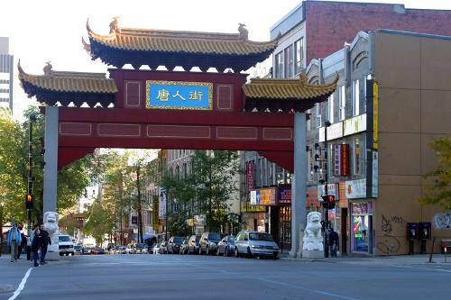
I plan to visit Chinatown in Toronto.

Slide 13
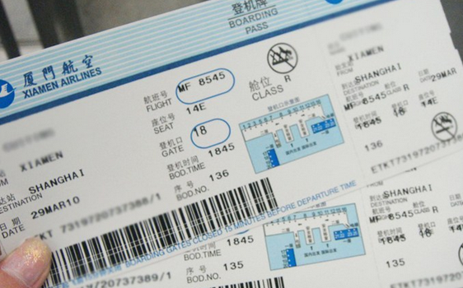
I booked my plane ticket today.

Slide 14
记忆大比拼！
老师将单词卡片按照随意
顺序摆好，学生记忆，
之后老师随意打
乱顺序，学生根
据记忆将单词还原。

Slide 15
Homework
1.Remember these new words.
2.Read the dialogue to your parents.

Slide 16
Thank You!

