Slide 1
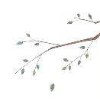
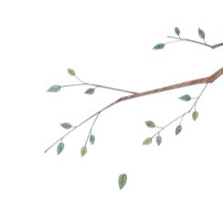
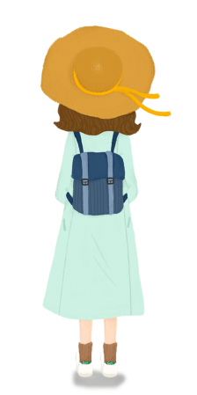

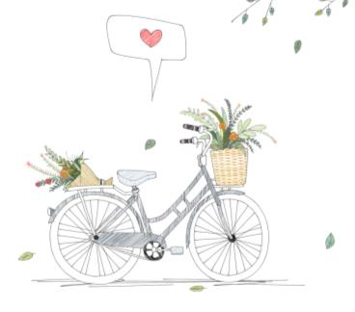



Unit1 This is me!
Comic strip & Welcome to the unit
WWW.PPT818.COM

Slide 2
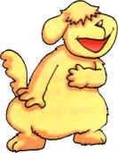
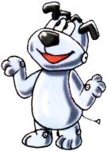
Lead-in
Hello! I'm Eddie. I'm your new friend.
a real dog
Hi! My name is Hobo. I'm an e-dog.
an e-dog
Are you curious about (好奇) the
relationship(关系) between Eddie and Hobo?

Slide 3
Study aims:
1.熟练掌握并学会运用重点单词及短语： master, look after, good morning, good afternoon, good evening, good night等。
2.能用英语询问他人的姓名，并简单问候。

Slide 4

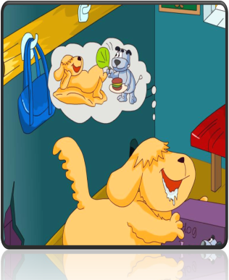

  Questions
Master means a person who is able to control something
Who has an e-dog?
Eddie has an e-dog.
Is Eddie the master of Hobo?
照顾，照看
Look afer sb./sth.= take care of sb./sth.
Yes.
What does Hobo ask Eddie to do?
Read a book.
Why should Eddie read it?
Eddie can know how to look after the e-dog.

Slide 5
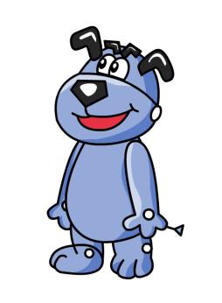


  Complete the paragraph
Hi! I'm Hobo, an . Eddie is my , but he doesn't know how to
me. I think he should read my first.
e-dog
master
look after
take care of
book
Hobo

Slide 6
延迟符
Guessing
Love me, love my dog.
爱屋及乌
It’s raining cats and dogs.
倾盆大雨
Every dog has its day.
人人皆有得意时
work like a dog
拼命工作

Slide 7
Exercise
What's your n___ ? I'm Hobo.
ame
This is my instruction book, and r it now.
ead
Look! It's my e-dog, so I'm the m of the e-dog.
aster
Please look the dog for me.
after
=
Please the dog for me.
take care of

Slide 8
Act it out
Work in pairs. One acts Eddie. Another one is Hobo. Pay attention to your pronunciation(语音) and intonation(语调).

Slide 9





Eddie
a dog
master
Hobo’s ______
Who is Eddie's master?
Hobo
e-dog
an ______
Millie
a student
Eddie’s master
Millie gives the present
to Eddie .
She looks after him very well.

Slide 10





let's get to know some of Millie's friends!
Amy
5
1
Sandy
Daniel
4
2
3
Simon
Kitty

Slide 11
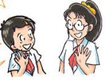
Greetings
Sandy: Good morning!
Millie: Good ! I'm Millie.
what's your ?
morning
name
Sandy: My name is Sandy. Nice to
meet you.
Mille: Nice to meet you .
too

Slide 12
Greetings（问候语）
before one of you go to bed
18:00
07:15
14:30
Good evening
Good night
Good morning
Good afternoon

Slide 13

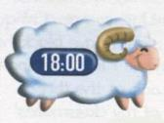

Good morning.
(we use it to greet
people in the morning)
2.45 p.m.
Good afternoon.
(we use it to greet
people before the
sunset 日落)
6.00 p.m.
Good evening.
(we use it to greet
people after the sunset
and before going to bed)
7.15 a.m.

Slide 14
Pair work: Make a dialogue in pairs.
A: Hello. / Hi. / Good morning…
B: Hello. / Hi. / Good morning…
A: I’m…/ My name is… What’s your name?
B: I’m…/ My name is…
A: Nice to meet you.
B: Nice to meet you, too.

Slide 15
Exercise
I get up at 6:30 a.m. and I say to my parents.
Our PE class is at 4:00 p.m., so we say to the PE teacher.
Good morning
Good afternon
I have supper at my grandparents' home, so I say to them.
Before we go to bed, we should say to each other.
Good night
Good evening

Slide 16
Summary（总结）
Sentence patterns
New words and phrases
What's your name?
My name is.../I'm ...
Nice to meet you.
Nice to meet you too.
e-dog, master,
look after/take care of
Greetings
Good morning/afternoon/evening/night

