Slide 1
Module 3 Unit 2
The cows are drinking water.
WWW.PPT818.COM

Slide 2
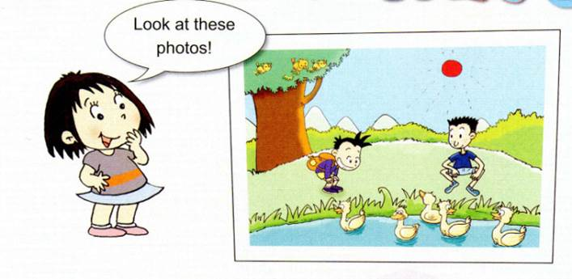
Watch and say
Let’s review
The sun is shining. The birds are singing .

Slide 3
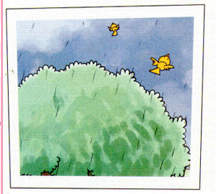
Watch and say
Let’s review
The birds are flying away.

Slide 4
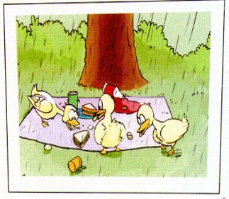
Watch and say
Let’s review
The ducks are eating our sandwiches.

Slide 5
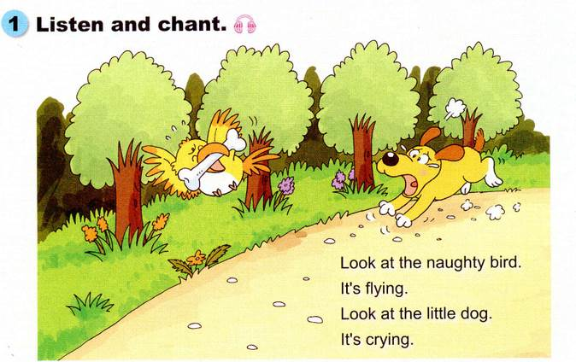
Let’s chant
Look at the naughty bird.看这只淘气的鸟。
lt's flying.它正在飞。
Look at the little dog.看这只小狗。
lt's crying．它正在哭。

Slide 6
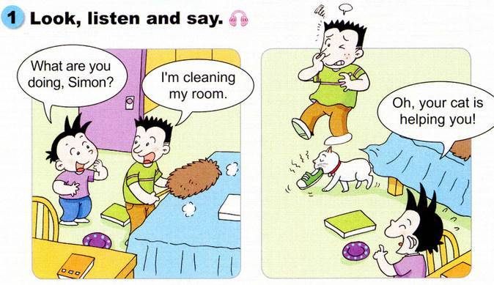
Watch and say
What are you
doing，Simon?
I'm cleaning
my room.
Oh，your cat is
helping you!

Slide 7
Let’s learn.
“What are you doing ？”
你正在做什么？
表示对你现在正在做的事情的询问。
I'm cleaning my room.
我正在打扫我的房间。
“I ‘m + 动词ing ”
表示我正在做什么（事情）。

Slide 8
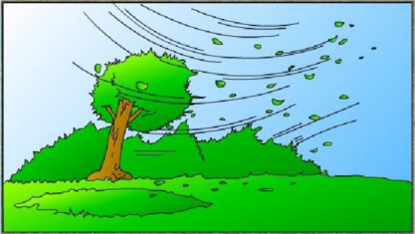
单词学习
blow 吹，刮
The wind is blowing .

Slide 9
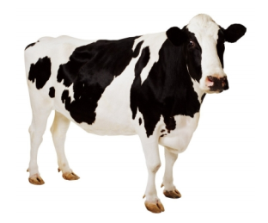
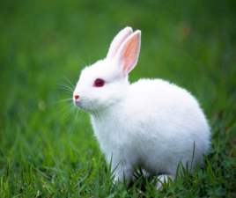
单词学习
What is it ?
cow 奶牛
rabbit 兔子

Slide 10
Watch and say
Let’s try
The sun is shining .
太阳正在照耀.
The wind is blowing .
风正在刮着.

Slide 11
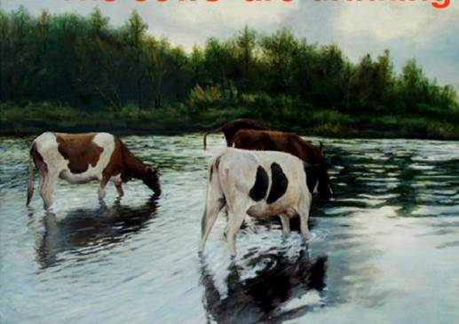
Watch and say
Let’s try
The cows are drinking water.
奶牛正在喝水。

Slide 12
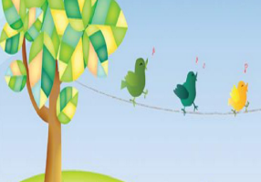
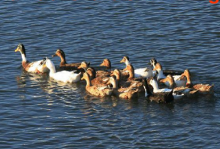
Watch and say
Let’s try
What are they doing ?
The birds are singing.
小鸟正在唱歌.
The ducks are swimming.
鸭子正在游泳.

Slide 13
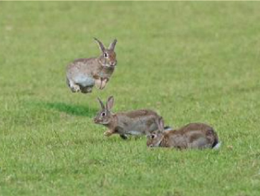
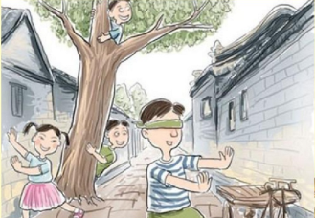
Watch and say
Let’s try
The rabbits are jumping.
兔子正在跳跃.
Game：hide-and-seek.
游戏：捉迷藏.

Slide 14
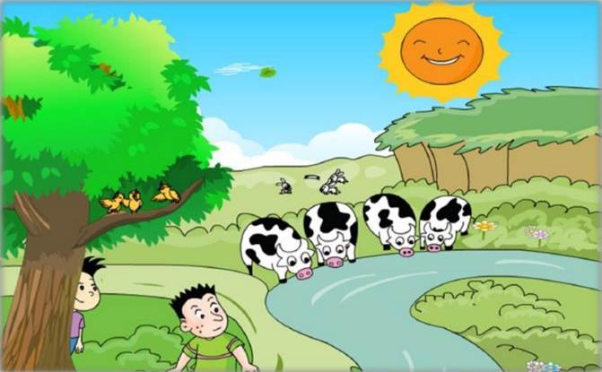
Look and say
What is Daming doing ?

Slide 15
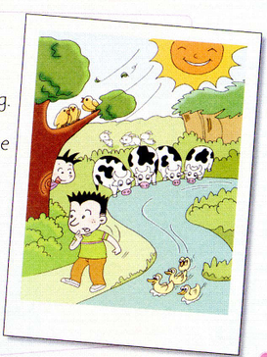
Let’s read
Dear Lingling，
In this photo，we are in the mountains.
The sun is shining and the wind is blowing .
The cows are drinking water. The birds are singing.The ducks are swimming,The rabbits are jumping.Simon and l are playing
hide-and-seek.
We are having a lovely time!
Love,
Daming
捉迷藏
玩的愉快，过的高兴

Slide 16
Watch and answer
What’s the weather like ?
It’s sunny and windy .
What are the cows doing ?
The cows are drinking water.
Are the birds singing ?
Yes, they are .
What is Daming doing?
He is playing hide-and-seek with Simon .
Are they happy ?
Yes, they are having a lovely time .

Slide 17
Key sentences.
现在进行时态：
表示正在发生的动作或发生的事情，通常与now连用。
基本形式：
Be ( am/ is / are ) + doing(现在分词)
Be 动词使用口诀：
I 用am ，you 用are ，is 跟着he / she /it 。
至于复数（we / they / you）, 全部都用一个are 。

Slide 18
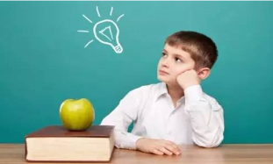
现在分词又是怎么构成呢?
大多数的动词直接在动词的后面加ing。
Eg: send—sending fly—flying
以不发音e结尾的动词，要先去e在加ing.
Eg: shine—shining have—having
以重读闭音节结尾，呈现“辅-元-辅”结构的
动词，先双写末尾的辅音字母，再加ing。
Eg: swim—swimming run—running

Slide 19
全班抢答竞赛，单词和词组知识一闪而过，
看谁记得快记得牢。
everyone
fly away
rabbit
What are you doing ？
The sun is shining .
naughty ducks
blow
cow
hide-and-seek
火眼金睛
drinking water
have a lovely time

Slide 20
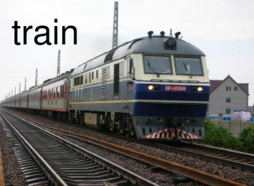
Watch and say
What is it ?
train
window

Slide 21
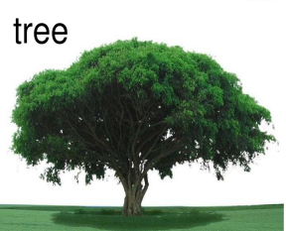
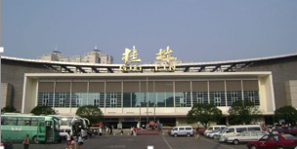
Watch and say
What is this ?
tree
station

Slide 22
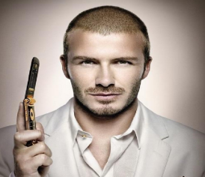
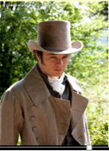
Watch and say
man
hat
A man is wearing a big hat .
一个男人正戴着一顶大帽子。

Slide 23
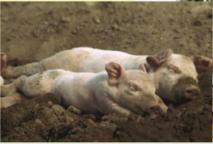
Watch and say
What are the pigs doing?
Sleeping
The pigs are sleeping
under a tree .

Slide 24
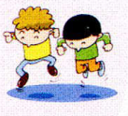
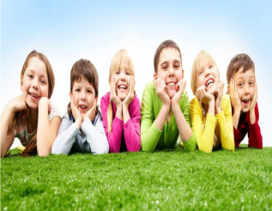
Watch and say
What are they doing?
children
The children are jumping
in the water .

Slide 25
Watch and write
Where
are you?.

Slide 26
Check answers
train
window
raining
sleeping
tree
man
hat
children
jumping
train
sation
我在火车上。我正在向窗外看。天正在下雨。一些猪正在树下睡觉。一个男人正戴着一顶大帽子。一些孩子正在水里跳。现在火车正来到车站。我能看见你！

Slide 27
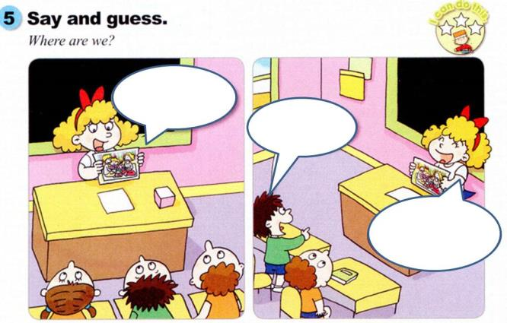
Watch and Guess
In this photo,
we’re having a
picnic.
Are you in
the park?
That’s right.
The weather is
very good.

Slide 28
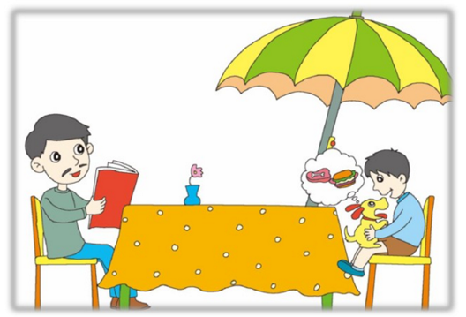
Let's try
Show your photo and ask your partner to
guess “ Where you are” .

Slide 29
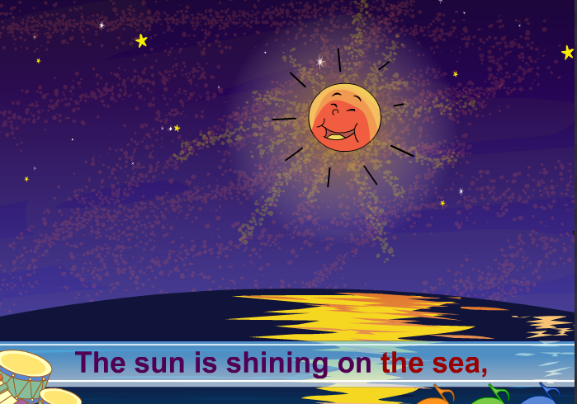
Read and chant

Slide 30
Read and say.Then chant
The sun is shining on the sea，太阳正照耀着大海，
shining,shining brightly.照耀着，明亮地照耀着。
And this is strange，这很奇怪，
because it is the middle of the night.
因为这是在半夜。
The moon is shining sadly,月亮悲伤地照耀着，
because she thinks the sun is wrong to be there in the sky after the day is gone.
因为她认为白天已经结束,可是太阳（还）在天空中是不对的。
“The sun is very bad. He spoils my time,”she says.
“太阳很坏。他破坏了我的时光。”她说。

Slide 31
Read and say.Then chant

Slide 32
Challenge your memory!
Are you ready?
go...

Slide 33
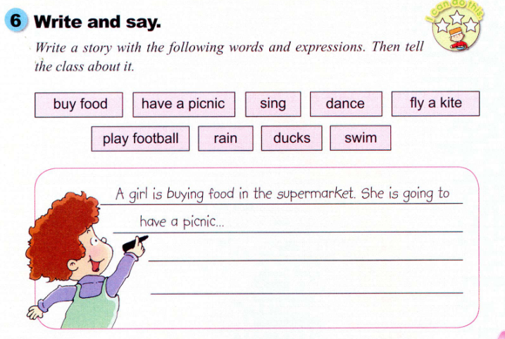
write and say
Q：What are you doing?

Slide 34
小组合作，选用下列单词写一个小故事，然后讲给大家听。
A girl is buying food in the supermarket . She is
going to have a picnic . The birds are singing . A
boy is flying a kite. It’s going to rain soon . Children
are running to home .the ducks are swimming on
the pond .

Slide 35
现在进行时态：
表示正在发生的动作或发生的事情，通常与now连用。
基本形式：
Be ( am/ is / are ) + doing(现在分词)
Be 动词使用口诀：
I 用am ，you 用are，is 跟着he / she /it 。
至于复数（we /they / you）,全部都用一个are .

Slide 36
现在分词的构成：
大多数的动词直接在动词的后面加ing。
Eg: send—sending fly—flying
以不发音e结尾的动词，要先去e在加ing.
Eg: shine—shining have—having
以重读闭音节结尾，呈现“辅-元-辅”结构的
动词，先双写末尾的辅音字母，再加ing。
Eg: swim—swimming run—running

Slide 37
Homework
能独立完整地朗读第17页活动2的内容。
完成配套教辅相应的练习。

