Slide 1
初中英语外研版八年级下
Module5 Cartoons
Unit1
It’s time to watch a cartoon.
WWW.PPT818.COM

Slide 2
Warm-up
1
Presentation
2
Language Points
3
Exercise
4

Slide 3
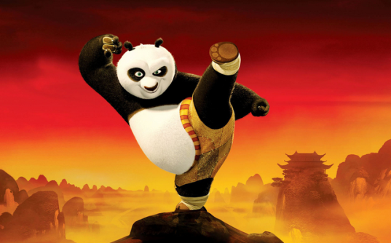
Warm-up
Talk about
Do you know this cartoon?
What’s the name of the cartoon?

Slide 4
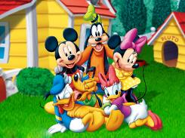
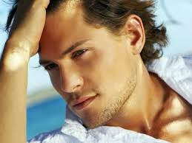
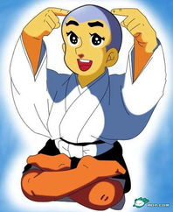
Presentation
Learn some new words
cartoon
handsome
smart
sky

Slide 5
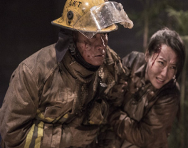
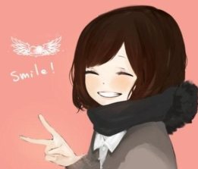
cool
hero
humorous
laugh
lesson

Slide 6
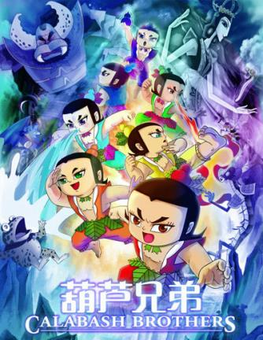
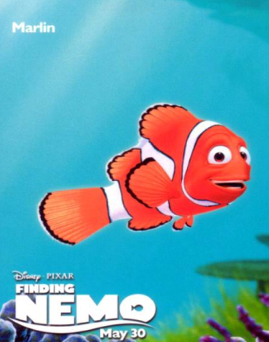
1
Answer the questions
What kind of cartoons do you like?

Slide 7
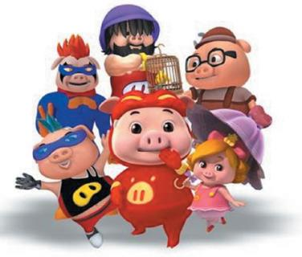
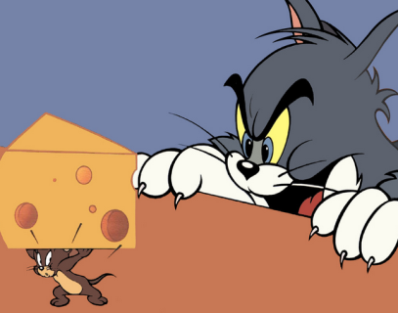
2. Do cartoons always end in a happy way?

Slide 8
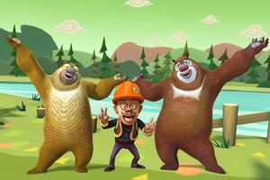
3. What cartoons do you think are funny?

Slide 9
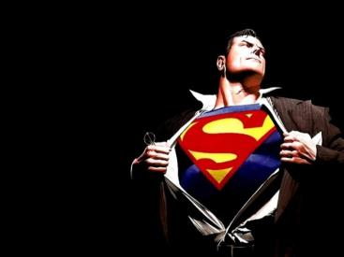
Now work in pairs and check.
Do they like the same cartoon as you?
No, they don’t.

Slide 10
3
Read and answer the questions.
1. What are Tony and Daming
talking about?
They are talking about cartoons.
2. What does Daming think is better?
He thinks Superman is better.

Slide 11
Read the dialogue and mark T or F.
1. Daming and Tony have finished their homework. ( )
2. Spiderman can fly, but he can’t climb up buildings with his hands and feet. ( )
3. At last Daming and Tony watch Tom and Jerry together. ( )
T
F
T

Slide 12
Read the dialogue and answer the questions.
1. What does Tony think about Spiderman?
Spiderman can’t fly, but he climbs up buildings with his hands and feet. That’s cool.
2. Why does Daming think Superman is better?
Because he’s stronger than Spiderman. He can fly though the sky and fight bad people.

Slide 13
3. Why do they both like Tom and Jerry?
Because Tom and Jerry are very funny.
4. What lesson can Tony learn from
Tom and Jerry?
They fight a lot, but they really love
each other.

Slide 14
Language points
1. Do cartoons always end in a happy way?
卡通片常以快乐的方式结束吗？
in a … way 表示“以一种…的方式”。
e.g. He talked about it in a similar way.
他对此事有相似的说法。

Slide 15
2. It’s time to watch a cartoon.
是时候看卡通片了。
It’s time to do sth. 表示“该做某事的
时候了”。
It’s time for sth./doing sth.表示“该做
某事的时候了”。
e.g. It’s time to have breakfast.
=It’s time for breakfast/ having breakfast.
该吃早饭了。

Slide 16
3. He can fly through the sky and fight bad people.他能在空中飞并且打败坏人。
fight v. (fought, fought) 与……战斗
n. 战斗；斗争
fight sb. “和某人打仗”
fight for sth. “为…打仗”
e.g. Let’s fight poverty and disease together. 让我们一起克服贫困和疾病。

Slide 17
4. He keeps fighting bad people.
他坚持和坏人作斗争。
keep doing sth. “坚持做某事”。
e.g. We must keep learning English every day.
我们必须坚持每天学英语。
5. I can’t help laughing when I watch them.
我看这些总禁不住大笑。
can’t help doing sth. “禁不住做某事”。
e.g. The boy can’t help crying when he knows what is
happening.
当男孩知道发生了什么的时候禁不住地哭了。

Slide 18
6. Listen and underline the words the speaker
stresses.
1. That's a real hero!
2. I don't think we agree.
3. They fight a lot, but they really love each other. 4. I think there’s a lesson there!
Now listen again and repeat.

Slide 19
Exercise
Choose the best answers.
1. —It’s time ___ after school.
—Let’s go now.
A. go home B. going home
C. to go home
2. Look! The plane is flying ___ the sky.
A. on B. at
C. through D. for
C
C

Slide 20
3. The boy kept ___ until twelve o’clock yesterday.
A. studying B. to study C. studied
4. The woman couldn’t help ____ when she heard the bad news.
A. cry B. to cry C. crying
A
C

Slide 21
5. —Why are you worried?
—I’m expecting a call from my daughter. She ___ New York for three days.
A. has gone to B. has been to
C. has been in D. has come in
C
6. —What did you do last night?
—I ____TV and read books.
A. watch
B. watched
C. have watched
B

Slide 22
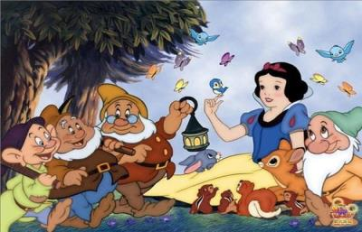
Homework:
谈谈你对这部卡通片的看法。60词左右。
(Snow White and Seven Dwarfs)

