Slide 1
Unit 8 Topic 2
The summer holidays are coming.
Section C
WWW.PPT818.COM

Slide 2
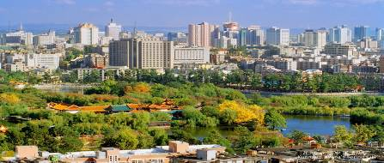
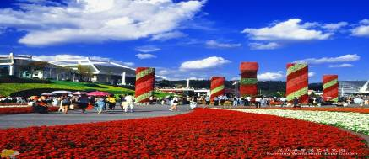
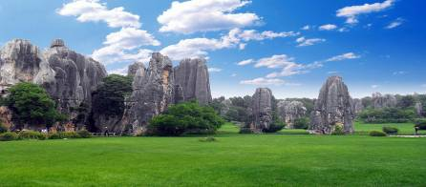
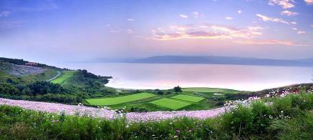
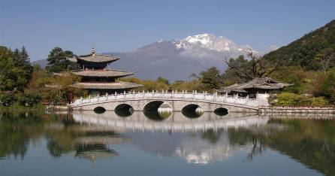
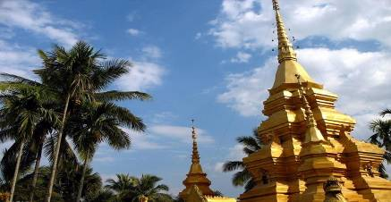
Can you tell me something about Yunnan?

Slide 3
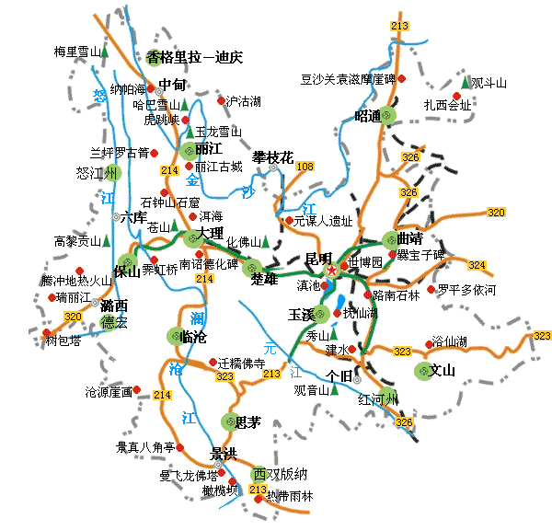
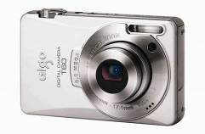
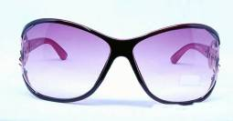
What should Jane take with her to Yunnan?
She had better take a camera, a pair of sunglasses, a map and so on.

Slide 4
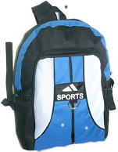
What would you like to take for the trip?
You'd better take a bag.It can help you carry water, clothing and some other things.
clothing

Slide 5
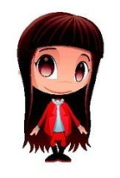
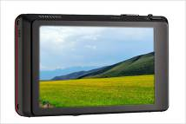
I think you should take a camera.
Because you can use it to take photos.
Then you can share the fun with your friends.
乐趣
share...with sb.
与某人分享...

Slide 6
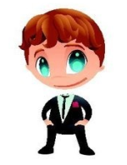
You should take a map with you.
It can help you decide what you want to visit.
决定

Slide 7
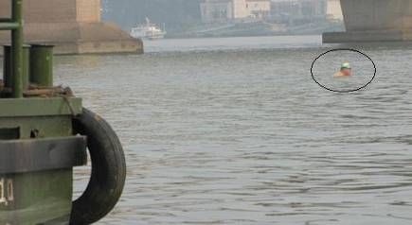
Attention !
You shouldn't stay in the sun too long.
Don't go swimming. It's too dangerous.
If you like to swim, remember you shouldn't swim alone.
×

Slide 8
Skim the passage and check(√) the one that best summarizes the main idea.
Skimming is reading quickly for the main idea. The first sentence of each paragraph may help you.
√
A.Teach us how we should be careful on a trip.
B.Tell us a story about a careful trip.
C.Explain why we should be careful on a trip.

Slide 9
Read 1a and write what you should and shouldn't do on a trip.
You should...
1.travel with a friend
2.carry a map
3.drink safe water and put on a hat and a pair of sunglasses
You shouldn't...
1.go to dangerous places
2.stay in the sun too long
3.swim alone

Slide 10
Work in pairs. Tell you partner what you have learned from the passage with the help of the information in 1b.
You can begin like this:
How can you have a wonderful holiday trip? You should prepare well for it. Before your trip you should/you'd better/
don't.../remember to...
On the trip, you should/you'd better/don't.../remember to...

Slide 11
Suppose Kangkang wants to climb a mountain with his friends. Discuss it with your partners and check( √ )what they should or shouldn't do.
Item | Should | Shouldn't
1. Keep together with your friends.
2. Drink any water you can find.
3. Take some food.
4. Wear the right shoes.
5. Keep away from dangerous animals.
6. Cook in the mountains.
7. ...
√
远离

Slide 12
Write a letter to Kangkang to give him some suggestions.
Dear Kangkang,
I‘m glad to know you will climb a mountain in your holiday. You should prepare well for it. When you climb a mountain with your friends, you should be very careful...
Yours,
_______

Slide 13
Listen and read the following words aloud. Pay attention to the pronunciation of the blue parts.
scarf scale slow sleep small
smile snake snow skirt sky
speak spoon spider spring
stand star street strawberry
swim sweet screen scream
program progress quiet quite

Slide 14
Summary
1.Important phrases:
prepare...for..., share...with.., in the sun,
keep together with, keep away from.
2.Go on learning to make suggestions for trips .
You should...
You shouldn't...
You'd better...
Don't...
Remember to...

Slide 15
Homework
1. Read 1a and then try to recite it .
2. Finish Section C in your workbook.
3. Write a composition according to 2b in this section.

