Slide 1
Unit 10
If you go to the party, you’ll
have a great time!
WWW.PPT818.COM

Slide 2
Revision
一、将下列词组或句子翻译成英语。
1. 有许多担忧 ___________________
2. 与某人交谈 ___________________
3. 害怕做某事 ___________________
4. 最终 ____________
5. 生气 ___________
have a lot of worries
talk to someone
be afraid to do sth.
in the end
be angry

Slide 3
6. 犯一些粗心的错误
_____________________________
7. 分享我的问题 ____________________
8. 逃避问题 ________________________
9. 将……分成两半 _______________
10. 有时候他们在学业上出现问题。
________________________________
_________________________
make some careless mistakes
share my problems
run away from the problems
cut … in half
Sometimes they have problems with their schoolwork.

Slide 4
11. 在生活中，有困难和担忧是正常的事。
___________________________________
12. 如果不和别人谈一 谈，我们肯定会觉得
更糟。
__________________________________
_______________________
罗伯特就一些寻常的问题向学生们提了
建议。_______________________________
_____________________
Problems and worries are normal in life.
Unless we talk to someone, we’ll certainly feel worse.
Robert advises students about common problems.

Slide 5
3a
Finding
Talk to someone you know. Find out his/her three biggest worries. Try to think of some solutions to the problems and write them down.

Slide 6
Problems Possible solutions
eat less junk food and more vegetables, do more exercise
too heavy
don’t stay up late, buy an alarm clock, ride your bike to go to school
always be late for school
take notes in class, do more exercises, ask the teacher for help
physics is difficult

Slide 7
Writing
3b
Write about your friend’s first problem and the possible solutions. Use the structures below to help you plan your writing.
My friend _______ has a problem. He/She ___________________________. I think he/she should _______________.
If he/she _________________________,
he/she will _______________________.

Slide 8
指导
分析3b中的作文提纲，可以看出。需写三个方面的内容就能轻松完成一篇小作文。
首先，写清楚朋友的名字及其现在存在的问题或困难。
然后，写出自己给他的建议。并用if从句来进一步说明自己建议将会起到的作用。
最后，复读一遍作文来检查有没有错误。

Slide 9
Possible version
My friend Jenny has a problem. She is too heavy. I think she should eat less junk food and eat more vegetables and fruit. I think she also should get more exercise. If she eats more vegetables and fruit, she will eat less junk food. If she gets more exercise, she’ll be much thinner soon.

Slide 10
Now write your advice for your friend’s second and third problem. Use the structures in 3b to help you.
3c
My friend also has two other problems. __________________________________
__________________________________
__________________________________

Slide 11
Possible version
….She is always late for school. I think she shouldn’t stay up later on weekdays. She should get an alarm clock. She should rides her bike to school. If she has an alarm clock, she will get up early.

Slide 12
If she rides her bike to school, it will costs(花费) her less time to get to school. She thinks physics is too difficult for her. I think she should take notes in class. She should also do more exercises. She should ask the teacher for help after class.

Slide 13
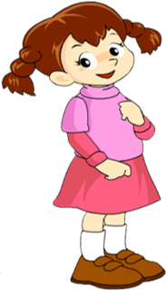
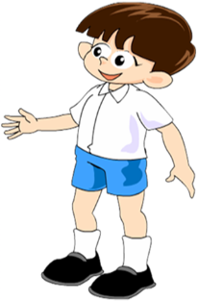
If I do that, I’ll bring the old people some flowers.
What will you do if you visit an old people’s home?

Slide 14
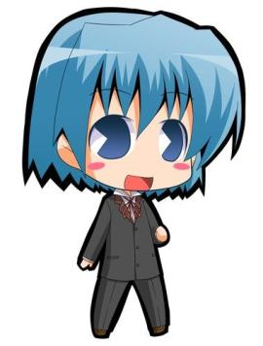
If I do that, I’ll sing and dance for them to make them happy.

Slide 15
Self check
1. Fill in the blanks with the words in the box.
meeting, teenagers, video, experience
1. If my family travels to a new country
this summer, I’ll send you a letter about my __________.
2. Will you watch the ______ with me if
you’re free this weekend?
experience
video

Slide 16
meeting, teenagers, video, experience
3. If the _________ stay out too late, their parents will worry about them.
4. I’ll go to the __________ if it ends by 5:00 p.m.
teenagers
meeting

Slide 17
2. Complete the conversation with
words in the box. Some words are
used more than once.
if, are, will, fight, want, sorry, going
A: Hi, Sally, _____ you ______ to the party tomorrow?
B: I ______ to, but I can’t.
are
going
want

Slide 18
A: Oh! But _____ you don’t go to the party, you ______ miss all the fun!
B: I know, but I got into a _____ with my parents.
if
will
fight
A: Hmm… then you should just say _____ to your parents.
B: I guess you’re right. I _____ talk to them tonight.
sorry
will

Slide 19
3. Use your imagination! What will
you do if…
1. it rains all weekend?
_________________________________
_________________________________
If it rains all weekend, I’ll chat with my friends online and play computer games.

Slide 20
2. there’s an English test tomorrow?
_________________________________
_________________________________
3. your cousin decides to come and visit
from another town?
_________________________________
_________________________________
_________________________________
If there’s an English test tomorrow, I’ll go over my books and notes.
If my cousin decides to come and visit from another town, I’ll have a party for him. And I’ll invite a lot of good friends.

Slide 21
Free Talk
If you win a large amount of money, what will you do?

Slide 22
Name | Plans
I | I will buy a big house for my parents.
S1 | …
S2 | …
S3 | …

