Slide 1

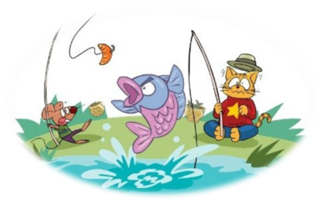
6
Unit
My e-friend
WWW.PPT818.COM

Slide 2
Learning aims
1. I know the sound of letter "w".
我知道字母w的发音。
2. I can understand Cartoon time and try to act it.
我能理解卡通部分并且能试着表演出来。
3.I know how to write Chinese and English addresses.
我知道怎么书写中文与英文的地址。

Slide 3

Let’s chant.
I wish I could fly!
fly
my
sky
try
why
High , high in the sky,
I can see a butterfly.
High, high in the sky,
I wish I could fly !

Slide 4
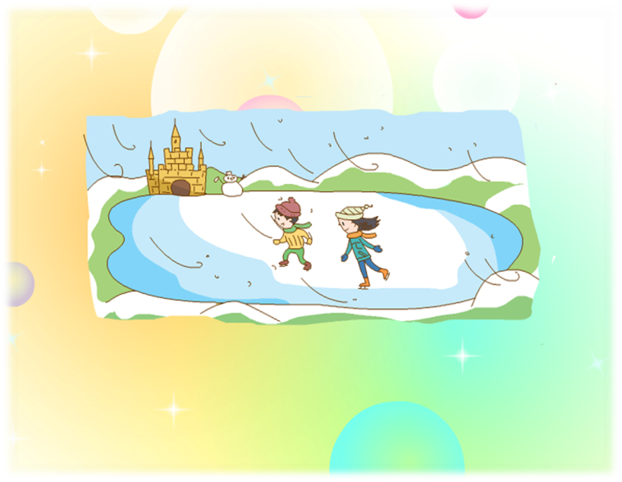
look and say
winter

Slide 5


Look and say
变成
In winter,
_______turns to ice.
water
And sometimes it .
We can make snowmen.
snows
下雪（动词）

Slide 6

Look and say
So when the winter weather comes,
We always wear .
总是
warm clothes
cool clothes

Slide 7
Listen and read.
In winter, water turns to ice.
And sometimes it snows.
So when the winter weather comes,
We always wear warm clothes!
w
w
w
w
w
w
w
w
Tips: 停顿 ， 更长停顿 。
I can read this rhyme.

Slide 8
Think and say
/w/
W-
Can you say more word like this(像这样)?
你还知道哪些含字母w并发/w/的单词?
I can say more words.

Slide 9
Try to read.
你会读下列单词吗？
wale
条痕
win
赢
wog
病菌
weak
虚弱的
wake
唤醒
worm
虫子
I can read the new words.

Slide 10
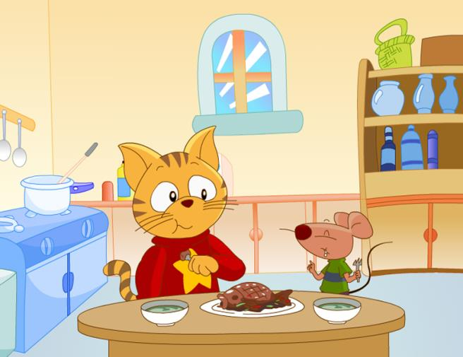
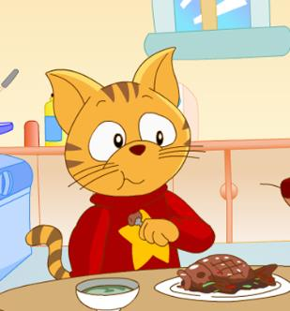
Look and say
Bobby and Sam eat fish at a snack bar.

Slide 11


Watch and answer
What will(将) they do tomorrow（明天）?
A.Go swimming.
B.Go skating.
C.Go fishing(去钓鱼).
Is Bobby good at
fishing?

Slide 12
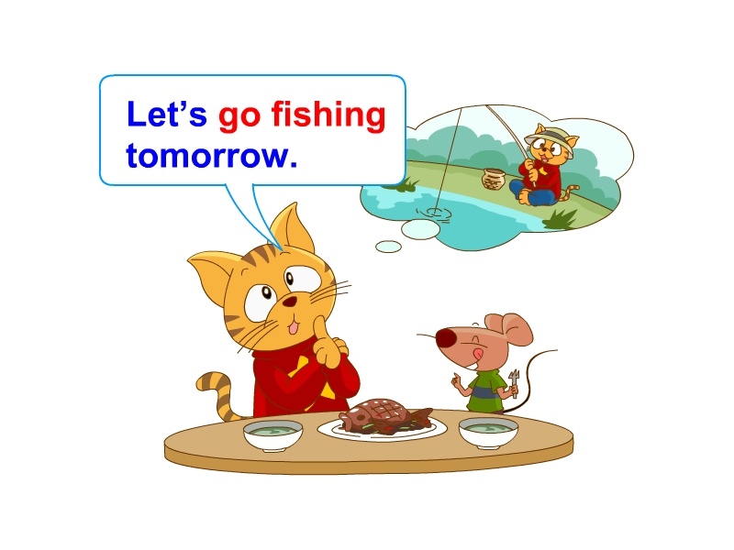
Let’s read.
Bobby and Sam eat fish at a snack bar.
OK, but I’m not good at fishing.
Don’t worry, Bobby. I can teach you.
别担心

Slide 13


Watch and answer
What do fish eat?
A.Apples. B.Oranges. C.Worms(虫子).
But what do they use to fish?
(但是他们用什么来钓鱼？)

Slide 14
Watch and answer
But what do they use to fish?
(但是他们用什么来钓鱼？)
A.Apples. B.Oranges. C.Worms(虫子).
Sam’s joke!
玩笑

Slide 15
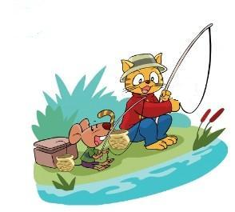
Let’s read.
Bobby and Sam sit by the river.坐在河边
They eat apples.
What do fish eat ,Sam?
Do they eat oranges too?
Yes, they do.

Slide 16
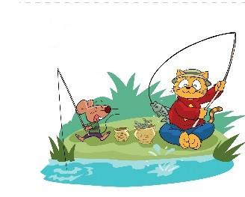
Now, Sam has many fish, but Bobby does not have any.
You’re really good at fishing, Sam.
Yes! Look!
I don’t have any fish.

Slide 17
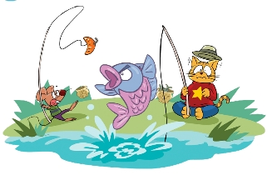
Bobby waits and waits.等啊等
I don't eat oranges.
angry 生气的

Slide 18



评星标准：
Read and act
能正确、流利地朗读课文。
能正确、流利地表演课文。
能正确、流利、有感情地表演课文。
1、Read in roles.（分角色读）
2、Read together.（齐读）
3、Act in roles.（分角色演）

Slide 19



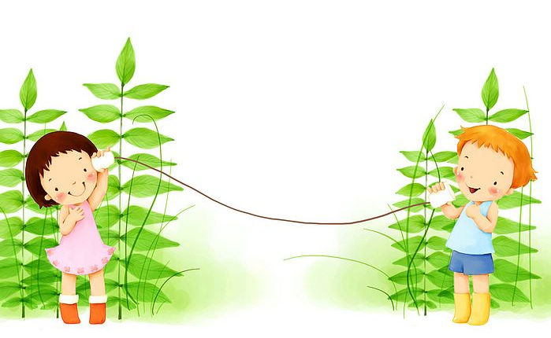
A life without a friend
is a life without a sun!

Slide 20
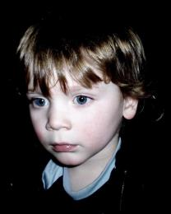
Let’s know him
Name: Jack Willson
Age: 12 years old
Home: New York（纽约）
Subjects: PE
Sport: swimming
Season : winter
Hobbies: skating
making friends
…
pen friend
笔友

Slide 21
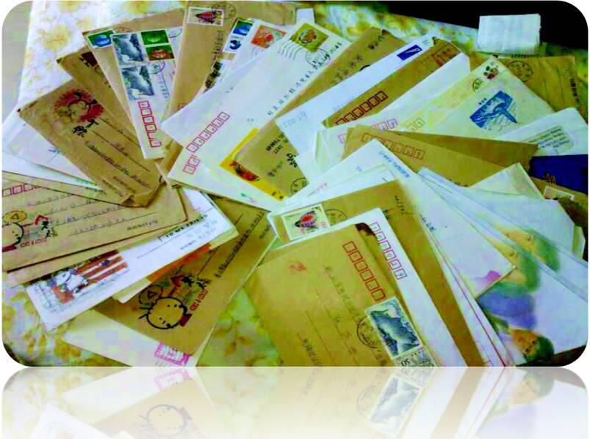
letter 信

Slide 22
address
中国江苏省无锡市惠山区天一街39号
沈老师 收
name
地址:从大到小
美国纽约市华尔街8号 杰克
address
People write Chinese addresses like this.
像这样

Slide 23
people write English addresses like this.
Jack Willson
name
8 Wall St.
New York, the US
address
地址:从小到大
注：Wall St. 华尔街 New York纽约

Slide 24
Tips:
英文信封上，收信人的名字和地址写在信封的中间，英文地址按“人名-地名-国名”的顺序书写，即由小到大的原则：先写门牌号、街道名称，再写城市、省（州），最后写上国家名称。

Slide 25

向Peter写封信,介绍一下你的好朋友吧！

Slide 26

128 Oxford St.
London, the UK
注：Oxford St. 牛津街
London 伦敦市
A
Peter Brown
Peter Brown
B
128 Oxford St.
London , the UK
Peter Brown
C
The UK
London, 128 Oxford St.

Slide 27

Try to write
Dear Peter,
I have a good friend.
He is 12 years old.
He lives in Wuxi too.
He likes Maths and Science.
He likes playing football very much.
We usually play football after school.
Do you like him?
Yours Shen

Slide 28
Try to write
Tips:在介绍时一定注意第三人称单数的表达哦！
Dear Peter,
I have a good friend.
He/She is _______ years old.
He/She lives in ______________
He/She likes_________________
He/She _____________________
We usually _______________ after school.
…
Do you like him/her?
Yours ________

