Slide 1
Unit 7 Chinese festivals
第1课时
五年级
WWW.PPT818.COM

Slide 2
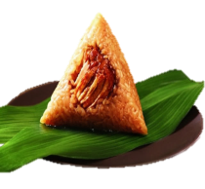
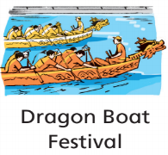
Try to guess
some rice in it
What festival?
节日
rice dumpling
green clothes
jump

Slide 3
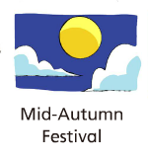
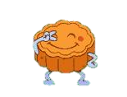
Try to guess
What festival?
It looks like a moon.
a pie
moon cake

Slide 4
What do you want to know about Chinese festivals?
(你想了解中国节日的哪些呢？)
Try to ask
What?
What do people eat?
When?
Chinese festivals
What do people do?

Slide 5
Watch and note
看动画，写出你所看到的节日。
What are the Chinese festivals ?
Learning tip(学习方法小提示):
当我们看动画时，可以尝试速记，如记录关键信息的单词首字母。
Take notes(速记)：
What are the Chinese festivals?
Festivals:
Spring Festival
SF

Slide 6
Watch and note
看动画，写出你所看到的节日。
What are the Chinese festivals ?

Slide 7
Watch and note
看动画，写出你所看到的节日。
What are the Chinese festivals ?
Learning tip(学习方法小提示):
当我们看动画时，可以尝试速记，如记录关键信息的单词首字母。
Take notes（速记）：
What are the Chinese festivals?
Festivals:
SF
DBF
MAF
DNF

Slide 8


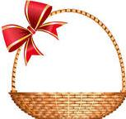


听录音，将节日和月份匹配。
Listen and match
When are the festivals？
November
A. in October or November
October
uary
uary
B. in January or February
October
C. in May or June
November
September
ber
D. in September or October
September
The____ Festival is in _______.

Slide 9
Read and fill
1.默读课文，划出关键词并完成表格。
2.完成表格后进行小组讨论。
What? | When? | What to do? | What to eat?
The Spring Festival
in January or
February
The Dragon Boat Festival
in May or
June
The Mid-Autumn Festival
in September or October
The Double Ninth Festival
in October or November
Notes:
9

Slide 10
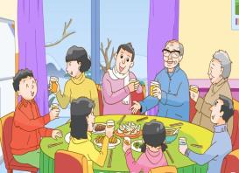
A:What do people do?
B: They …
Read and fill
What do people do?
A:What do people eat?
B: They eat…
默读课文，划出答案。
What do people eat?
What? | When? | What to do? | What to eat?
The Spring Festival
in January or
February
get together with
families
dumplings
The Spring Festival is in January or February. People also call it Chinese New Year. At this festival, people get together with their families. Some people eat dumplings.
get
together
团聚
饺子
Learning tips(学习方法小提示):
遇到不懂的单词,可以根据插图或联系上下文猜测！

Slide 11
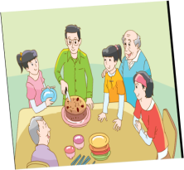
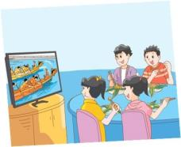

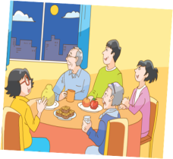
Read and fill
What do people do and eat at these festivals?
1.自读课文，完成表格。
2.完成表格后进行小组讨论。 。
Learning tip(学习方法小提示):
遇到不懂的单词,可以根据插图或联系上下文猜测！
People_______________ at this festival. People eat ________ at this festival.

Slide 12
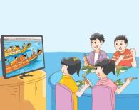
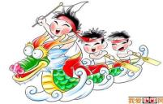
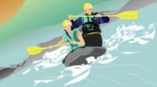
1.默读课文，划出关键词并完成表格。
2.完成表格后进行小组讨论。
Read and fill
What? | When? | What to do? | What to eat?
The Dragon Boat Festival
in May or
June
have dragon boat races
rice dumplings
dragon boat races
The Dragon Boat Festival is in May or June. There are dragon boat races in some places. People eat rice dumplings at this festival.
√
A.
B..
龙舟赛
People_______________ at this festival. People eat ________ at this festival.
Notes:
12

Slide 13
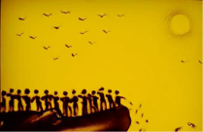
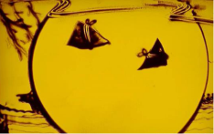
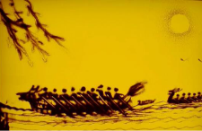

Culture time
端午节的由来
Please remember our Chinese festivals.
Blessing 祈福
Reunion 团聚
Fun 乐趣

Slide 14
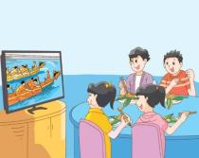
Read and fill
1.默读课文，划出关键词并完成表格。
2.完成表格后进行小组讨论。
What? | When? | What to do? | What to eat?
The Dragon Boat Festival
in May or
June
have dragon boat races
rice dumplings
The Dragon Boat Festival is in May or June. There are dragon boat races in some places. People eat rice dumplings at this festival.
People_______________ at this festival. People eat ________ at this festival.
Notes:
14

Slide 15
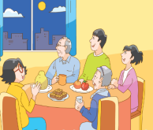
Read and fill
1.默读课文，划出关键词并完成表格。
2.完成表格后进行小组讨论。
What? | When? | What to do? | What to eat?
The Mid-Autumn Festival
in September or October
look at the moon
moon cakes and fruit
The Mid-Autumn Festival is in September or October. People
look at the moon at night with their families. They eat moon cakes and fruit.
People_______________ at this festival. People eat ________ at this festival.
Notes:
15

Slide 16
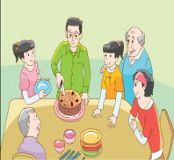
1.默读课文，划出关键词并完成表格。
2.完成表格后进行小组讨论。
Read and fill
What? | When? | What to do? | What to eat?
The Double Ninth Festival
in October or November
visit old people, climb mountains
eat rice cakes
The Double Ninth Festival is in October or November. It is a festival for old people. People visit their parents and grandparents. They also climb mountains and
eat rice cakes at this festival.
People_______________ at this festival. People eat ________ at this festival.
Notes:
16

Slide 17
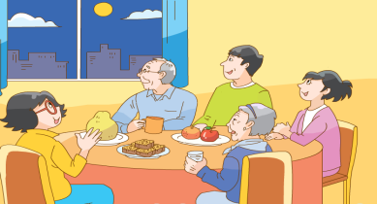
Listen and imitate
The Mid-Autumn Festival is in September or October.
People look at the moon at night with their families.
They eat moon cakes and fruit.
'

Slide 18
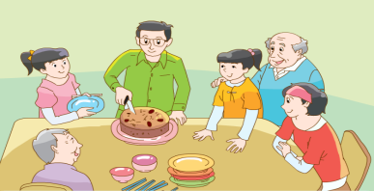
Listen and imitate
'
The Double Ninth Festival is in October or November.
'
'
It is a festival for old people.
People visit their parents and grandparents.
'
They also climb mountains and eat rice cakes at this festival.
'

Slide 19




Read freely
挑选一幅图，朗读课文。
Read after one
(一人领读)
Read in turns
(轮流读)
Read with music
(配乐朗诵)
...
Excellent:
语音正确
语速适中
语调优美
富有感情
Great:
语音正确
语速适中
语调优美
Good:
语音正确
语速适中

Slide 20
Read freely
挑选一幅图，朗读课文。
Excellent:
语音正确
语速适中
语调优美
富有感情
Great:
语音正确
语速适中
语调优美
Good:
语音正确
语速适中

Slide 21

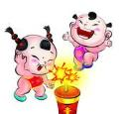


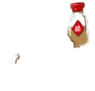



1. What do people do at Spring Festival?
A.
B.
C.
D.
B.
D.
2. What do people eat at Spring Festival?
A.
B.
C.
D.

Slide 22







Spring Festival
...
Time
Activities
活动
Food
January or
February

Slide 23
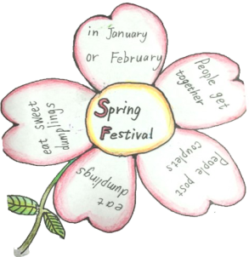
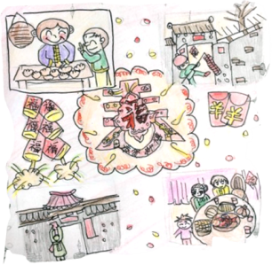
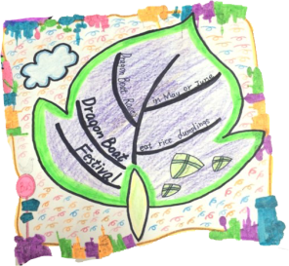
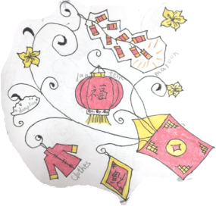
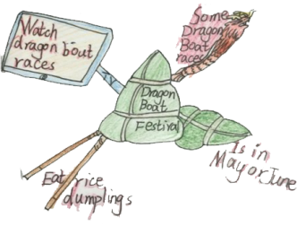
Show time
发挥想象，画出你向往的节日，并用所学句型写一写。
When?
The ________ is in__________.
People ________ at this festival.
They also_______________.
What to do?
People eat ___________.
They also eat_______________.
What to eat?
...
_______________.

Slide 24

Homework
To be continued…
Continue to finish the mind-map of your festival.
Surf the Internet to look up some Western festivals.
Listen and try to imitate.
未完待续
完善节日的思维导图，下节课汇报。
一起完成作业，模仿跟读。
上网查阅了解西方的传统节日。

