Slide 1
Do you like bananas?
Section A 第2课时
WWW.PPT818.COM

Slide 2
Cindy Smith
a sports star
a volleyball star
eating habits

Slide 3
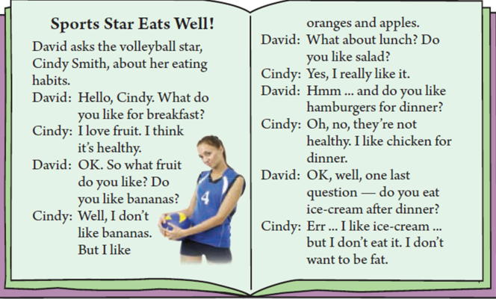

Slide 4
Sports Star Eats Well！
运动明星吃得科学！
eat v. 吃 .作及物动词用时后面可接名词做宾语，表示 “吃……”。
Eat some apples, please. 请吃苹果。
eat | have
常和具体的食物名词连用，也可单独使用。 | 表示“吃”时，常和三餐名词连用；涉及到具体吃的内容时，可与eat互换。
The boy likes eating strawberries. | She has breakfast at 7:00 am.
 | Do you like eating / having chicken?

Slide 5
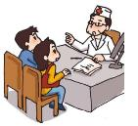
David asks the volleyball star, Cindy Smith, about her eating habits.
戴维就饮食习惯问题采访了排球明星，辛迪·史密斯。
1. ask sb. about sth. 向某人询问某事。
about表示“关于”，用来解释说明（问的）是哪方面的问题。
The doctor ask him about his illness.
2. eating habits意思是“饮食习惯”。
eating是动名词作定语。

Slide 6
Hello, Cindy! What do you like for breakfast?
你好，辛迪！你早餐喜欢吃什么呢？
1. 这是一个询问个人喜好的句子，答语可以是：I like……
句型“like...for+某餐”，表示“某餐喜欢吃……”。
—What do you like for lunch? —I like chicken and rice for lunch.
类似的句子:“have...for+某餐”，表示“某餐吃……”。
—What do you have for dinner? —I have hamburgers for dinner.
2. for是介词，意为“为，替，给”等，可以表示用途、对象、目的等。
I have some books for children. 我给孩子们买了些书。
Let’s go out for a walk. 我们去外边散步吧。

Slide 7
I love fruit. I think it’s healthy.
我喜欢吃水果。我认为水果有利于健康。
healthy | health
形容词 身体健康的；对健康有益的 可修饰名词，还可单独在句子中作表语。 | 名词 健康；健康状态 在句中可做主语或宾语。
He likes healthy food. | His health is not good.

Slide 8
Yes, I really like it.
是的，我真的很喜欢沙拉。
really adv. 事实上，真正地
用于加强语气，表示程度，放在实意动词前，be动词、情态动词、
助动词之后。
I really don’t know. 我真的不知道。
I really love sports. 我真的喜欢体育运动。

Slide 9
OK, well, one last question – do you eat ice-cream after dinner?
好的，再问最后一个问题——你晚饭后吃冰淇淋吗？
after dinner 用餐后
dinner n. 正餐，晚餐 dinner一词比较正式，邀请朋友赴宴常用它。
We’ll have dinner together in the evening.

Slide 10
Err… I like ice-cream… but I don’t eat it. I don’t want to be fat.
呃……我喜欢冰淇淋……但是我不吃。我不想长胖。
want v. 想 ，想要
want sth. 想要某物 | I want an apple.
want to do sth. 想要去做某事 | I want to eat an apple.
want to be 想要成为 | I want to be an English teacher.
want sb. to do sth. 想要某人做某事 | I want you to help me.

Slide 11
一、用词的正确形式填空。
1. Apples are ________(health) food.
2. This is his ________(eat) habit.
3. Let me ask her _______(介词) her family.
二、补全句子。
1. She ______ ___ _____ a question. 她想问个问题。
2. I ______ _____ _____a good student.我想成为一名好学生。
What_____ you ______ _______ lunch? 你午饭喜欢吃什么？
I _____ ______ know his name. 我真的不知道他叫什么名字。
healthy
eating
about
wants to ask
wants to be
do like for
really don’t

Slide 12
辨析
eat和have
health和healthy
动词
want
ask
句型
for
其他
really
What do you like for…？

