Slide 1
Unit 2 How are you?
2
第三课时
WWW.PPT818.COM

Slide 2
Ask and answer
How are you?
I'm sorry.
I’m very well.
Not very well.
I’m fine.
Not good.
I’m happy.
Just so so.
Notes:
2

Slide 3
How are you?
Name:
William

Slide 4
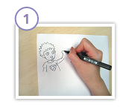
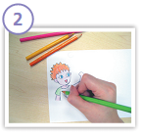
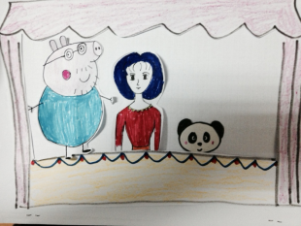
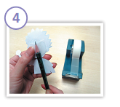
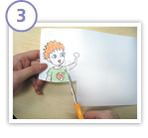
PPT模板：www.1ppt.com/moban/ PPT素材：www.1ppt.com/sucai/
PPT背景：www.1ppt.com/beijing/ PPT图表：www.1ppt.com/tubiao/
PPT下载：www.1ppt.com/xiazai/ PPT教程： www.1ppt.com/powerpoint/
资料下载：www.1ppt.com/ziliao/ 范文下载：www.1ppt.com/fanwen/
试卷下载：www.1ppt.com/shiti/ 教案下载：www.1ppt.com/jiaoan/
PPT论坛：www.1ppt.cn PPT课件：www.1ppt.com/kejian/
语文课件：www.1ppt.com/kejian/yuwen/ 数学课件：www.1ppt.com/kejian/shuxue/
英语课件：www.1ppt.com/kejian/yingyu/ 美术课件：www.1ppt.com/kejian/meishu/
科学课件：www.1ppt.com/kejian/kexue/ 物理课件：www.1ppt.com/kejian/wuli/
化学课件：www.1ppt.com/kejian/huaxue/ 生物课件：www.1ppt.com/kejian/shengwu/
地理课件：www.1ppt.com/kejian/dili/ 历史课件：www.1ppt.com/kejian/lishi/
Draw.
Colour.
Cut.
Stick.
Notes:
4

Slide 5
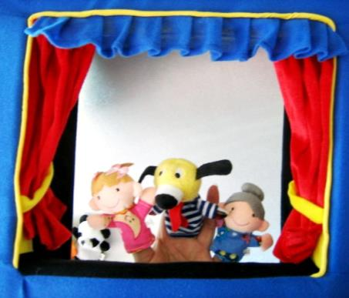
Show Time
S1: I’m Mr/Miss/Mrs…
S2: I’m Mr/Miss/Mrs …
S3: I’m Mr/Miss/Mrs …
S1: Hello/Hi/Good morning, …
S2: Hello/Hi/Good morning,…
S3: …
S1: How are you?
S2: …
S3: …
S1: Goodbye./…
S2: …
S3: …
Notes:
5

Slide 6
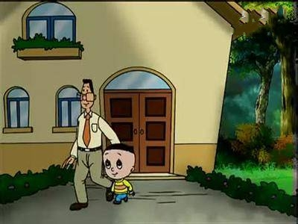
Come in ,please!
I’m fine. Thank you .And you?
I’m happy .
Hi，I am Dolly .
How are you, Mr Ma?

Slide 7
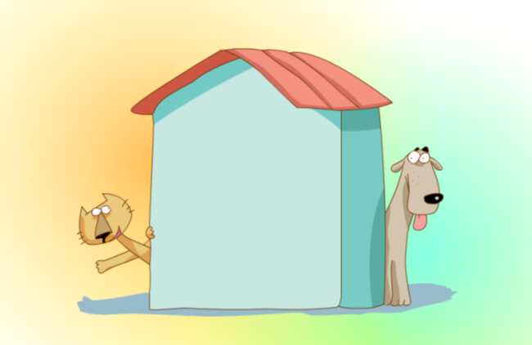
Hi! I’m Miss Cat.
C
Hi! I’m Mr Dog.
D

Slide 8
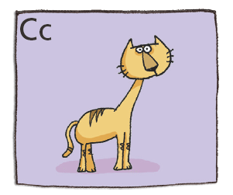
[K]
cat
Notes:
8

Slide 9
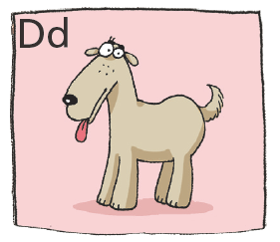
dog
[d]
Notes:
9

Slide 10
找朋友。找出划线部分发音相同的单词。
cat
chair can cake card
dog
dance do doll dress

Slide 11
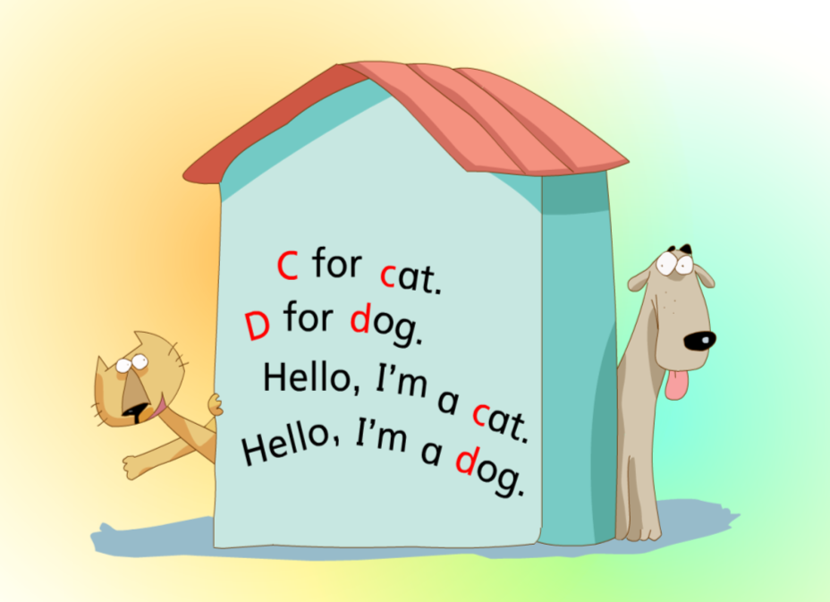
Chant

Slide 12
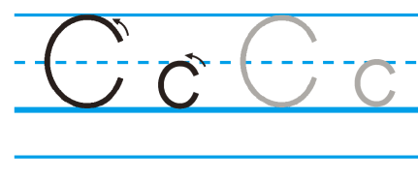
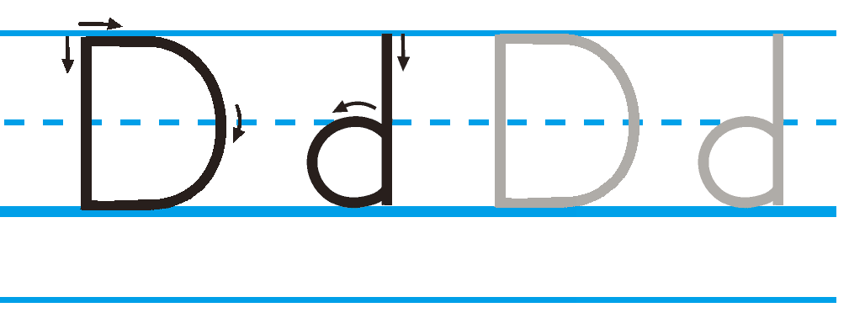
Trace and write
（活动手册P10）
C
c
D
d
Notes:
12

Slide 13
看谁耳朵灵，看谁能排序。
d
c
b
a
I’m full.Thank you ,Joe.
How are you today, Mr Cat?
a
It’s OK.Goodbye,Mr Cat.
b
I’m not very well.I’m hungry.
Would you like some fish?
Good morning ,Mr Cat.
c
Sure!
Good morning, Joe.
d

Slide 14
读一读，看谁记性好。
Good morning ,Mr Cat.
How are you today, Mr Cat?
Good morning, Joe.
I’m not very well.I’m hungry.
a
b
Would you like some fish?
I’m full.Thank you ,Joe.
c
Sure!
d
It’s OK.Goodbye,Mr Cat.

Slide 15
情景会话，读一读，描写出正确句子。
Hi.I’m…
I'm Mr Cat.
I'm Mr Cat.
I'm Mr Dog.
I'm Mr Pig.
…
Good morning.
Good afternoon.
Good morning.
Good morning.
Goodbye.
…
I’m not very well.
Hello.I'm Joe.
Hi,I'm Mr Cat.
How are you?
How are you?

Slide 16
最佳编剧，看谁能编故事。
Good … ,...
How are you today, …?
a
Good …, Joe.
b
I’m…
Would you like some …?
I’m full.Thank you ,Joe.
c
Sure!
d
It’s OK.Goodbye,...
Notes:
16

Slide 17
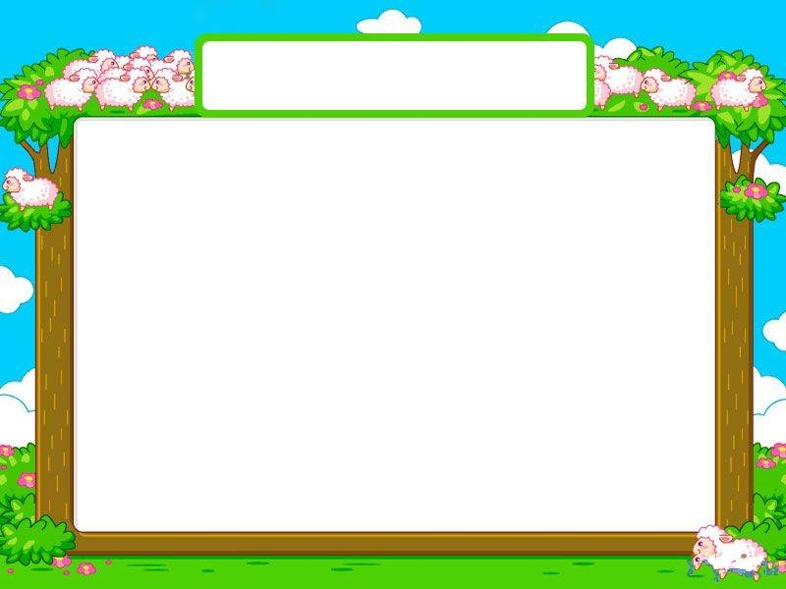
今天的收获
What have you learned today?
How are you today?
Are you happy today?

Slide 18
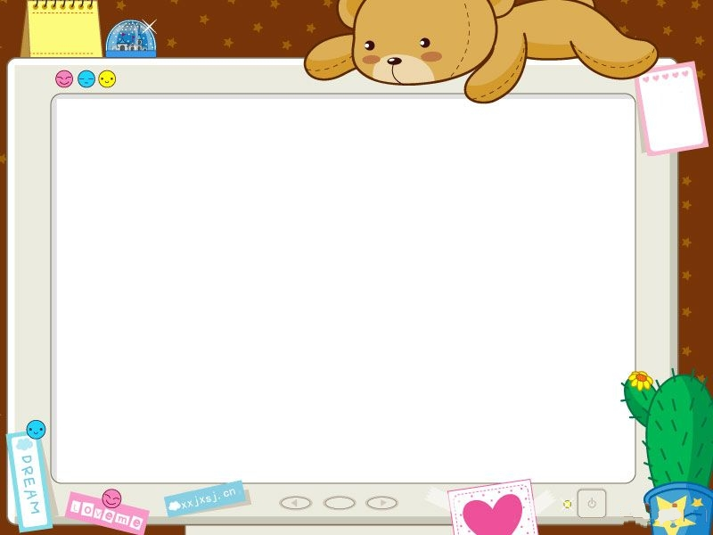
Homework
a. 抄写下列字母及单词：
Cc Dd are fine goodbye hi thank you
b. 抄写字母及单词，写出你所编的故事。
a. 听读 U2五次.
b. 听读 U2五次.表演铅笔偶给家长看。
同学们根据自己的能力选择作业哦！

