Slide 1
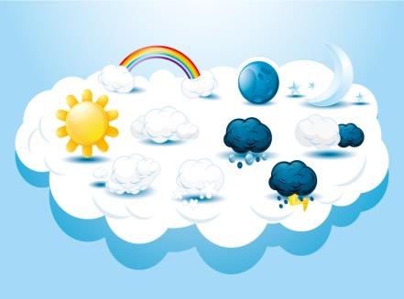
Unit 2
What a day!
第一课时
WWW.PPT818.COM

Slide 2
Introduce
Answer questions：
1. Did it rain in the afternoon ?
2.
 | In the morning | Then | In the afternoon
What’s the weather like ? | It is ________. | The weather became ________ and ________. | There were black ________ in the sky. It _______.
What did they do ? | ___________ | ___________ | ___________

Slide 3
Words
sunny
/'sʌnɪ/
形容词,表示“晴朗的” ,名词为“ sun ” ,表示“太阳”。
常用短语：sunny day 晴天
sunny weather 阳光灿烂的天气
eg：I hope it will be sunny tomorrow .
我希望明天天气会晴朗。
sunny
小练习：It was ______(sun) yesterday. So I went to the park.

Slide 4
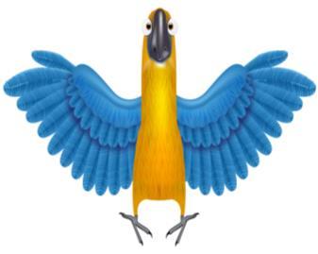
Words
show
/ʃəʊ/
名词,表示“展览、秀”。
动词,表示“展示、指示” 。
常用短语：parrot show 鹦鹉秀
fashion show 时装秀
eg ：They are watching a parrot show in the forest.
他们正在森林里看一场鹦鹉秀。
小练习：（ ） We are watching a puppet ___ this afternoon.
A. show B. TV
A

Slide 5
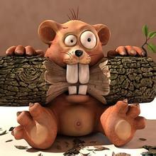
Words
interesting
/'ɪnt(ə)rɪstɪŋ/
形容词, 表示“有趣的” ;名词为interest , 表示“兴趣”。
常用短语：very interesting 非常有趣;
an interesting story 一个有趣的故事
eg ：This English book is very interesting.
这是一本非常有趣的英语书。
小练习：（ )This film is very _________.
A. interested B. interesting
B

Slide 6
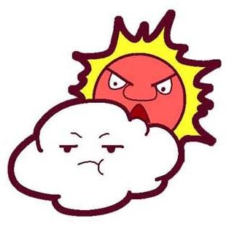
Words
weather
/ 'weðə /
名词;表示“天气” ;不可数名词
常用短语： good weather 好天气
hot weather 炎热的天气
eg ： I don’t like hot weather.
我不喜欢炎热的天气。
小练习： windy, the , became, cloudy, weather, and , (.)
______________________________________
The weather became windy and cloudy.

Slide 7
Expressions
Su Hai , Mick, Liu Tao and I went to the park by bike.
我和Su Hai , Mick, Liu Tao骑车去公园。
“by + 交通工具”表示一种交通方式,怎么到那儿的。
eg : My friend went to Shanghai by plane yesterday.
昨天我朋友坐飞机去了上海。
小练习 : （ ）We go to the Zoo _____ car every day.
A. on B. by
B

Slide 8
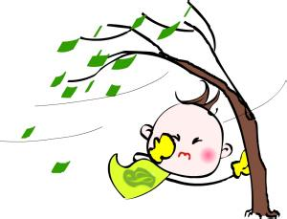
Expressions
Then the weather became windy and cloudy.
然后天气变得有风而且多云。
become 意思为“变成” ,为连系动词,一般后面接形容词作表语。
eg : It became cloudy in the morning.
早上天气变得多云了。
小练习 : It _______ (变为) sunny in the afternoon.
became

Slide 9
Expressions
It was time for lunch.
是吃午饭的时间了。
“It is time for +名词” 表示“是该......的时候了 ” 。
“It’s time to +动词+要做的事情” 表示“该到......的时候了。 ”
eg ： It’s time for class. 该上课了。
It’s time to go to school. 该去上学了。
小练习 : It is time ___ go to the park. It is time ___ the park.
A. to B. for
A
B

Slide 10
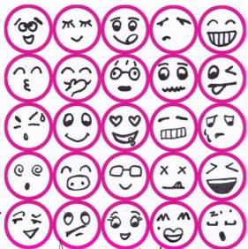
Expressions
What a day !
难忘的一天！
可以翻译成“糟糕的一天！\ 忙碌的一天！ ”等。
但是这一天肯定是让人难忘的。
eg ： What kind woman they are !
她们是多么善良的女人呀！
小练习 : What fine weather !______________________
What a big apple ! _______________________
多么美好的一天呀！
多么大的一个苹果呀！

Slide 11
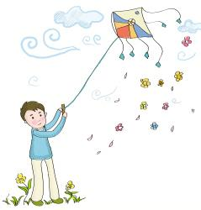
Translation
Sunday, 20th September
It was sunny in the morning.
Su Hai, Mike , Liu Tao and I went to the park by bike.
9月20日，星期日
早上天气很晴朗。
我和Su Hai, Mick, Liu Tao 骑车去公园。

Slide 12
Translation
There was a parrot show in the park. We saw some interesting parrots.
公园里有场鹦鹉秀。我们看了很多有趣的鹦鹉。
Then, the weather became windy and cloudy. We flew kites high in the sky.
然后天气变得有风而且多云。我们把风筝放上高高的天空。
It was time for lunch. We brought some dumplings, some bread and honey and some drinks.
是吃午饭的时间了。我们带了一些饺子、一些面包和蜂蜜,还有一些饮料。

Slide 13
Translation
We saw ants on the bread and honey. There were some bees too. We could not eat our lunch.
我们看到面包和蜂蜜上有蚂蚁,还有一些蜜蜂。我们不能吃我们的午饭了！
In the afternoon, there were black clouds in the sky .It rained. We were hungry and wet.
What a day !
下午，天空中满是黑云。下雨了,我们很饿而且都湿了。真是难忘的一天呀！

Slide 14
Expand
interesting和 interested的区别
1.interesting 形容词,意为“有趣的，有意思的” , 主语通常是物。
eg ：The book is very interesting. 这本书很有趣
2.interested 形容词 意为“对……感兴趣” ,主语通常是人。
eg：He is interested in the film。他对这部电影感兴趣。

Slide 15
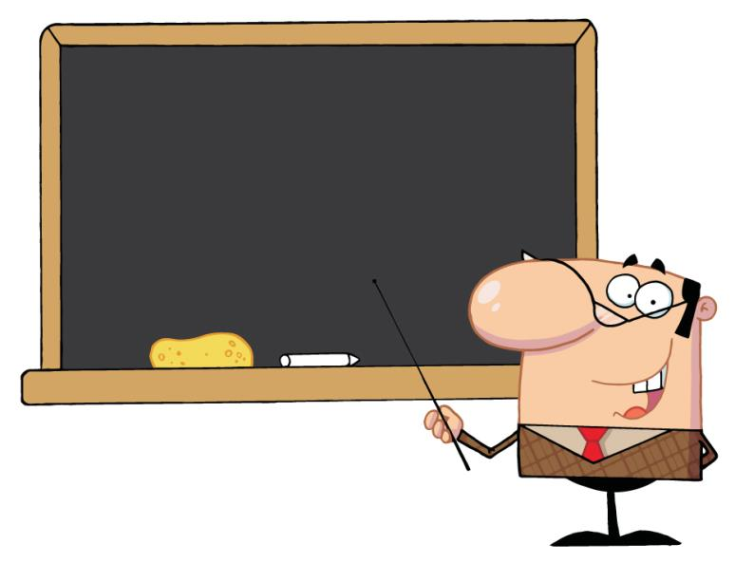
Summary
sunny show
interesting weather
By··· become···
It’s time for/to do···
What ···!

Slide 16
Exercise
My sister _____ some books for me . I was happy.
A. bring B. bringed C. brought
2. It was time for ______.
A. have lunch B. lunch C. having lunch
C
B

Slide 17
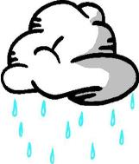
Exercise
3. It was ______ in the afternoon.
A. rain B. rainy C. rained
4. There was _________ interesting parrot show in the Zoo.
A. a B. an C. some
B
B

Slide 18
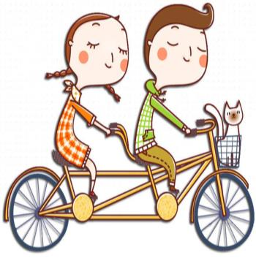
Exercise
5. _______ a day !
A. What B. How C. what
6.Let’s go to the park _______ bike.
A. in B. on C. by
A
C

Slide 19
Homework
Write a diary in English using past simple tense!
 | 中文日记 | English Diary
格式 | 年*月*日*星期* 天气* 正文 | 星期*日*月* 天气* 正文
时态 | 无 | 一般过去式，特殊情况除外。

