Slide 1
Unit 1 Li Ming Goes to Canada
Lesson 4 Making Dinner
WWW.PPT818.COM

Slide 2
Warming-up
1.Let’s play a game
“what’s missing?”
breakfast
home
clock
there
house
time
floor
put
toilet
table
kitchen
study
2.Free talk

Slide 3
Presentation
1.听录音，回答问题
What time is it?
What is Mrs. Smith doing?
It’s half past six.
She is cooking meat and vegetables.

Slide 4
Presentation
2.听录音，回答问题
Why is Jenny hungry?
What’s for dinner?
What vegetables does Mrs. Smith need?
Because she only ate an apple for lunch.
Meat and vegetables.
Tomatoes, potatoes and carrots.

Slide 5
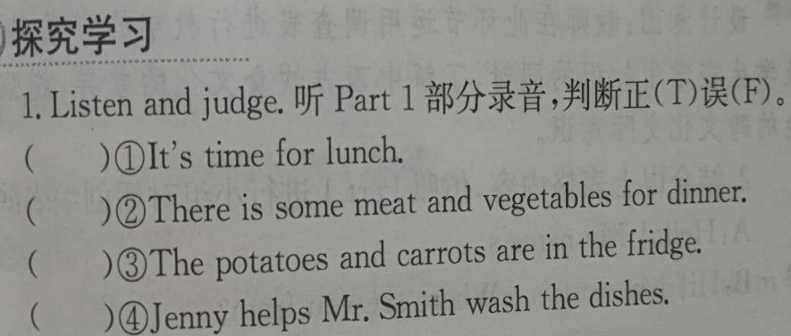
Presentation
F
T
F
F

Slide 6
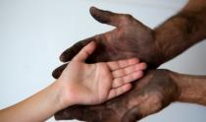
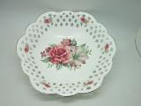
Presentation
dish
dry
clean, dirty
wash

Slide 7
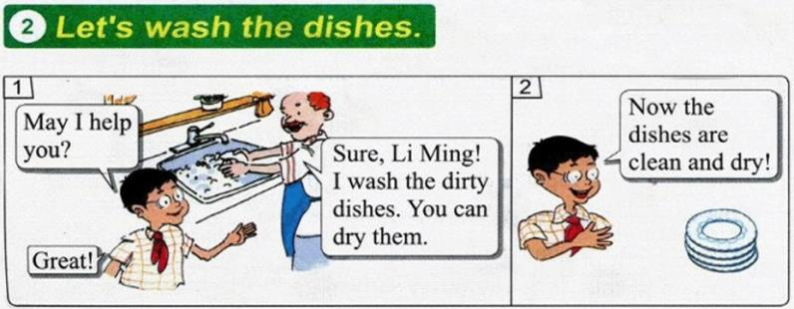
Presentation

Slide 8
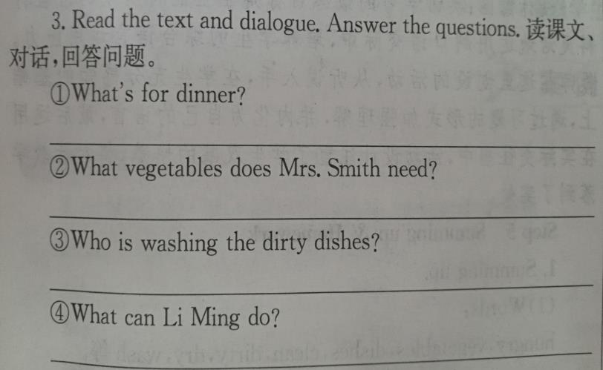
Presentation
There is some meat and vegetables for dinner.
She needs some tomatoes and potatoes.
Mr. Smith.
He can dry the dishes.

Slide 9
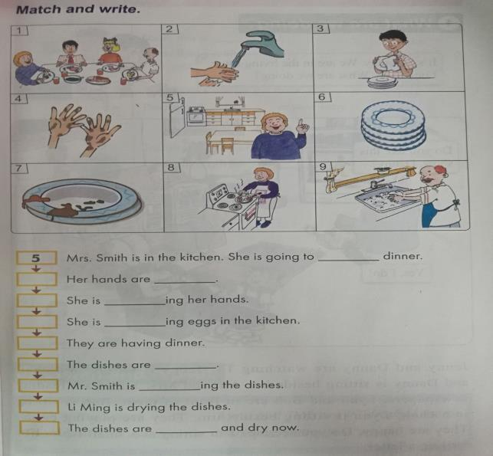
Practice
making
4
dirty
2
washing
8
cooking
1
7
dirty
9
washing
3
6
clean

Slide 10
Consolidation
1.完成调查表的填写
 | breakfast | lunch | Dinner
China
Canada
2.结合表格内容，仿照Part1小组创编对话

Slide 11
Summing up
1.Words:
hungry, vegetables, dishes, clean, dirty, dry, wash
2.Sentences:
I only ate an apple for lunch.
What’s for dinner?
I’m cooking meat and vegetables.
I wash the dirty dishes.
Now the dishes are clean and dry!
3.
这节课我的收获是：_____________
这节课我的不足是：_____________

Slide 12
Homework
1.听录音，朗读本课的第一、二部分
2.完成相关习题
3.结合本课学习内容创编一个新对话并将其表演出来

