Slide 1
Unit2 Travelling
Grammar 2
WWW.PPT818.COM

Slide 2
▲现在完成时态的含义是表示过去发生的或已完成的动作对现在造成的影响或结果。特点是既涉及过去，又联系现在：动作是过去发生的，结果是现在存在的。
She has gone. (她走了。) 从这句话中动词所用的现在完成时态可以看出“走”的动作是过去发生的，而对现在所造成的结果是她不在这里了。

Slide 3
用Have(has)been或have (has) gone填空:
has gone
1.My father __________ to Beijing. He will be
back in two days.
have been
2.The Greens __________ to the USA twice.
3.A:Where are your parents now? I haven’t
seen them for a long time.
B:They __________ to Xiamen.
have gone
has been
4.Millie __________ to many places of interest
in our city.
has gone
5.A:_____ Tommy _____ to Nanjing?
B:Yes. He went there last month and hasn’t
come back yet.

Slide 4
Translate the following sentences.
1.我叔叔已去过美国两次,但我从没去过。
My uncle has been to America twice, but I
have never been there.
2.Nick 在哪里？他去了图书馆。
Where is Nick? He has gone to the library.
3.Kitty和爸爸妈妈去了香港，她们一个礼拜之后回来。
Kitty and her parents have gone to Hong Kong.
They will be back in a week.

Slide 5
-Have you ever seen this film ?
-Yes , I ________ (see) it recently .
- When ____ you ____ (see) it ?
- Last week .
have seen
did see
完成时表示动作完成
过去时表动作发生具体时间

Slide 6
I lived here five years ago .(同义句)
I have lived here since five years ago .
I have lived here for five years .
此句中的动词live 是可以延续的， 可以和since+点时间以及for + 一段时间连用。
如果动词是非延续性的，则不可以和since以及for连用

Slide 7
如buy和borrow是非延续性动词，我们在使用时要注意。
我们可以说：I bought a present last week .
但我们不可以说：
I have bought a present for one week .
I have bought a present since one week ago .
为了和for以及since连用，在使用完成时我们需把非延续性动词转换成延续性。
buy
have / has had

Slide 8
×
He has left Beijing for a week.
√
He has not left Beijing yet.
He has been away from Beijing for a week.
√
He has bought a car since 2007.
×
√
He has not bought any new car since 2007.
√
He has had a car since 2007.

Slide 9
1.buy have (has) had
2.borrow have (has) kept
3.arrive have (has) been in/at
4.leave have (has) been away
5.join have (has) been in /a member of
6.die have (has) been dead
7.get married have (has) been married
8.come/go have (has) been in/at
9.begin/start have (has) been on
10.stop have (has) been over
延续性动词特点
(have / has been )

Slide 10
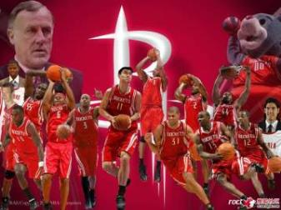
join the Rockets
six years ago
Yao Ming joined the Rockets six years ago.
has been in
He ________ the Rockets since six years ago.
… for six years.
has been a member of
He _________________ the Rockets since
six years ago.

Slide 11
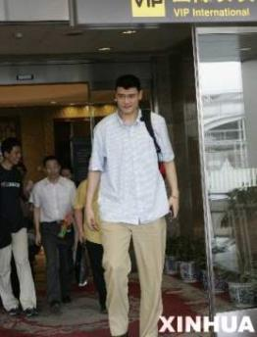
leave Beijing
six months ago
Yao Ming left Beijing six months ago.
has been away from
Yao Ming _______________ Beijing since six months ago.

Slide 12
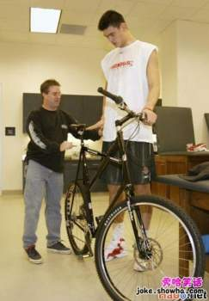
borrow a bike
last week
Yao Ming borrowed a bike from the boy last week.
has kept
Yao Ming _______ the bike since last week.

Slide 13
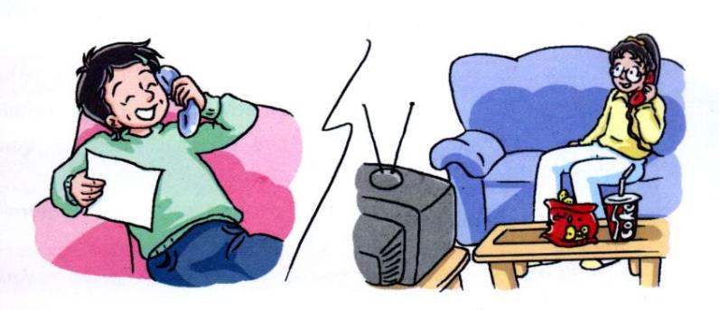
Finish the exercise on p28.

Slide 14
同义句改写
He bought this motorcycle over two years ago.
She borrowed this book nearly three weeks ago.
Kitty arrived in Hong Kong two days ago.
She left home a month ago.
Simon joined the Football Club last year.
The lamb died quite some time ago.
They got married more than fifteen years ago.
My cousin went/came to Beijing a month ago.
The parade began almost an hour ago.
The conference stopped last Saturday.

Slide 15
用for, since, ago填空
since
Sally has been away from London ________ last Saturday.
Our school has changed a lot ________ the new building was built.
Tommy has had this motorcycle ________ three years.
I have been in Nanjing ________ eight years.
My parents has been married since twenty years ________.
My cousin joined the army three months ______ .
since
for
for
ago
ago

Slide 16
Exercises
1.( ) – I have watched the game.
--When ____ you ____ it?
A have ,watched B do ,watch
C did ,watch D will ,watch
C
2. ( ) His grandma ______ for two years.
A died B has been dead
C was dead D has died
B

Slide 17
3. ( ) –Where is Han Mei now?
--- She ____ to Shanghai. She will be back
in two days.
A has gone B has been C goes D had gone
A
4.( ) You haven’t changed your mind , ______?
A do you B are you C have you D did you
C

Slide 18
5. ( )---Where have you _____ these days?
---- I have _____ to Beijing with my friends.
A been , gone B been , been
C gone , been D gone, gone
6. ( ) How long have you ____ this book?
A bought B borrowed C had D lent
B
C

Slide 19
Translation
1.这本书我已经借了两星期了,明天我会还给Amy.
I _____ _____ the book ____ two weeks. I will
return it to Amy tomorrow.
2.会议已经开始一个小时了.
The meeting _____ _____ _____ for one hour.
3.我加入英语俱乐部半年了.
I _____ _____ _____ the English Club for half a
year.
have kept for
has been on
have been in

Slide 20
4.他们结婚十年了.
They _____ _____ _______ ______ ten years ago.
5.我的表弟离开北京两周了.
My cousin _____ _____ _____ _____ Beijing
_____ two weeks.
6.这家商店营业已经三天了.
The shop _____ _____ _____ for three days.
have been married since
has been away from
for
has been open

Slide 21
Game: T or F
1.He has gone to the cinema since last night.
F
He went to the cinema last night.
2.He has seen many great films.
T
3.My grandfather has died for two years.
F
My grandfather died two years ago.
My grandfather has been dead for two years.
4.They have been in Britain since 1998.
T

Slide 22
Homework:
1. Go over Grammar A & B.
2. Finish the exercises in the workbook.
3. Prepare Integrated skills.

Slide 23
Goodbye

